Slide 1
Quality of law
IT Summerschool
Bart van der Sloot
www.bartvandersloot.com

Slide 2
Overview
(1) Mass surveillance
(2) Complaint procedure
(3) In accordance with the law
(4) Q&A

Slide 3
(1) Mass surveillance

Slide 4


Slide 5
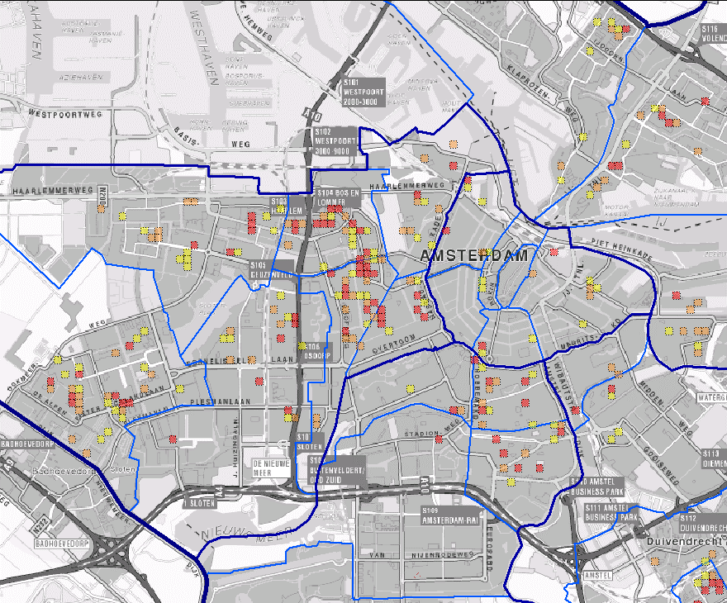

Slide 6

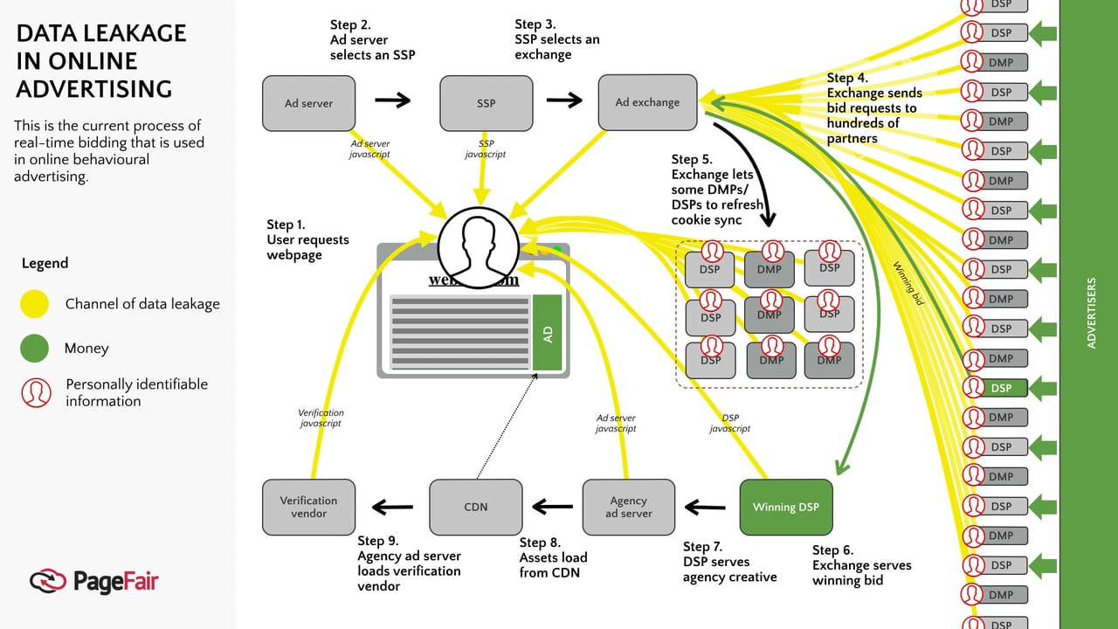

Slide 7


Slide 8

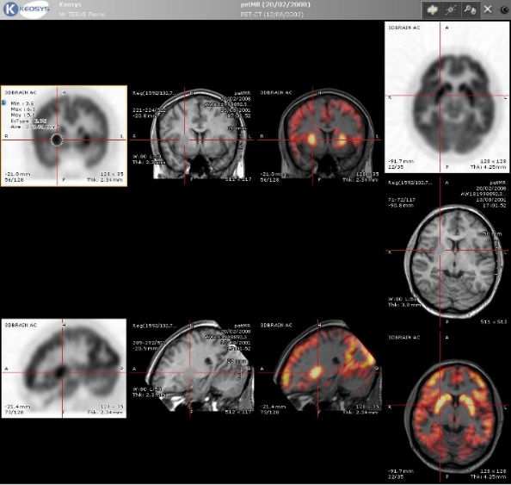


Slide 9




Slide 10
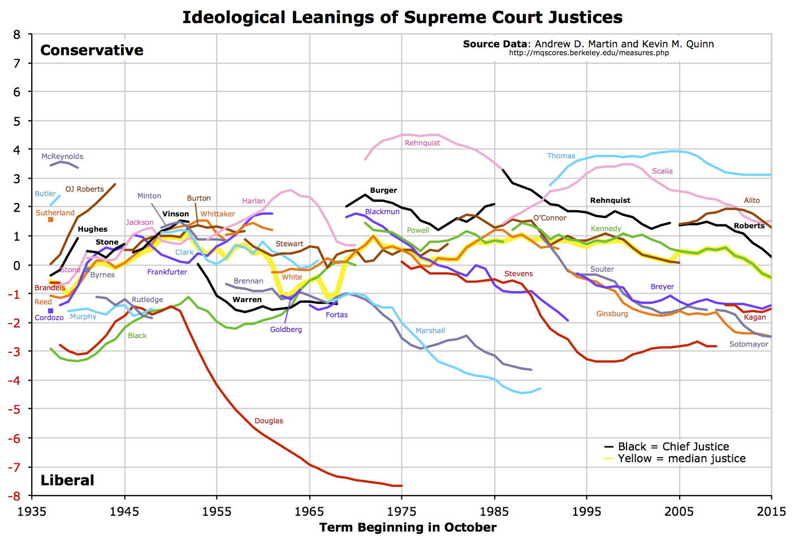

Slide 11
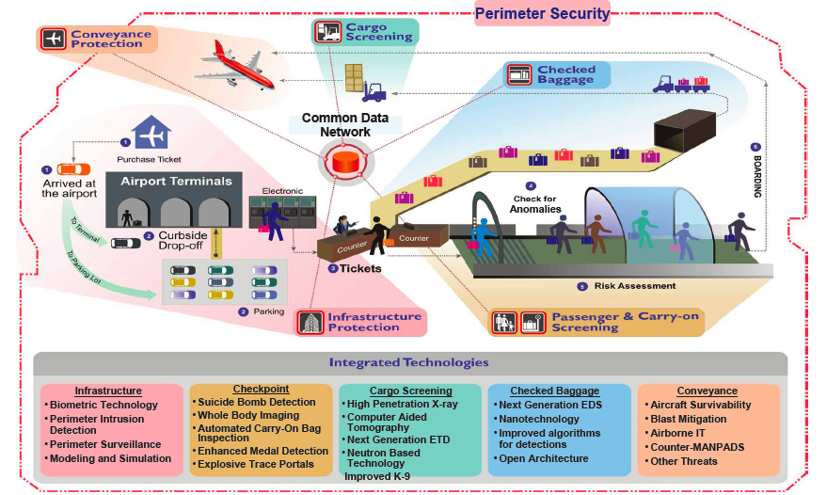
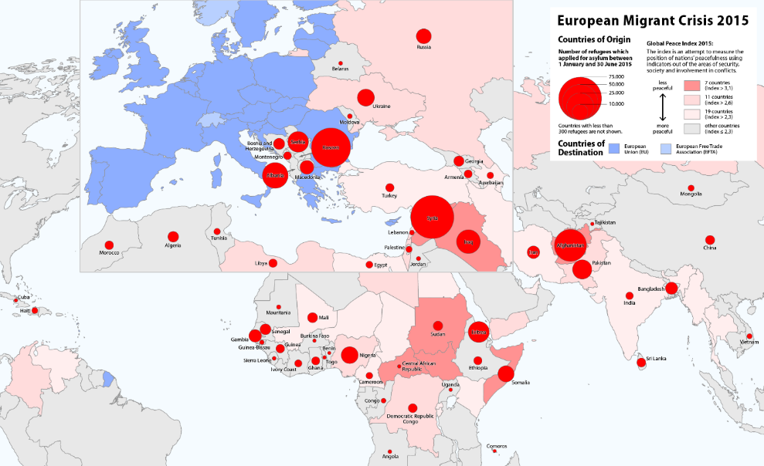

Slide 12




Slide 13


Slide 15



Slide 16


Slide 17
(2) Complaint procedure under the ECHR
Formal criteria
  Exhaustion
  Time limit
  Substantially the same
  Abuse of right
  Locus standi
  De Minimis regel
  Manifestly ill-founded
Material criteria
  Ratione Personae
  Ratione Loci
  Ratione Temporis
  Ratione Materiae

Slide 18
(2) Complaint procedure under the ECHR
Formal criteria
  Exhaustion
  Time limit
  Substantially the same
  Abuse of right
  Locus standi
  De Minimis regel
  Manifestly ill-founded
Material criteria
  Ratione Personae
  Ratione Loci
  Ratione Temporis
  Ratione Materiae
ARTICLE 35
Admissibility criteria
1. The Court may only deal with the matter after all domestic remedies have been exhausted,

Slide 19
(2) Complaint procedure under the ECHR
Formal criteria
  Exhaustion
  Time limit
  Substantially the same
  Abuse of right
  Locus standi
  De Minimis regel
  Manifestly ill-founded
Material criteria
  Ratione Personae
  Ratione Loci
  Ratione Temporis
  Ratione Materiae
ARTICLE 35
Admissibility criteria
1. The Court may only deal with the matter after all domestic remedies have been exhausted, according to the generally recognised rules of international law, and within a period of six months from the date on which the final decision was taken.

Slide 20
(2) Complaint procedure under the ECHR
Formal criteria
  Exhaustion
  Time limit
  Substantially the same
  Abuse of right
  Locus standi
  De Minimis regel
  Manifestly ill-founded
Material criteria
  Ratione Personae
  Ratione Loci
  Ratione Temporis
  Ratione Materiae
ARTICLE 35
Admissibility criteria
2. The Court shall not deal with any application submitted under Article 34 that
(a) is anonymous; or
(b) is substantially the same as a matter that has already been examined by the Court or has already been submitted to another procedure of international investigation or settlement and contains no relevant new information.

Slide 21
(2) Complaint procedure under the ECHR
Formal criteria
  Exhaustion
  Time limit
  Substantially the same
  Abuse of right
  Locus standi
  De Minimis regel
  Manifestly ill-founded
Material criteria
  Ratione Personae
  Ratione Loci
  Ratione Temporis
  Ratione Materiae
ARTICLE 35
Admissibility criteria
3. The Court shall declare inadmissible any individual application submitted under Article 34 if it considers that:
(a) the application is incompatible with the provisions of the Convention or the Protocols thereto, manifestly ill-founded, or an abuse of the right of individual application; or.

Slide 22
(2) Complaint procedure under the ECHR
Formal criteria
  Exhaustion
  Time limit
  Substantially the same
  Abuse of right
  Locus standi
  De Minimis regel
  Manifestly ill-founded
Material criteria
  Ratione Personae
  Ratione Loci
  Ratione Temporis
  Ratione Materiae
ARTICLE 35
Admissibility criteria
3. The Court shall declare inadmissible any individual application submitted under Article 34 if it considers that:
(b) the applicant has not suffered a significant disadvantage, unless respect for human rights as defined in the Convention and the Protocols thereto requires an examination of the application on the merits and provided that no case may be rejected on this ground which has not been duly considered by a domestic tribunal.

Slide 23
(2) Complaint procedure under the ECHR
Formal criteria
  Exhaustion
  Time limit
  Substantially the same
  Abuse of right
  Locus standi
  De Minimis rule
  Manifestly ill-founded
Material criteria
  Ratione Personae
  Ratione Loci
  Ratione Temporis
  Ratione Materiae
ARTICLE 35
Admissibility criteria
3. The Court shall declare inadmissible any individual application submitted under Article 34 if it considers that:
(b) the applicant has not suffered a significant disadvantage, unless respect for human rights as defined in the Convention and the Protocols thereto requires an examination of the application on the merits and provided that no case may be rejected on this ground which has not been duly considered by a domestic tribunal.

Slide 24
(2) Complaint procedure under the ECHR
Formal criteria
  Exhaustion
  Time limit
  Substantially the same
  Abuse of right
  Locus standi
  De Minimis regel
  Manifestly ill-founded
Material criteria
  Ratione Personae
  Ratione Loci
  Ratione Temporis
  Ratione Materiae
ARTICLE 35
Admissibility criteria
3. The Court shall declare inadmissible any individual application submitted under Article 34 if it considers that:
(a) the application is incompatible with the provisions of the Convention or the Protocols thereto, manifestly ill-founded, or an abuse of the right of individual application; or.

Slide 25
(2) Complaint procedure under the ECHR
Formal criteria
  Exhaustion
  Time limit
  Substantially the same
  Abuse of right
  Locus standi
  De Minimis regel
  Manifestly ill-founded
Material criteria
  Ratione Personae
  Ratione Loci
  Ratione Temporis
  Ratione Materiae
Admissibility Guide ECHR
191. Compatibility ratione personae requires the alleged violation of the Convention to have been committed by a Contracting State or to be in some way attributable to it.

Slide 26
(2) Complaint procedure under the ECHR
Formal criteria
  Exaustion
  Time limit
  Substantially the same
  Abuse of right
  Locus standi
  De Minimis regel
  Manifestly ill-founded
Material criteria
  Ratione Personae
  Ratione Loci
  Ratione Temporis
  Ratione Materiae
Admissibility Guide ECHR
216. Compatibility ratione loci requires the alleged violation of the Convention to have taken place within the jurisdiction of the respondent State or in territory effectively controlled by it

Slide 27
(2) Complaint procedure under the ECHR
Formal criteria
  Exhaustion
  Time limit
  Substantially the same
  Abuse of right
  Locus standi
  De Minimis regel
  Manifestly ill-founded
Material criteria
  Ratione Personae
  Ratione Loci
  Ratione Temporis
  Ratione Materiae
Admissibility Guide ECHR
225. In accordance with the general rules of international law (principle of non-retroactivity of treaties), the provisions of the Convention do not bind a Contracting Party in relation to any act or fact which took place or any situation which ceased to exist before the date of the entry into force of the Convention in respect of that Party

Slide 28
(2) Complaint procedure under the ECHR
Formal criteria
  Exaustion
  Time limit
  Substantially the same
  Abuse of right
  Locus standi
  De Minimis regel
  Manifestly ill-founded
Material criteria
  Ratione Personae
  Ratione Loci
  Ratione Temporis
  Ratione Materiae
Admissibility Guide ECHR
252. The compatibility ratione materiae with the Convention of an application or complaint derives from the Court’s substantive jurisdiction. For a complaint to be compatible ratione materiae with the Convention, the right relied on by the applicant must be protected by the Convention and the Protocols thereto that have come into force.

Slide 29
(2) Complaint procedure under the ECHR
Applications will be declared incompatible ratione personae with the Convention on the following grounds:
if the applicant lacks standing as regards Article 34 of the Convention
if the applicant is unable to show that he or she is a victim of the alleged violation
if the application is brought against an individual
if the application is brought directly against an international organisation which has not acceded to the Convention
if the complaint involves a Protocol to the Convention which the respondent State has not ratified

Slide 30
(2) Complaint procedure: Travaux préparatoires
ARTICLE 33
Inter-State cases
Any High Contracting Party may refer to the Court any alleged breach of the provisions of the Convention and the Protocols thereto by another High Contracting Party.
ARTICLE 34
Individual applications
The Court may receive applications from any person, non-governmental organisation or group of individuals claiming to be the victim of a violation by one of the High Contracting Parties of the rights set forth in the Convention or the Protocols thereto. The High Contracting Parties undertake not to hinder in any way the effective exercise of this right.

Slide 31
(2) Complaint procedure: Travaux préparatoires
Dicussions when drafting:
  1. Should there be a European Convention?
  2. How should such a Convention look like?
  3. Should there be a Commission?
  4. Should there be a Court?
  5. Should individuals have a right to complain?

Slide 32
(2) Complaint procedure: Travaux préparatoires
1. Should there be a European Convention?
  Yes, Europe should have its own list of rights and have a more precise and effective mechanism of enforcement
  No, we already have a Universal Declaration of Human Rights and we should not have a document that could conflict with it
Compromise
  Yes, there is a Convention, but signing was optional

Slide 33
(2) Complaint procedure: Travaux préparatoires
2. How should such a Convention look like?
  Ennumeration (Alternative A)
  Precise definition (Alternative B)
Compromise
  Precise definition was taken as basis, but the rights ennumerated in Alternative A and the other provisions were merged

Slide 34
(2) Complaint procedure: Travaux préparatoires

Slide 35
(2) Complaint procedure: Travaux préparatoires

Slide 36
(2) Complaint procedure: Travaux préparatoires
3. Should there be a Commission?
  Yes, the Commission could investigate the facts of the matter, its judgement would have a reputational effect and the Commission could try and it could stimulate a settlement
  No, there is no need for a supervisory mechanism within the Council of Europe, both because countries had mechanisms in place and because there was the International Court of Justice in The Hague
Compromise
  Yes, there is a Commission, but its authority was dependent on ratification by each individual Member State

Slide 37
(2) Complaint procedure: Travaux préparatoires
4. Should there be a Court?
  Yes, a Court could impose sanctions and penalties, meaning that there would be an effective enforcement-mechanism for the ECHR
  No, this would limmit the national authority + if there was a truly totalitarian regime, it would not be stopped by a European Court + the judgements by the Commission would be sufficient
Compromise
  Again, the Court’s authority was optional

Slide 38
(2) Complaint procedure: Travaux préparatoires
5. Should individuals have a right to complain?
  Yes, otherwise the ECHR would not be effective as a human rights guarantee
  No, fear of higher numbers of complaints + fear of abuse of right + fear of many small, individual matters put forward
Compromise:
  Both inter-state & indivdiual complain right, but individuals only allowed to pettition to the Commission

Slide 39
(2) Complaint procedure: Travaux préparatoires

Slide 40
(3) Complaint procedure: Dominant approach by the ECtHR
ARTICLE 33 Inter-State cases
Any High Contracting Party may refer to the Court any alleged breach of the provisions of the Convention and the Protocols thereto by another High Contracting Party.
ARTICLE 34 Individual applications
The Court may receive applications from any person, nongovernmental organisation or group of individuals claiming to be the victim of a violation by one of the High Contracting Parties of the rights set forth in the Convention or the Protocols thereto. The High Contracting Parties undertake not to hinder in any way the effective exercise of this right.

Slide 41
(2) Complaint procedure: Interpretation by the ECtHR
Protocol No. 9 to the Convention for the Protection of Human Rights and Fundamental Freedoms Rome, 6.XI.1990
Article 44 of the Convention shall read as follows:
"Only the High Contracting Parties, the Commission, and persons, non-governmental organisations or groups of individuals having submitted a petition under Article 25 shall have the right to bring a case before the Court."
Article 45 of the Convention shall read as follows:
"The jurisdiction of the Court shall extend to all cases concerning the interpretation and application of the present Convention which are referred to it in accordance with Article 48."

Slide 42
(2) Complaint procedure: Interpretation by the ECtHR
Article 48 of the Convention shall read as follows:
"1The following may refer a case to the Court, provided that the High Contracting Party concerned, if there is only one, or the High Contracting Parties concerned, if there is more than one, are subject to the compulsory jurisdiction of the Court or, failing that, with the consent of the High Contracting Party concerned, if there is only one, or of the High Contracting Parties concerned if there is more than one:
a the Commission;
ba High Contracting Party whose national is alleged to be a victim;
ca High Contracting Party which referred the case to the Commission;
da High Contracting Party against which the complaint has been lodged;
e the person, non-governmental organisation or group of individuals having lodged the complaint with the Commission.
2If a case is referred to the Court only in accordance with paragraph 1.e, it shall first be submitted to a panel composed of three members of the Court. There shall sit as an ex officio member of the panel the judge elected in respect of the High Contracting Party against which the complaint has been lodged, or, if there is none, a person of its choice who shall sit in the capacity of judge. If the complaint has been lodged against more than one High Contracting Party, the size of the panel shall be increased accordingly.
If the case does not raise a serious question affecting the interpretation or application of the Convention and does not for any other reason warrant consideration by the Court, the panel may, by a unanimous vote, decide that it shall not be considered by the Court. In that event, the Committee of Ministers shall decide, in accordance with the provisions of Article 32, whether there has been a violation of the Convention."

Slide 43
(2) Complaint procedure: Interpretation by the ECtHR
Protocol No. 11 to the Convention for the Protection of Human Rights and Fundamental Freedoms, restructuring the control machinery established thereby Strasbourg, 11.V.1994
Article 26 – Plenary Court
The plenary Court shall:
aelect its President and one or two Vice-Presidents for a period of three years; they may be re-elected;
bset up Chambers, constituted for a fixed period of time;
celect the Presidents of the Chambers of the Court; they may be re-elected;
dadopt the rules of the Court; and
eelect the Registrar and one or more Deputy Registrars.

Slide 44
(2) Complaint procedure: Interpretation by the ECtHR
“[T]he extent to which a non-governmental organization can invoke such a right must be determined in the light of the specific nature of this right. It is true that under Article 9 of the Convention a church is capable of possessing and exercising the right to freedom of religion in its own capacity as a representative of its members and the entire functioning of churches depends on respect for this right. However, unlike Article 9, Article 8 of the Convention has more an individual than a collective character(…).”
ECmHR, Church of Scientology of Paris v. France, application no. 19509/92, 09 January 1995.

Slide 45
(2) Complaint procedure: Interpretation by the ECtHR
Complaint by: | Original intention of authors of the ECHR | Dominant approach
State | Authors thought states should take the main initiative | Inter-State complaints seldom used. About 20 so far, vis-à-vis 22000 individual complaints.
Group | WWII had an impact on groups (Jews, Gays, Gypsies); minorities were granted a right to submit a complaint as a group. | The court has denied groups as group a claim right. Individuals can bundle their complaints, but have to demonstrate individual harm each.
Legal person | Goal was to allows civil society/human rights organizations to submit a complaint | Legal persons are allowed to complain with respect to a number of rights, such as the freedom of religion or the freedom of speech, but the Court has been very hesitant to allow legal persons to submit a complaint.
Natural person | Many countries were very hesitant to allow natural persons to complaint and made reservations | Natural persons are responsible for the fast majority of complaints.

Slide 46
(2) Complaint procedure: Interpretation by the ECtHR
Original intention of authors of the ECHR | Dominant approach
Negative duty of the state | Positive duty of the state
Negative right/freedom of the individual | Positive right/freedom of the individual
General interests/abuse of power | Individual interests/development of personality (almost everything that affects a personal interest will fall under the scope of Article 8 ECHR)
Societal/group harm | Individual harm (almost all complaints in which no personal harm can be demonstrated will be rejected by the ECtHR)

Slide 47
(2) Complaint procedure: Interpretation by the ECtHR
“Insofar as the applicant complains in general of the legislative situation, the Commission recalls that it must confine itself to an examination of the concrete case before it and may not review the aforesaid law in abstracto. The Commission therefore may only examine the applicant's complaints insofar as the system of which he complains has been applied against him.”
ECtHR, Lawlor v. The United Kingdom, application no. 12763/87, 14 July 1988.

Slide 48
(2) Complaint procedure: Interpretation by the ECtHR
A priori claims
“It can be observed from the terms ‘victim’ and ‘violation’ and from the philosophy underlying the obligation to exhaust domestic remedies provided for in Article 26 that in the system for the protection of human rights conceived by the authors of the Convention, the exercise of the right of individual petition cannot be used to prevent a potential violation of the Convention: in theory, the organs designated by Article 19 to ensure the observance of the engagements undertaken by the Contracting Parties in the Convention cannot examine - or, if applicable, find – a violation other than a posteriori, once that violation has occurred. Similarly, the award of just satisfaction, i.e. compensation, under Article 50 of the Convention is limited to cases in which the internal law allows only partial reparation to be made, not for the violation itself, but for the consequences of the decision or measure in question which has been held to breach the obligations laid down in the Convention.”
ECmHR, Tauira and others v. France, application no. 28204/95, 04 December 1995.

Slide 49
(2) Complaint procedure: Interpretation by the ECtHR
Hypothetical claim

Slide 50
(2) Complaint procedure: Interpretation by the ECtHR
“The Court reiterates in that connection that the Convention does not allow an actio popularis but requires as a condition for exercise of the right of individual petition that an applicant must be able to claim on arguable grounds that he himself has been a direct or indirect victim of a violation of the Convention resulting from an act or omission which can be attributed to a Contracting State.”
ECtHR, Asselbourg and 78 others and Greenpeace Association-Luxembourg v. Luxembourg, application no. 29121/95, 29 June 1999.

Slide 51
(2) Complaint procedure: the problem with mass surveillance
Citizens often unaware that their data are gathered
Intelligence agencies will not tell, as this jeopardizes their activities
Data not gathered about specific individuals, but about millions
Data not gathered with a specific reason, but for prevention
Harm is difficult to substantiate
Harm is difficult to individualise

Slide 52
(2) Complaint procedure: the problem with mass surveillance
“In Chappell v. the United Kingdom, the Court considered that a search conducted at a private individual's home which was also the registered office of a company run by him had amounted to interference with his right to respect for his home within the meaning of Article 8 of the Convention. The Court reiterates that the Convention is a living instrument which must be interpreted in the light of present day conditions. [] Building on its dynamic interpretation of the Convention, the Court considers that the time has come to hold that in certain circumstances the rights guaranteed by Article 8 of the Convention may be construed as including the right to respect for a company's registered office, branches or other business premises.”
ECtHR, Stes Colas Est and others v. France, appl.no. 37971/97, 16 April 2002, § 40-41.

Slide 53
(2) Complaint procedure: the problem with mass surveillance
Klass and others v. Germany: Before the Court, which dealt with the case in substance, the Delegates of the Commission considered that the government was requiring a too rigid standard for the notion of ‘victim’. They submitted that, in order to be able to claim to be the victim of an interference with the exercise of the right to privacy, ‘it should suffice that a person is in a situation where there is a reasonable risk of his being subjected to secret surveillance.’
The Court took it even one step further and held that ‘an individual may, under certain conditions, claim to be the victim of a violation occasioned by the mere existence of secret measures or of legislation permitting secret measures, without having to allege that such measures were in fact applied to him.’

Slide 54
(2) Complaint procedure: the problem with mass surveillance
In Mersch and others v. Luxembourg, the Commission carefully distinguished between the two tests, applying them to two different types of complaints. The case was declared incompatible with the provisions of the Convention in so far as it regarded a violation of the Convention’s provisions on account of measures taken under a legal instrument, as the claimants had not been subjected to surveillance measures. Likewise, the Commission stressed that legal persons, one of the applicants being a legal person, could not complain about such matters as they could not be subjected to monitoring or surveillance ordered in the course of criminal proceedings because legal persons had no criminal responsibility.
However, it continued to point out that another part of the claim regarded laws as such, allowing for surveillance not confined to persons who may be suspected of committing the criminal offences referred to therein. With regard to this abstract claim, the Commission accepted all applicants in their claim and declared the case admissible.

Slide 55
(2) Complaint procedure: the problem with mass surveillance
Vice versa, in Hilton v. the UK, the Commission stated that ‘the Klass case falls to be distinguished from the present case in that there existed a legislative framework in that case which governed the use of secret measures and that this legislation potentially affected all users of postal and telecommunications services. In the present case the category of persons likely to be affected by the measures in question is significantly narrower. On the other hand, the Commission considers that it should be possible in certain cases to raise a complaint such as is made by the applicant without the necessity of proving the existence of a file of personal information. To fall into the latter category the Commission is of the opinion that applicants must be able to show that there is, at least, a reasonable likelihood that the Security Service has compiled and continues to retain personal information about them.’

Slide 56
(2) Complaint procedure: the problem with mass surveillance
In Weber and Saravia v. Germany, the applicants claimed that certain provisions of the Fight against Crime Act violated Article 8 ECHR. The Court reiterated that the mere existence of legislation which allows a system for the secret monitoring of communications entails a threat of surveillance for all those to whom the legislation may be applied. ‘This threat necessarily strikes at freedom of communication between users of the telecommunications services and thereby amounts in itself to an interference with the exercise of the applicants’ rights under Article 8, irrespective of any measures actually taken against them’.

Slide 57
(2) Complaint procedure: the problem with mass surveillance
In Liberty and others v. the UK its findings ‘in previous cases to the effect that the mere existence of legislation which allows a system for the secret monitoring of communications entails a threat of surveillance for all those to whom the legislation may be applied. This threat necessarily strikes at freedom of communication between users of the telecommunications services and thereby amounts in itself to an interference with the exercise of the applicants’ rights under Article 8, irrespective of any measures actually taken against them.’

Slide 58
(2) Complaint procedure: a new approach
‘As the Court observed in Kennedy, where the domestic system does not afford an effective remedy to the person who suspects that he was subjected to secret surveillance, widespread suspicion and concern among the general public that secret surveillance powers are being abused cannot be said to be unjustified. In such circumstances the threat of surveillance can be claimed in itself to restrict free communication through the postal and telecommunication services, thereby constituting for all users or potential users a direct interference with the right guaranteed by Article 8. There is therefore a greater need for scrutiny by the Court, and an exception to the rule denying individuals the right to challenge a law in abstracto is justified. In such cases the individual does not need to demonstrate the existence of any risk that secret surveillance measures were applied to him. By contrast, if the national system provides for effective remedies, a widespread suspicion of abuse is more difficult to justify. In such cases, the individual may claim to be a victim of a violation occasioned by the mere existence of secret measures or of legislation permitting secret measures only if he is able to show that, due to his personal situation, he is potentially at risk of being subjected to such measures.’

Slide 59
(2) Complaint procedure: a new approach
Exceptions
Zakharov v. Russia (2015)
Centrum För Rättvisa v. Sweden (2018)
Big Brother Watch and others v. the United Kingdom (2019)
Centrum För Rättvisa v. Sweden Grand Chamber (2021)
Big Brother Watch and others v. the United Kingdom Grand Chamber (2021)

Slide 60
(2) Complaint procedure: a new approach
Normal approach by the ECtHR | New approach
No in abstracto claims | In abstracto claims accepted in exceptional cases
De minimis rule | The law has not yet been applied
Individual interest | Societal interest at stake: legality & legitimacy
Executive power (sometimes judgements) | Legislative power
Accordance with the law and is necessary in a democratic society | Abstract test
Court hesitant to allow complaints by legal persons | Legal persons and natural persons can submit a complaint
Time limit | No time limit
Exhaustion of domestic remedies | Only effective remedy (reason to belief that there is an effective remedy)
Not a court of fourth instance | Court of first Instance
Case by case basis | Conventionality

Slide 61
(3) In accordance with the law
ARTICLE 8
Right to respect for private and family life
1. Everyone has the right to respect for his private and family life, his home and his correspondence.
2. There shall be no interference by a public authority with the exercise of this right except such as is in accordance with the law and is necessary in a democratic society in the interests of national security, public safety or the economic well-being of the country, for the prevention of disorder or crime, for the protection of health or morals, or for the protection of the rights and freedoms of others.

Slide 62
(3) In accordance with the law
ARTICLE 9
Freedom of thought, conscience and religion
1. Everyone has the right to freedom of thought, conscience and religion; this right includes freedom to change his religion or belief and freedom, either alone or in community with others and in public or private, to manifest his religion or belief, in worship, teaching, practice and observance.
2. Freedom to manifest one’s religion or beliefs shall be subject only to such limitations as are prescribed by law and are necessary in a democratic society in the interests of public safety, for the protection of public order, health or morals, or for the protection of the rights and freedoms of others.

Slide 63
(3) In accordance with the law
ARTICLE 10
Freedom of expression
1. Everyone has the right to freedom of expression. This right shall include freedom to hold opinions and to receive and impart information and ideas without interference by public authority and regardless of frontiers. This Article shall not prevent States from requiring the licensing of broadcasting, television or cinema enterprises.
2. The exercise of these freedoms, since it carries with it duties and responsibilities, may be subject to such formalities, conditions, restrictions or penalties as are prescribed by law and are necessary in a democratic society, in the interests of national security, territorial integrity or public safety, for the prevention of disorder or crime, for the protection of health or morals, for the protection of the reputation or rights of others, for preventing the disclosure of information received in confidence, or for maintaining the authority and impartiality of the judiciary.

Slide 64
(3) In accordance with the law
ARTICLE 11
Freedom of assembly and association
1. Everyone has the right to freedom of peaceful assembly and to freedom of association with others, including the right to form and to join trade unions for the protection of his interests.
2. No restrictions shall be placed on the exercise of these rights other than such as are prescribed by law and are necessary in a democratic society in the interests of national security or public safety, for the prevention of disorder or crime, for the protection of health or morals or for the protection of the rights and freedoms of others. This Article shall not prevent the imposition of lawful restrictions on the exercise of these rights by members of the armed forces, of the police or of the administration of the State.

Slide 65
(3) In accordance with the law: Traveaux preparatoires
Precise definition of enumeration method: Art. 6. In the exercise of these rights, and in the enjoyment of the freedoms guaranteed by the Convention, no lirnitations shall be imposed except those established by the law, with the sole object of ensuring the recognition and respect for the rights and freedorns of others, or with the purpose of satisfying the just requirements of public morality, order and security in a democratie society
Rule of law and democracy: One group stressed that the ultimate power in constitutional democracies was with the legislative branch, while the other group underlined that even the democratic legislator was bound by constitutional principles and the rule of law. Although neither group was glaringly victorious, it is clear that idea that the democratic legislator should not be scrutinised by the European Court of Human Rights eventually took the upper hand

Slide 66
(3) In accordance with the law: Traveaux preparatoires
Art. 7. The object of this collective guarantee shall be to ensure that the laws of each state in which are ern bodied the guaranteed rights and freecloms as well as the application of these laws are in accordance with "the general principles of law as recognised by civilisecl nations" and referred to in Article 38c of the Statute of the International Court of Justice.
Rejected; reference in Article 7 ECHR and preamble instead:
‘Being resolved, as the governments of European countries which are like-minded and have a common heritage of political traditions, ideals, freedom and the rule of law, to take the first steps for the collective enforcement of certain of the rights stated in the Universal Declaration’.

Slide 67
(3) In accordance with the law: Traveaux preparatoires
To provide another example, a proposal was made to annex a special Convention to the ECHR, to law down principles of the rule of law. ‘In my opinion, what we must fear to-day is not the seizure of power by totalitarianism by means of violence, but rather that totalitarianism will attempt to put itself in power by pseudo-legitimate means. [] For example, the Italian constitution was never repealed, all constitutional principles remained in theory, but the special laws approved by the Chambers, elected in one misdirected campaign, robbed the constitution little by little of all its substance, especially of its substance of freedom. The battle against totalitarianism should rather be modified and should become a battle against abuse of legislative power, rather than abuse of executive power.’ It was suggested that the ECtHR should have the power to hold any law contrary to the ECHR unconstitutional ipso jure. That proposal, however, was also rejected as well.
Traveaux Préparatoires, Vol II, p. 136-138.
Traveaux Préparatoires Vol II, p. 140.

Slide 68
(3) In accordance with the law: Traveaux preparatoires

Slide 69
(3) In accordance with the law: Traveaux preparatoires
‘It seems to suggest that the only form of reparation will be compensation. It seems to suggest that the European Court will be able to grant indemnities to victims, damages and interest, or reparation of this kind. It does not say that the European Court will be able to pronounce the nullity or invalidity of the rule, or the law, or the decree which constitutes a violation of the Convention. That, Ladies and Gentlemen, is something very grave. True, reparation in kind may be advisable where the victim is a specified individual. In case of an action ultra vires of this sort on the part of the local police, a mayor, a prefect, or even a minister, satisfaction may be given in the form of reparation in cash or the awarding of an indemnity. But can the graver form of violation which consists in removing a fundamental law guaranteeing a specific freedom for the whole nation, from the laws of a country in virtue of some law or decree, can such a violation be redressed by awarding a symbolic farthing darn­ ages to the citizens of the country? If, tomorrow, France were to sink into a dictatorship, and if her dictator were to suppress the freedom of the Press, would the European Court award a franc damages to all Frenchmen so as to compensate for the injury which the suppression of this fundamental freedom had caused them? Such a proceeding would not make sense. If we really want an European Court to succeed in guaranteeing the rights which we have placed under its protection, we must grant jurisdiction to declare void, if need be, the laws and decrees which violate the Convention.’
Traveaux Préparatoires, Vol V, p. 300-302.

Slide 70
(3) In accordance with the law: dominant approach
What are the restrictions for the executive power?
  There should be a law
  The law should have democratic legitimacy
  The executive power should use the powers for the purposes specified in the law
  The executive power should stay within the limmits specified in the law: time, location, person, etc.
  The executive power should fulfill the conditions for using the power specified in the law: e.g. get a warrent
  The executive power is not allowed to circumvent these restrictions by hiring a private sector body

Slide 71
(3) In accordance with the law: dominant approach
Often relatively short judgements:‘The Court notes that the envelope in which the applicant's first letter of 21 May 2003 was sent to the Court from the Chełm Prison bears two stamps that read: “censored” and “the Chełm District Court”. [] The Court observes that, according to Article 214 of the Code of Execution of Criminal Sentences, persons detained on remand should enjoy the same rights as those convicted by a final judgment. Accordingly, the prohibition of censorship of correspondence with the European Court of Human Rights contained in Article 103 of the same Code, which expressly relates to convicted persons, was also applicable to detained persons. Thus, censorship of the applicant's two letters to the Court was contrary to the domestic law. It follows that the interference in the present case was not “in accordance with the law”.’ ECtHR, Lewak v. Poland, application no. 21890/03, 06 September 2007.

Slide 72
(3) In accordance with the law: early exceptions
Sunday Times (1979), the applicants argued, inter alia, that the law of contempt of court was so vague and uncertain and the principles enunciated in a decision at national level so novel that the restraint imposed on them could not be regarded as "prescribed by law". The Court stressed that the word "law" in the expression "prescribed by law" covered not only statute but also unwritten law, including established doctrines in common law. It recognised the slightly different formulations used throughout the Convention, such as "in accordance with the law" (Art. 8 ECHR) and "provided for by law" (Arts. 9-11 ECHR), and stressed that two requirements followed from the latter formulation (but not from the formulation used in Art. 8 ECHR). ‘Firstly, the law must be adequately accessible: the citizen must be able to have an indication that is adequate in the circumstances of the legal rules applicable to a given case. Secondly, a norm cannot be regarded as a "law" unless it is formulated with sufficient precision to enable the citizen to regulate his conduct: he must be able - if need be with appropriate advice - to foresee, to a degree that is reasonable in the circumstances, the consequences which a given action may entail. Those consequences need not be foreseeable with absolute certainty: experience shows this to be unattainable. Again, whilst certainty is highly desirable, it may bring in its train excessive rigidity and the law must be able to keep pace with changing circumstances.’ ECtHR, Sunday Times v. the United Kingdom, application no. 6538/74, 26 April 1979, § 49.

Slide 73
(3) In accordance with the law: early exceptions
More about legislation and regulations as such, which must be foreseeable and accessible, not so much about the question whether the executive has complied with the conditions set by the law.
The Court quickly declared this doctrine applicable to Article 8 ECHR as well.
ECtHR, Silver and others v. the United Kingdom, application nos. 5947/72, 6205/73, 7052/75, 7061/75, 7107/75, 7113/75 and 7136/75, 25 March 1983, § 85.

Slide 74
(3) In accordance with the law: early exceptions
ECtHR, Malone v. the United Kingdom, application no. 8691/79, 02 august 1984‘Since the implementation in practice of measures of secret surveillance of communications is not open to scrutiny by the individuals concerned or the public at large, it would be contrary to the rule of law for the legal discretion granted to the executive to be expressed in terms of an unfettered power. Consequently, the law must indicate the scope of any such discretion conferred on the competent authorities and the manner of its exercise with sufficient clarity, having regard to the legitimate aim of the measure in question, to give the individual adequate protection against arbitrary interference.’
ECtHR, Leander v. Sweden, application no. 9248/81, 26 March 1987. In Leander (1987), this line of interpretation was confirmed when the Court stressed that, while laws can normally be more open, because policies and actions by governmental organisations are generally disclosed to the public, ‘where the implementation of the law consists of secret measures, not open to scrutiny by the individuals concerned or by the public at large, the law itself, as opposed to the accompanying administrative practice, must indicate the scope of any discretion conferred on the competent authority with sufficient clarity, having regard to the legitimate aim of the measure in question, to give the individual adequate protection against arbitrary interference.’

Slide 75
(3) In accordance with the law: early exceptions
The case of Malone had a significant impact on the principles of accessibility and foreseeability. Although the Court still points to the importance of legal certain for citizens, its main concern is not so much with abuse of power by the executive branch (using powers beyond the boundaries set by the legislator) but with arbitrary use of power (where the executive stays within those boundaries, but the problem is that the boundaries are very broad or non-existent).
In addition, an important alteration is that the principle of foreseeability is interpreted not so much as requiring that citizens should be able to know which actions are or are not prohibited (as secret surveillance by police units or intelligence agencies are generally introduced to uncover terrorist cells, organised crimes, etc., about which there is generally no doubt whether they are prohibited or not) but with the foreseeability of how the executive branch would use its powers, when and to whom.
Consequently, while the original formulation of the notions of accessibility and foreseeability concerned the relationship between the legislative branch and citizens, this interpretation of the principles focusses primarily on the relationship between the legislative branch and the executive branch, as the legislative power must set clear boundaries for the use of power the executive must respect.

Slide 76
(3) In accordance with the law: early exceptions
Gradually, the ‘quality of law’ principe has been applied in a variety of cases under Article 8 ECHR.
ECtHR, Olsson v. Sweden, application no. 10465/83, 24 March 1988. ECtHR, Kruslin v. France, application no. 11801/85, 24 April 1990. ECtHR, Huvig v. France, application no. 11105/84, 24 April 1990. ECtHR, Kopp v. Switzerland, application no. 23224/94, 25 March 1998. ECtHR, Amann v. Switzerland, application no. 27798/95, 16 February 2000. ECtHR, Weber and Saravia v. Germany, application no. 54934/00, 29 June 2006, §94-95. See also: ECtHR, Association for European Integration and Human Rights and Ekimdzhiev v. Bulgaria, application no. 62540/00, 28 June 2007. ECtHR, Liberty and others v. the United Kingdom, application no. 58243/00, 01 July 2008.

Slide 77
(3) In accordance with the law: early exceptions
Step by step, more reqruiements have been attached tot this doctrine:
  Unclarity with respect to the categories of people liable to have their telephones tapped;
  Unclarity with respect to the nature of the offences which may give rise to such an order;
  Absence of a limit on the duration of telephone tapping;
  No procedure for drawing up the summary reports containing intercepted conversations;
  Unclarity on the point of the precautions to be taken in order to communicate the recordings for possible inspection by the judge and the defence;
  Unclarity about the circumstances in which recordings may or must be erased.

Slide 78
(3) In accordance with the law: minimum requirements of law
Zakharov v. Russia (2015)
Centrum För Rättvisa v. Sweden (2018)
Big Brother Watch and others v. the United Kingdom (2019)

Slide 79
 | References to how prudently (or not) powers are used in practice | References to another minimum requirement of law
1. Accessibility of the domestic law |  | the Court did ‘not find it necessary to pursue further the issue of the accessibility of the domestic law. It will concentrate instead on the requirements of “foreseeability” and “necessity”. Zakharov ‘This is a question that goes to the foreseeability and necessity of the relevant law, rather than its accessibility.’ Big Brother Watch

Slide 80
 | References to how prudently (or not) powers are used in practice | References to another minimum requirement of law
2. Scope of application of the secret surveillance measures
2.1 The nature of the offences which may give rise to an interception order; |  | Although the Russian law ‘leaves the authorities an almost unlimited degree of discretion in determining which events or acts constitute such a threat and whether that threat is serious enough to justify secret surveillance, thereby creating possibilities for abuse’, the Court did not find a violation on this point. Instead, it referred to the fact that ‘prior judicial authorisation for interceptions is required in Russia. Such judicial authorisation may serve to limit the law-enforcement authorities’ discretion [].’ Zakharov
2.2 A definition of the categories of people liable to be subject to surveillance measures. | ‘while anyone could potentially have their communications intercepted under the section 8(4) regime, it is clear that the intelligence services are neither intercepting everyone’s communications, nor exercising an unfettered discretion to intercept whatever communications they wish.’ Big Brother Watch | ‘Bulk interception is by definition untargeted, and to require “reasonable suspicion” would render the operation of such a scheme impossible. Similarly, the requirement of “subsequent notification” assumes the existence of clearly defined surveillance targets, which is simply not the case in a bulk interception regime. Judicial authorisation, by contrast, is not inherently incompatible with the effective functioning of bulk interception. While the Court has recognised that judicial authorisation is an “important safeguard against arbitrariness”, to date it has not considered it to be a “necessary requirement” or the exclusion of judicial control to be outside “the limits of what may be deemed necessary in a democratic society”.’ (Big Brother Watch)

Slide 81
 | References to how prudently (or not) powers are used in practice | References to another minimum requirement of law
3. The duration of secret surveillance measures
3.1 The period after which an interception warrant will expire;
3.2 The conditions under which a warrant can be renewed;
3.3 The circumstances in which it must be cancelled. | ‘the duty on the Secretary of State to cancel warrants which were no longer necessary meant, in practice, that the intelligence services had to keep their warrants under continuous review.’ Big Brother Watch | ‘notwithstanding that the relevant legislation is less clear with regard to the third safeguard, it must be borne in mind that any permit is valid for a maximum of six months and that a renewal requires a review as to whether the conditions are still met.’ Centrum för Rättvisa

Slide 82
 | References to how prudently (or not) powers are used in practice | References to another minimum requirement of law
4. The procedures for processing data
4.1 Storing; | ‘Although the FRA may maintain databases for raw material containing personal data up to one year, it has to be kept in mind that raw material is unprocessed information. That is, it has yet to be subjected to manual treatment. The Court accepts that it is necessary for the FRA to store raw material before it can be manually processed.’ Centrum för Rättvisa ‘while the specific retention periods are not in the public domain, it is clear that they cannot exceed two years and, in practice, they do not exceed one year (with much content and related communications data being retained for significantly shorter periods).’ Big Brother Watch | IPT ‘can examine whether the time-limits for retention have been complied with and, if they have not, it may find that there has been a breach of Article 8 of the Convention and order the destruction of the relevant material.’ Big Brother Watch
4.2 Accessing;
4.3 Examining;
4.4 Using;
4.5 Destroying.

Slide 83
 | References to how prudently (or not) powers are used in practice | References to another minimum requirement of law
5. Authorisation procedures
5.1 The authority competent to authorise the surveillance; | ‘It is true that the Court has generally required a non-judicial authority to be sufficiently independent of the executive. However, it must principally have regard to the actual operation of a system of interception as a whole, including the checks and balances on the exercise of power, and the existence (or absence) of any evidence of actual abuse, such as the authorising of secret surveillance measures haphazardly, irregularly or without due and proper consideration. In the present case there is no evidence to suggest that the Secretary of State was authorising warrants without due and proper consideration.’ Big Brother Watch
5.2 Its scope of review; | In practice, courts never requested the interception agency to submit additional materials and ‘that a mere reference to the existence of information about a criminal offence or activities endangering national, military, economic or ecological security is considered to be sufficient for the authorisation to be granted.’ Zakharov | ‘while the privacy protection representative cannot appeal against a decision by the Foreign Intelligence Court or report any perceived irregularities to the supervisory bodies, the presence of the representative at the court’s examinations compensates, to a limited degree, for the lack of transparency concerning the court’s proceedings and decisions.’ Centrum för Rättvisa
5.3 The content of the interception authorisation. |  | ‘examine with particular attention whether the supervision arrangements provided by Russian law are capable of ensuring that all interceptions are performed lawfully on the basis of proper judicial authorisation.’ Zakharov

Slide 84
 | References to how prudently (or not) powers are used in practice | References to another minimum requirement of law
6. Ex post supervision of the implementation of secret surveillance measures
6.1 Independence; | The ECtHR noted that the public prosecutor could hardly be said to be an independent supervisory authority, but still it did not find a violation on that specific point. Zakharov
6.2 Competence. | ‘it is for the Government to illustrate the practical effectiveness of the supervision arrangements with appropriate examples.’ Zakharov ‘while there is no evidence to suggest that the intelligence services are abusing their powers – on the contrary, the Interception of Communications Commissioner observed that the selection procedure was carefully and conscientiously undertaken by analysts –, the Court is not persuaded that the safeguards governing the selection of bearers for interception and the selection of intercepted material for examination are sufficiently robust to provide adequate guarantees against abuse.’ Big Brother Watch

Slide 85
 | References to how prudently (or not) powers are used in practice | References to another minimum requirement of law
7. Conditions for communicating data to and receiving data from other parties
7.1 Communicating; |  | Although in ‘the Court’s view, the mentioned lack of specification in the provisions regulating the communication of personal data to other states and international organisations gives some cause for concern with respect to the possible abuse of the rights of individuals. On the whole, however, the Court considered that the supervisory elements described below sufficiently counterbalance these regulatory shortcomings.’ Centrum för Rättvisa
7.2 Receiving. | ‘As the Government, at the hearing, informed the Court that it was “implausible and rare” for intercept material to be obtained “unsolicited”, the Court will restrict its examination to material falling into the second and third categories.’ Big Brother Watch ‘no request for intercept material has ever been made in the absence of an existing RIPA warrant.’ Big Brother Watch

Slide 86
 | References to how prudently (or not) powers are used in practice | References to another minimum requirement of law
8. Notification of interception of communications |  | Court was clearly unsympathetic to this approach, it did not find a violation on this point, stressing that it would bear the absence of notification and the lack of an effective possibility of requesting and obtaining information, when assessing the effectiveness of remedies available under Russian law. Zakharov ‘Taking into account that the requirement to notify the subject of secret surveillance measures is not applicable to the applicant and is, in any event, devoid of practical significance,’ like in Zakharov, the Court underlined that its findings on the point of the notification would be taken into account when evaluating the last minimum requirement of law: the available remedies. Centrum för Rättvisa

Slide 87
 | References to how prudently (or not) powers are used in practice | References to another minimum requirement of law
9. Available remedies |  | ‘In the Court’s view, the aggregate of remedies, although not providing a full and public response to the objections raised by a complainant, must be considered sufficient in the present context, which involves an abstract challenge to the signals intelligence regime itself and does not concern a complaint against a particular intelligence measure. In reaching this conclusion, the Court attaches importance to the earlier stages of supervision of the regime, including the detailed judicial examination by the Foreign Intelligence Court of the FRA’s requests for permits to conduct signals intelligence and the extensive and partly public supervision by several bodies, in particular the Foreign Intelligence Inspectorate.’ Centrum för Rättvisa

Slide 88
(3) In accordance with the law: minimum requirements of law
Centrum För Rättvisa v. Sweden Grand Chamber (2021)
Big Brother Watch and others v. the United Kingdom Grand Chamber (2021)
The Grand Chamber emphasises that the checks and balances within the legal regime should be such that they ensure that the use of power will be limited to what is necessary in a democratic society. Restrictions imposed in the beginning of the process, e.g. on the grounds for whichmass surveillancemay be issued, are necessary to enable supervision at the end of the process, e.g. if there are virtually no restrictions at the beginning, no meaningful assessment of whether executive branches adhered to the prevailing restrictions can take place after the powers have been deployed (Big Brother Watch, § 370). The Grand Chamber‘considersthat the processmust be subject to “end-to-end safeguards”, meaning that, at the domestic level, an assessment should be made at each stage of the process of the necessity and proportionality of the measures being taken; that bulk interception should be subject to independent authorisation at the outset, when the object and scope of the operation are being defined; and that the operation should be subject to supervision and independent ex post facto review. In the Court’s view, these are fundamentalsafeguards which will be the cornerstone of any Article 8 compliant bulk interception regime (Big Brother Watch, § 350).

Slide 89
Q&A

