Slide 1
The Future of Big Data, Equality and Privacy

Slide 2


Slide 3


Slide 4
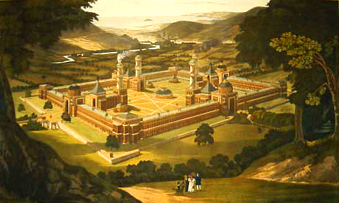

Slide 5
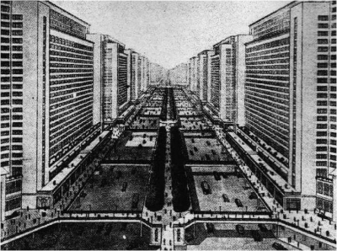

Slide 6
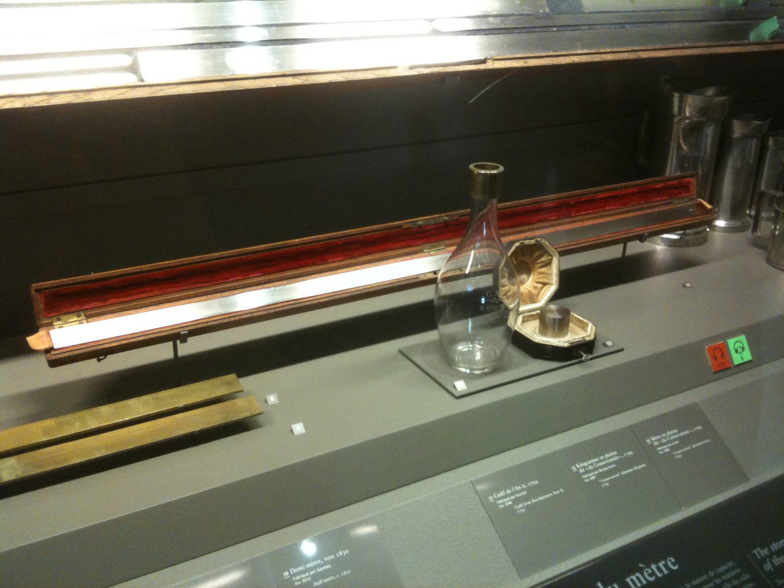

Slide 7
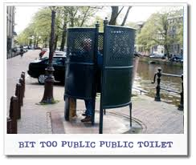
What is privacy?

Slide 8


Slide 9
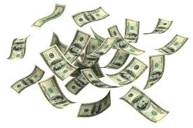
Question 1

Slide 10
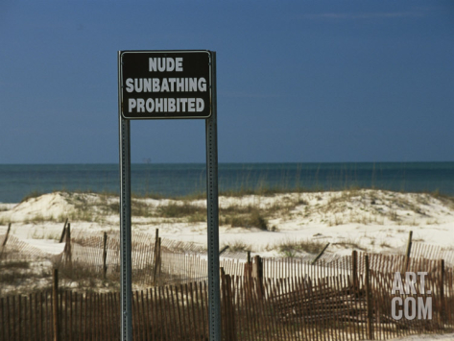
Question 2

Slide 11
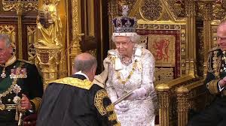
Question 3

Slide 12
Case 1
A 16 year old comes to the doctor and asks for Antidepressants; he/she tells that he/she is being bullied at school
Should the doctor inform the parents and/or the school?

Slide 13
Case 2
The police has been informed that someone in a certain neighborhood (among 300 residents) is planning a murder.
Should the police wire-tap all telecommunications of all residents living in this neighborhood?

Slide 14
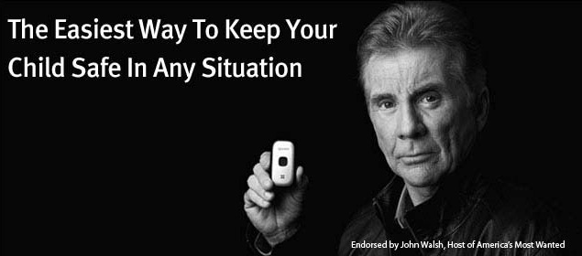
Case 3
A mother suspects that her 15 year old son is smoking pot.
Should she search his room, read his mails and place a tracking device on his telephone so as to keep track of his movements?

Slide 15
Right to respect for private and family life
1. Everyone has the right to respect for his private and family life, his home and his correspondence.
2. There shall be no interference by a public authority with the exercise of this right except such as is in accordance with the law and is necessary in a democratic society in the interests of national security, public safety or the economic wellbeing of the country, for the prevention of disorder or crime, for the protection of health or morals, or for the protection of the rights and freedoms of others.

Slide 16
Right to protection of personal data
1. Everyone has the right to the protection of personal data concerning him or her.
2. Such data must be processed fairly for specified purposes and on the basis of the consent of the person concerned or some other legitimate basis laid down by law. Everyone has the right of access to data which has been collected concerning him or her, and the right to have it rectified.
3. Compliance with these rules shall be subject to control by an independent authority.

Slide 17


Slide 18
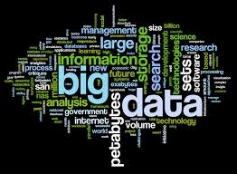
Big Data

Slide 19
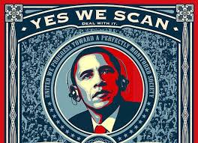
NSA

Slide 20
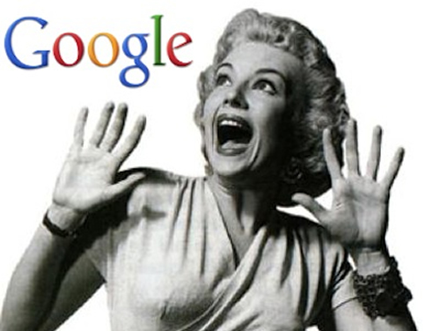
Google, Apple and Facebook

Slide 21
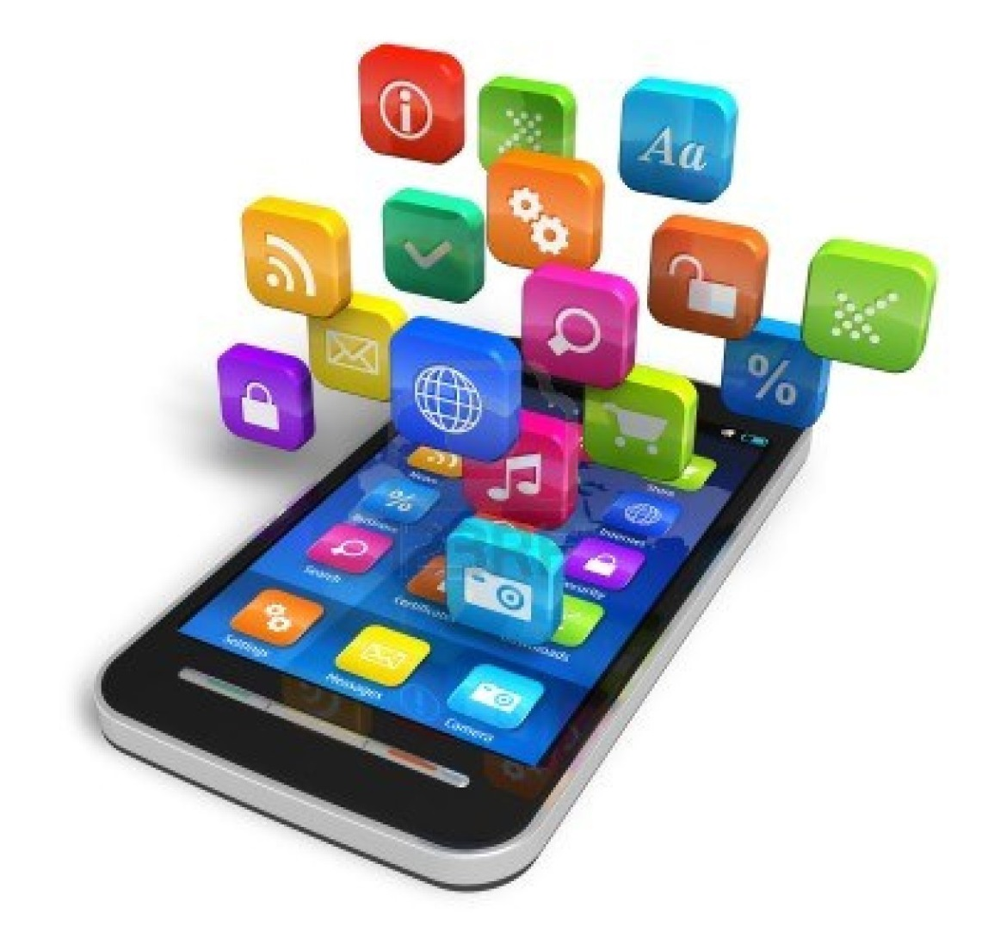
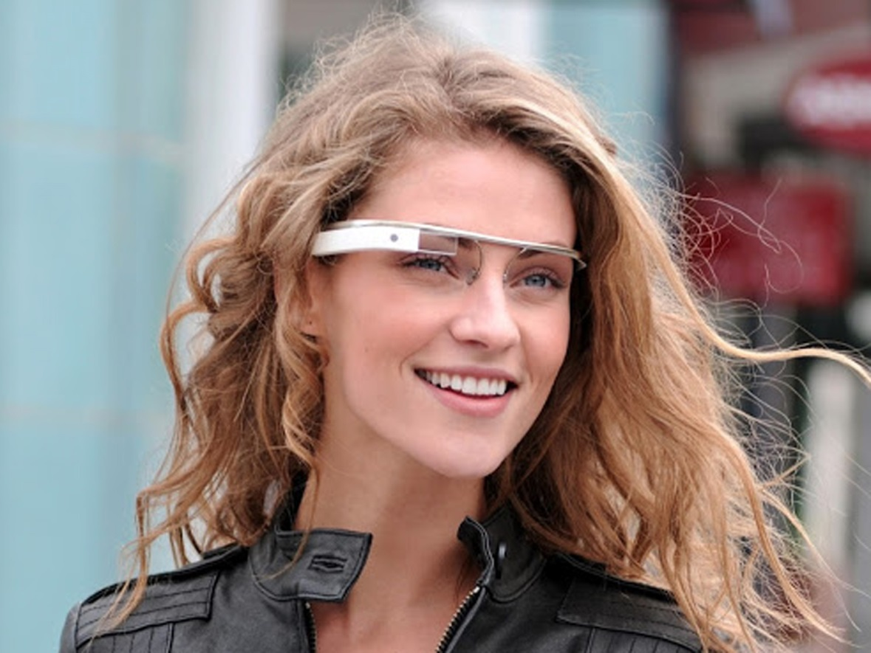
We

Slide 22

Profiling

Slide 23

Privacy

Slide 24
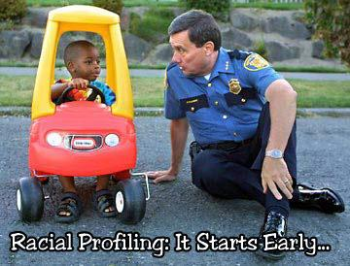
Stigmatisation/discrimination

Slide 25
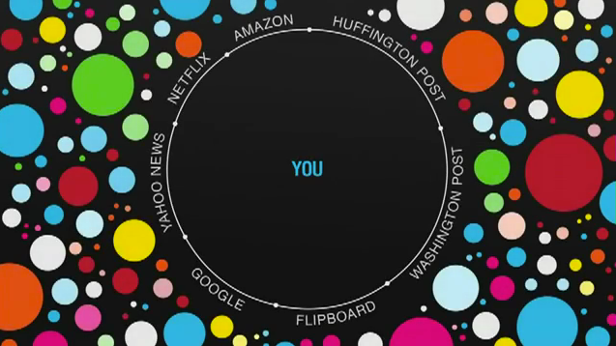
Filterbubble

Slide 26
Privacy in the current paradigm
1. Individual right
2. Personal interests
3. Balanced against the societal interest

Slide 27
Privacy and Big data
1. Difficult to claim individual right
2. No personal interests at stake
3. Difficult to balance against other values

Slide 28
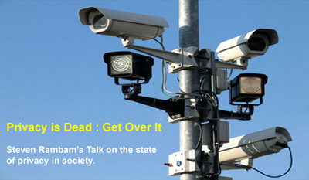

Slide 29
Reframing privacy
1. Privacy as a duty
2. Protecting a societal interest
3. Intrinsic test

Slide 30


