Slide 1

Regulating the Synthetic Society
Bart van der Sloot

Slide 2


Slide 3
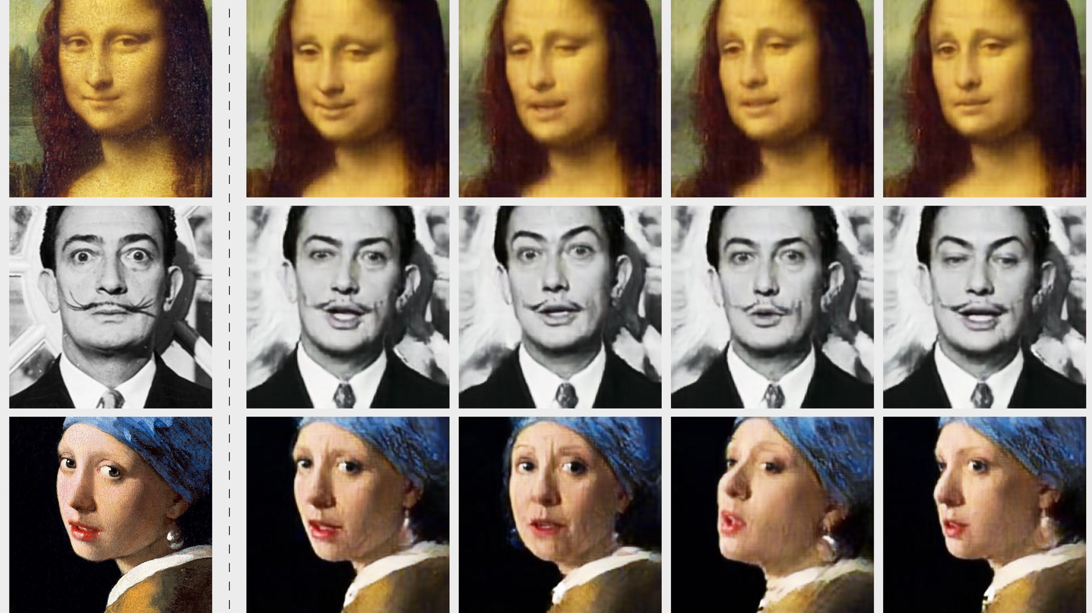

Slide 4
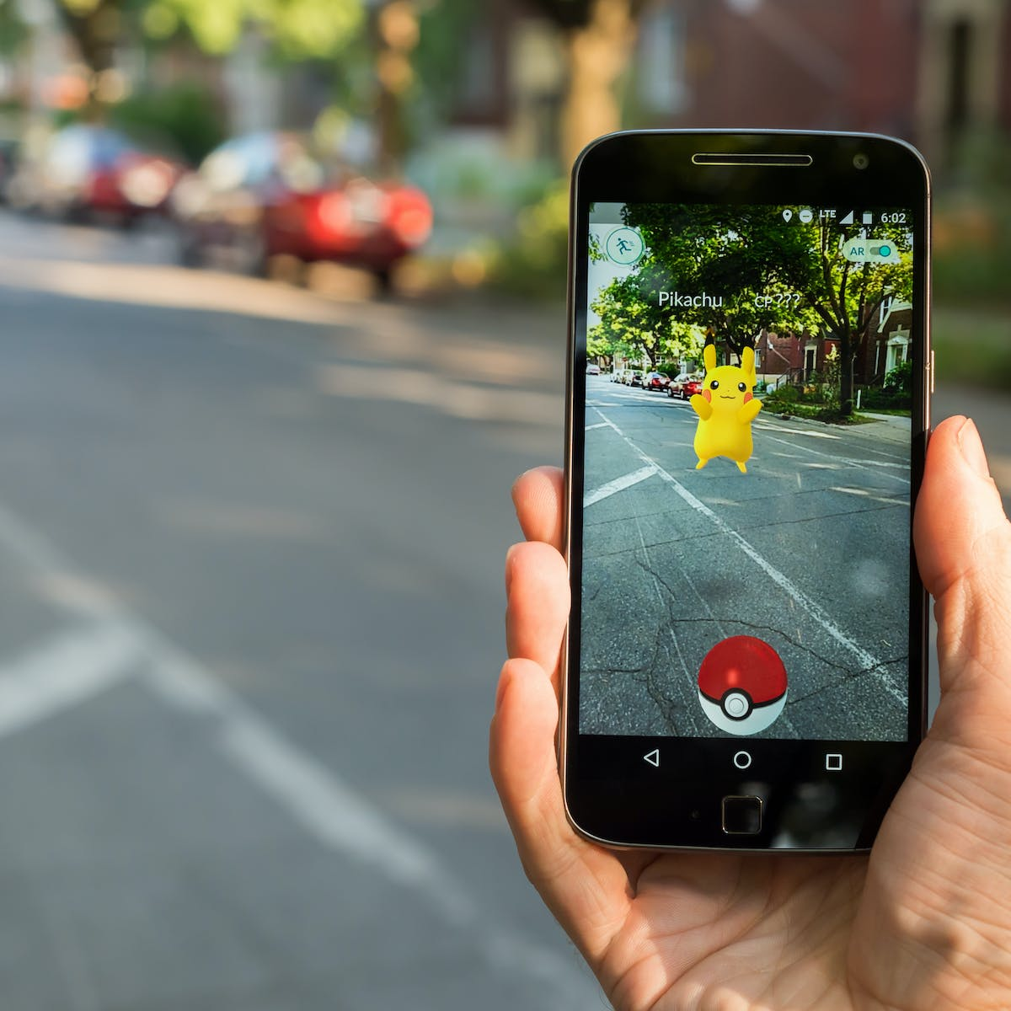

Slide 5


Slide 6
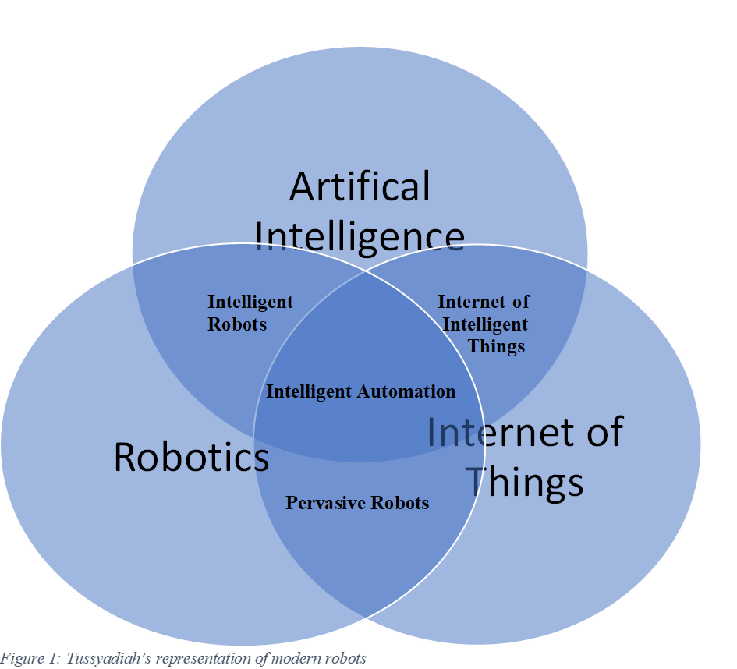

Slide 7
Robots 1.0: robots that have simple mechatronic structures without any degree of autonomy;
Robots 2.0: pre-programed systems that were widely used in industry, such as for assembly lines or in nuclear facilities;
Robots 3.0: teleoperated systems, that were used in space and medical practice;
Robots 4.0: robots that are sensor-driven, allowing for interconnected and collaborative robots. Still today, most of the current service robots, which require human-robot interaction, fall in this category;
Robotics 5.0: robots that are equipped with autonomous capacities, allowing for more complex behavioural patterns and safety-critical tasks in the proximity of humans. For example, most self-driving cars belong to this category, as well as many of the advanced surgical robots;
Robotics 6.0: the newest generation robots will integrate all the above qualities, in addition to more sensory input, a higher level of cognitive abilities and a connection to the internet, enabling more advanced self-learning systems.

Slide 8
Swarm robots: robots, usually of the less advanced sort, that are coordinated through a central system;
Co-robots: robots that are designed to assist humans in performing concrete tasks, such as industrial manufacturing work;
Networked robots: robots that are connected to each other via a network and coordinate and cooperate through that network, most often to accomplish a shared task;
Cloud robots: robots that are connected to the cloud and depend on distributed computing facilities. Through the cloud, they are able to share experiences and knowledge, enhancing their learning capacities;
Fog robots: robots that efficiently distribute computation and memory between edge, gateway, and cloud; the fog is usually closer to end-users, bringing cloud capabilities down to the ground and making them generally more reliable;
Drew robots: robots’ tasks are extremely distributed over a large number of devices, which are heterogeneous, ad-hoc programmable and self-adaptive, making it possible to realize highly distributed applications without the use of central nodes;
Cognitive robots: robots that are endowed with intelligent behaviour by providing them with a processing architecture that will allow them to learn and reason about how to behave in response to complex goals in a complex world;
Smart robots: robots that are equipped with an AI system that can learn from its environment and its experience and build on its capabilities based on that knowledge, making their self-learning and -directional capacity greater than that of cognitive robots;
Ubiquitous robots: smart robots with additional technologies from the fields of ubiquitous and pervasive computing, sensor networks, and ambient intelligence being built into their system;
Internet of Robotic Things: robots are connected with and make use of sensor and data analytics technologies from the IoT to enhance their situational awareness, inter alia enabling more precise task execution.

Slide 9
Humanoid Robots
Input capacity
Throughput capcity
Output capcity
Apperance

Slide 10
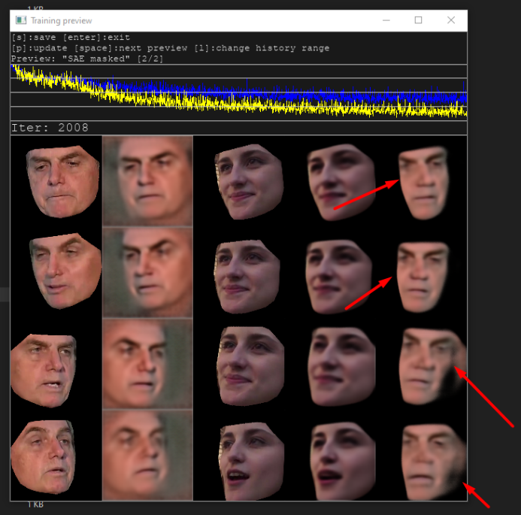
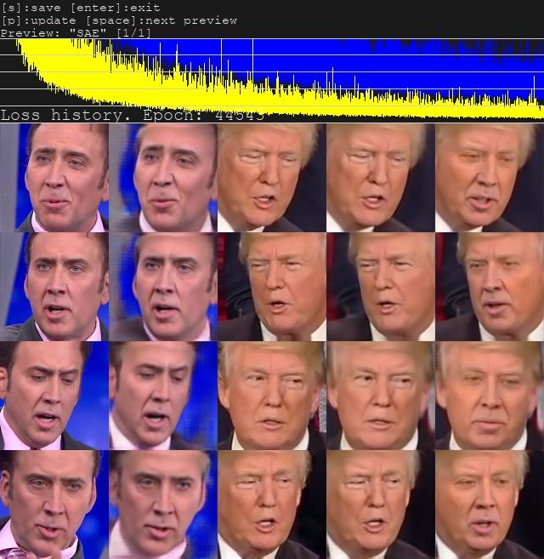
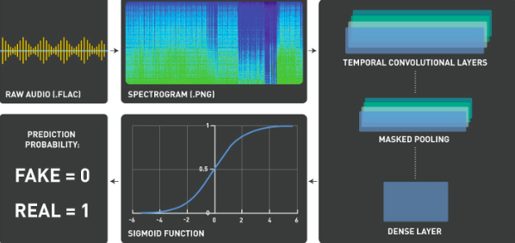

Slide 11
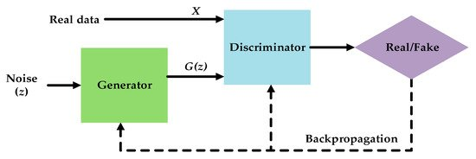

Slide 13
Six relevant factors are important for the question of whether material should be deemed a DF:
Type of data carrier and therefore the extent to which the fake infiltrates’ the consumer’s mind in unfiltered form;
The advanced or cutting-edge nature of the technology used for creating the material;
The degree of manipulation (the bigger the manipulation, the more the authentic view on reality is distorted);
The degree to which the manipulation is essential/relevant to the context;
Whether the deepfake involves a living, deceased or non-existent person;
The extent to which the user believes the material to be true

Slide 14
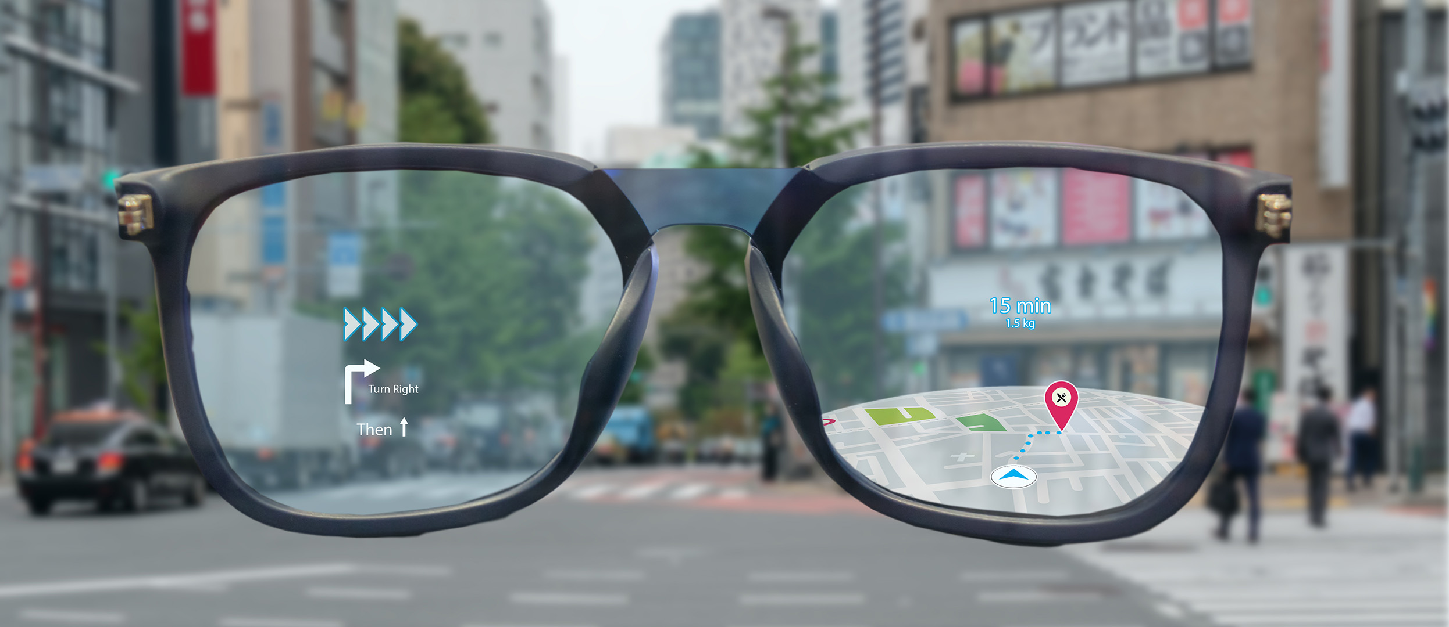
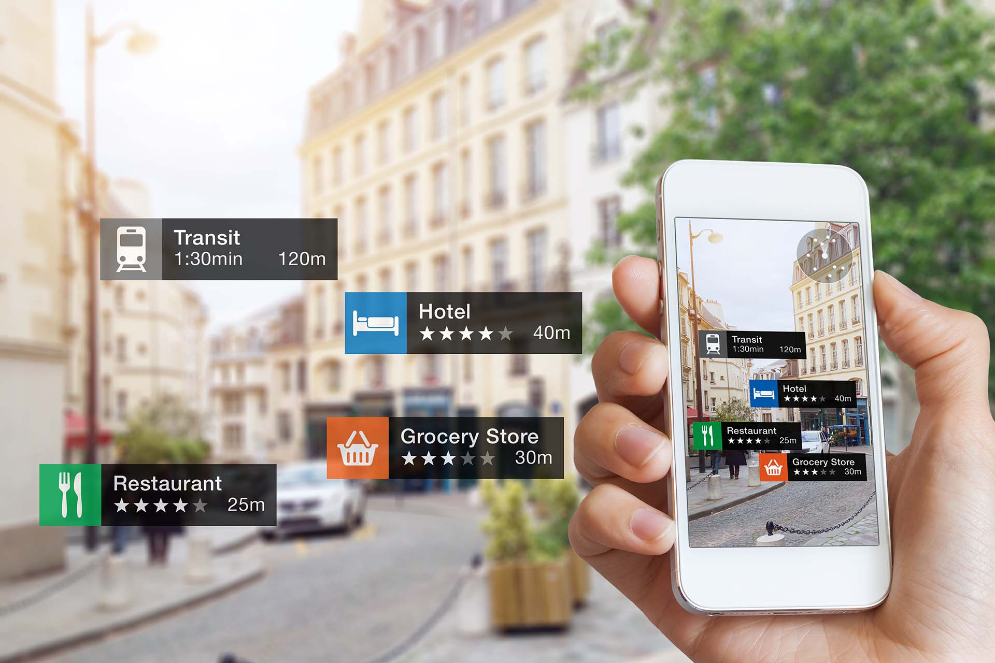
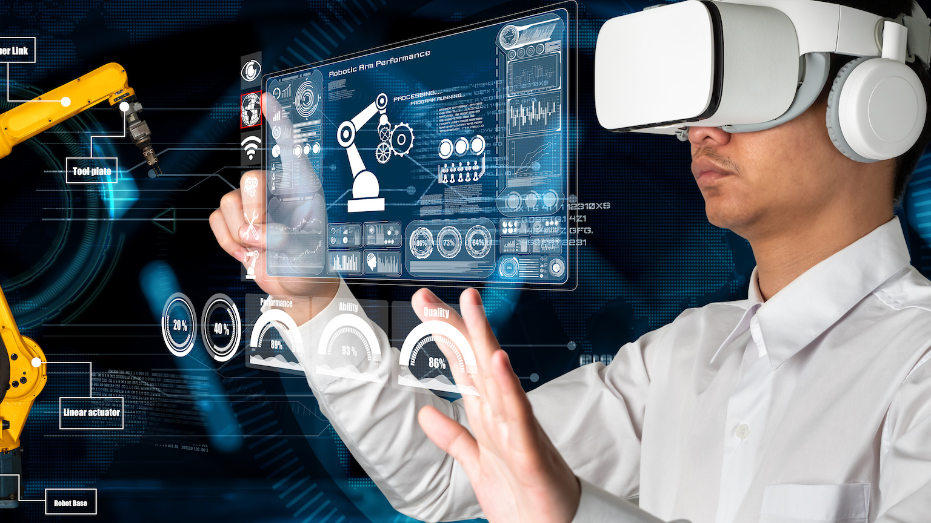

Slide 15
Reality: Face-to-face discussion
Augmented Reality: Digitally enriched environments
Augmented Virtuality: Virtual enhanced by physical world (digital maps)
Virtual Reality: Games

Slide 16
AR tracking generally happens through one of the following ways:
Fiducial marker-based tracking: In fiducial marker based tracking, inter alia, black and white squares with geometric figures are used as typical markers, which gives high contrast compared to background environment, allow for easy recognition. One of the downfalls of this approach is that the objects always have to be visible and cannot be obscured by other objects or weather induced obstacles during the augmentation;
Hybrid based tracking: Two or more data sources such as GPS, compass and accelerometer are used to calculate position and orientation. This yields information as to what should be augmented in the field of view without any actual processing of the real image (obviously, it is used for placing the augmented layer);
Modelled based tracking: by manipulating their position, colour or orientation, representations may accurately resemble predetermined 3D objects;
Natural feature tracking: objects in the real world can be used as markers, focussing on the peculiar features that distinguish them from others.

Slide 17
AR devices work through various display types, which can be roughly divided in four:
Optical See-Through: this type of system is based on a transparent head mounted display to show the virtual environment directly over the real world; placed in front of the user’s eyes, the material of the display can be either glass, plastic or any other transparent material;
Virtual Retinal: this version of AR is based on the projection of a modulated beam of light (from an electronic source) directly onto the retina of the eyes of the users, producing a rasterized image;
Video See-Through: a see-through device is typically placed on the head; it does not project a layer on the glass through which reality is seen, as in the first approach, but instead makes a combined projection by filming the environment and projecting those shots, with the additional artificial layer, on the screen in front of the user’s eyes;
Monitor based: the least futuristic, but currently most used form of AR is like the third option, but instead of using a headset for display purposes, the image is shown on a desktop monitor or a mobile device.

Slide 18
For AR systems there are, by and large, four major types of interfaces:
Tangible AR interfaces: this variant of AR makes use of sticks, paddles and other real-world objects, to allow the user to navigate through or rearrange AR;
Collaborative AR interfaces: this variant makes use of multiple displays to support remote and co-located activities, thus integrating the input from multiple devices with multiple locations;
Hybrid AR interfaces: in the third variant, there is a possibility for its users to interact through various complementary interfaces as well as the possibility to interact through a wide range of interaction devices, making it suitable for unplanned, everyday interaction where it is not known in advance which type of interaction display or devices will be used;
Multimodal interfaces: multimodal AR interfaces, the most recent of the four, combine real object input with naturally occurring forms of language and behaviour, such as speech, touch, natural hand gestures, or gaze.

Slide 19
Cloud based architecture: operate in a client-server model with Mobile Augmented Reality Devices (MARs) executing the terminal applications, while the AR server is located in the cloud and accessible through the internet.
Edge based architecture: also operate as a client-server model, but the AR server is hosted at the network edge, which is more suitable to serve latency critical applications, as edge servers at the core network provide a large scale of services.
Localised architecture: functions with an AR server very close to the MAR device, or with the AR server being eliminated, in which case the MAR device performs all computing tasks.
Hybrid architecture: integrates the three previous approaches, allowing AR to switch between or combine several platforms whenever profitable in terms of functionality, efficiency or longevity.

Slide 20
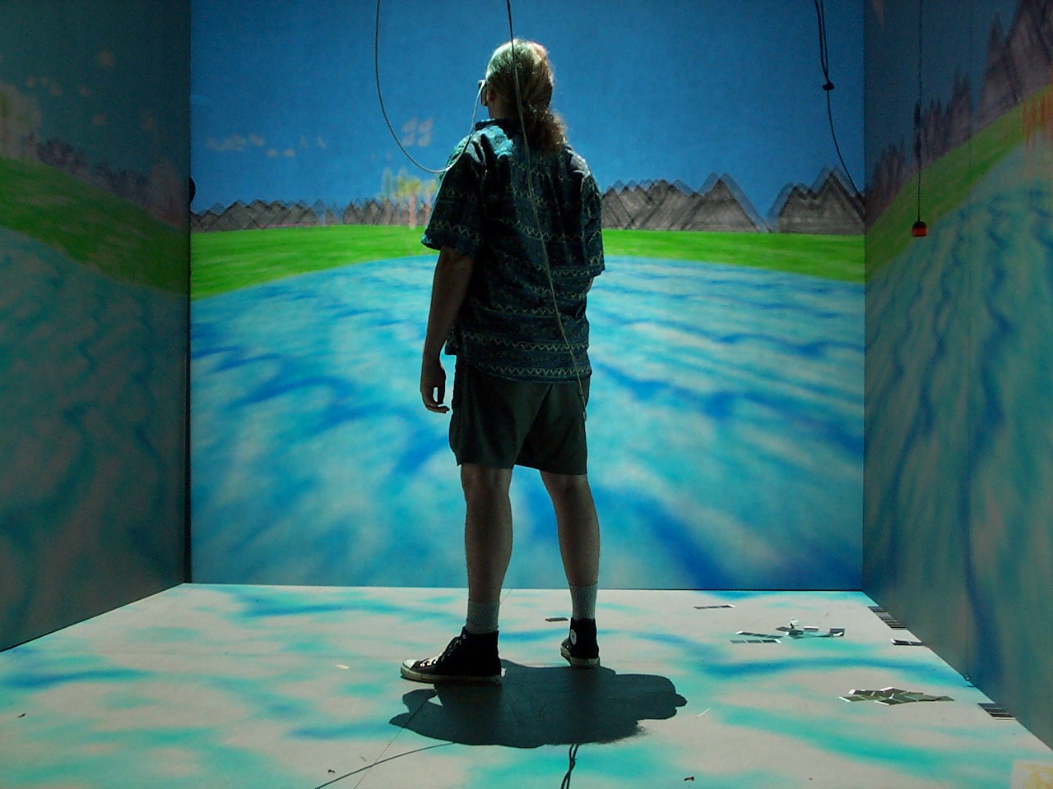

Slide 21
Fully Immersive VR: the user finds herself in a fully AI generated environment and gets sensory input from that environment through visual and audial display and force feedback from sensors;
Desktop VR: less advanced, desktop VR uses subjective immersion, which is less realistic, though the feeling of immersion can be enhanced through stereoscopic vision;
Cave VR: operates in a small room specially designed for VR experiences in which a computer-generated environment is projected onto the walls. Most Cave VR systems work in a two stream fashion, both depending on physical to virtual synchronisation as visa versa, virtual to physical synchronisation.

Slide 22
Four type of output devices can be distinguished:
Mobile Head-Mounted Displays (HMDs): these are usually deployed wireless and are able to operate without an additional PC. Such could be an add-one frame for a smart phone, an ergonomically designed smart phone case or a stand-alone system that is specifically designed for this purpose;
Wired HMDs: most stationary HMDs are connected to a powerful Personal Computer, but still allow the user to roam the space, usually a secluded room. This type is particularly suitable for both gaming and for training purposes;
Haptic devices: are generally body worn, but can also be carried by the user;
Multi sensor devices: allow for a combination of audio, video, haptic and/or olfactory sensory input.

Slide 23
As to the input devices, roughly three categories can be distinguished:
Controllers: are commonly hand worn, allowing for input from buttons or touchpads, for example one joystick for each hand. These input devices may either be wired or wireless, or if multiple input devices are used, a combination of both;
Navigation devices: the user can be provided with the illusion of moving through space, while staying relatively static, through the use of navigation devices;
Body tracking devices: gestures and other body signals can be tracked by body tracking devices, inter alia through magnetic data gloves.

Slide 24
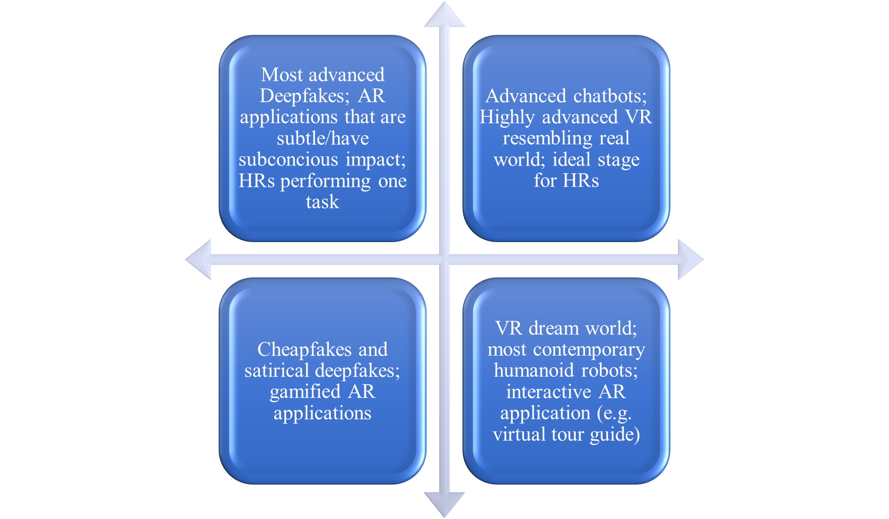
Resembling reality
One-Directional
Interactive
Clearly Inauthentic

Slide 25


Slide 26
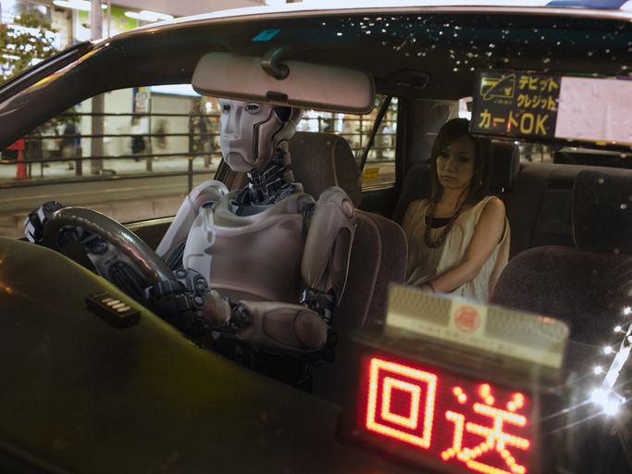
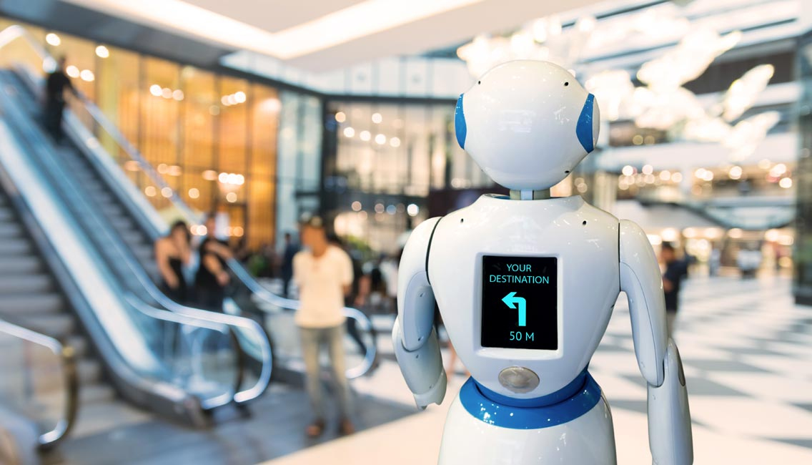

Slide 27
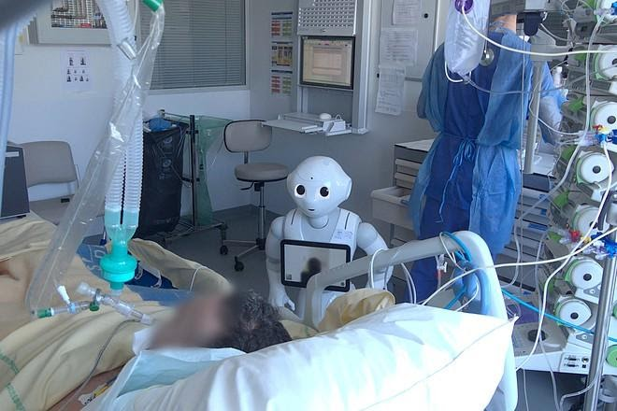


Slide 28
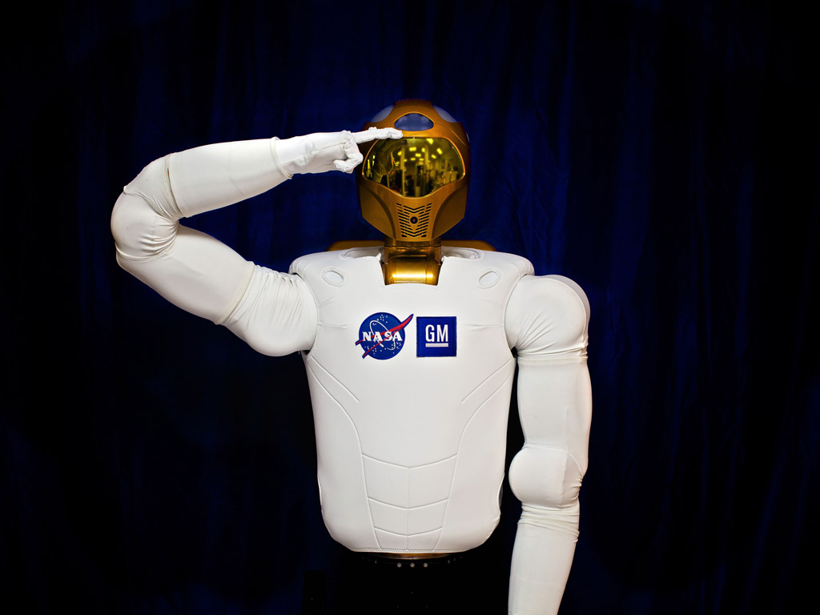


Slide 29

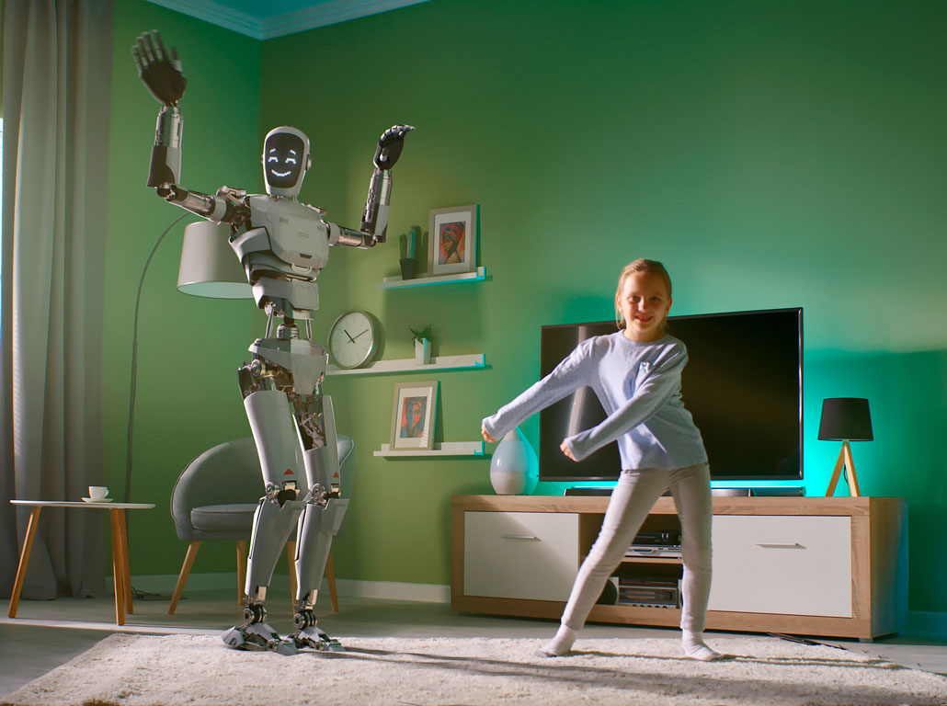

Slide 30
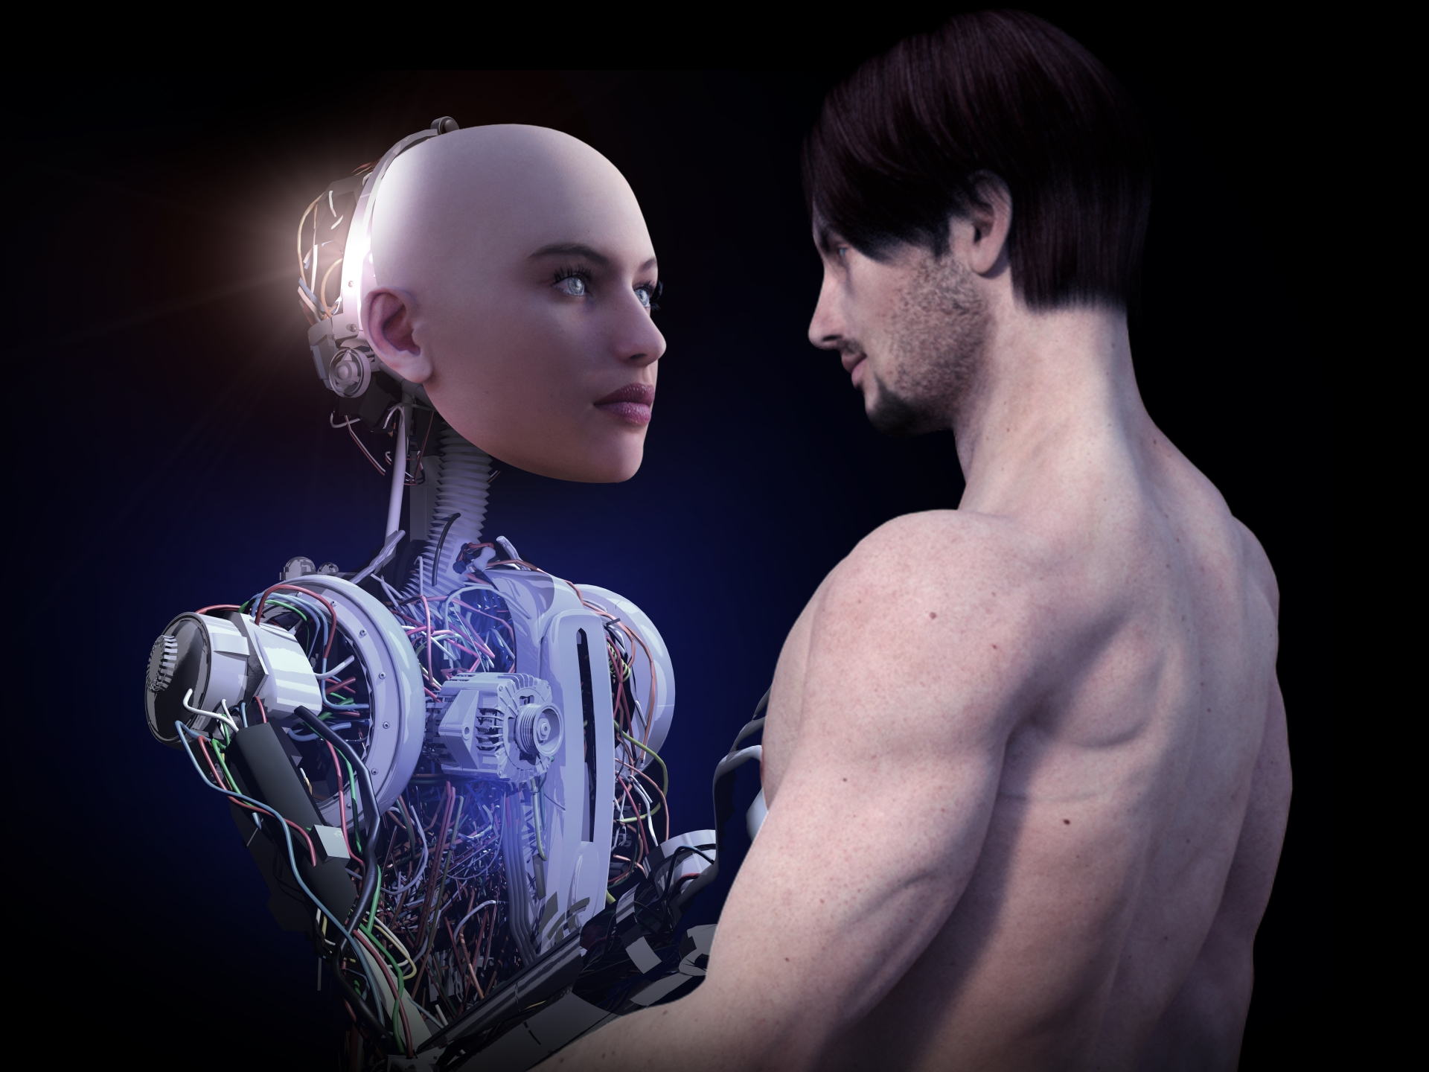

Slide 31
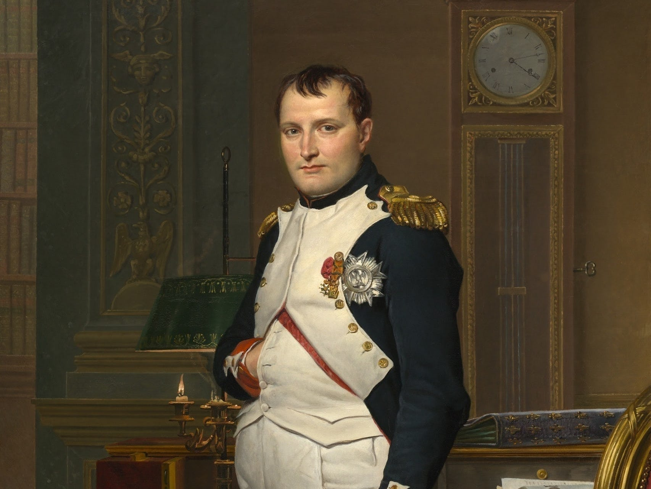

Slide 32


Slide 34


Slide 35

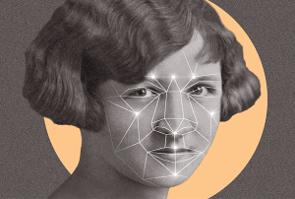

Slide 36
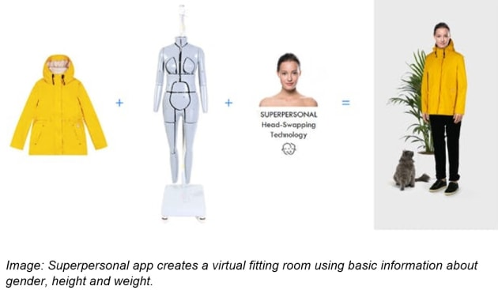

Slide 37
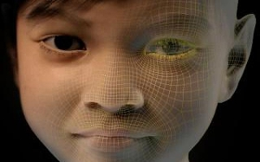

Slide 38
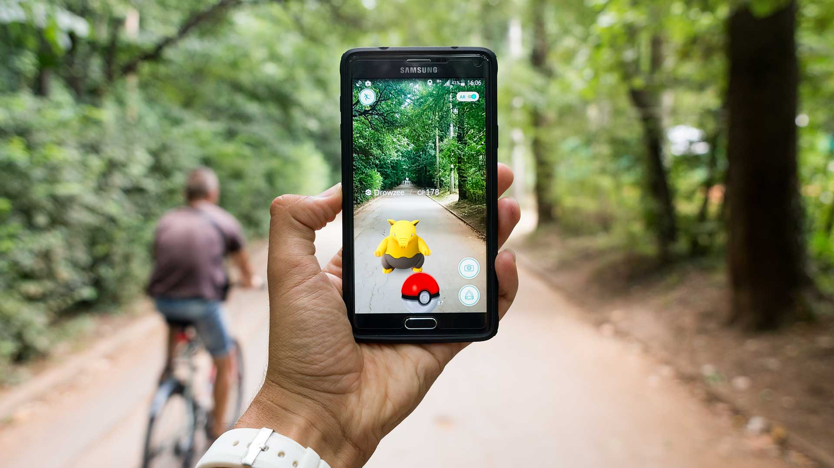

Slide 39
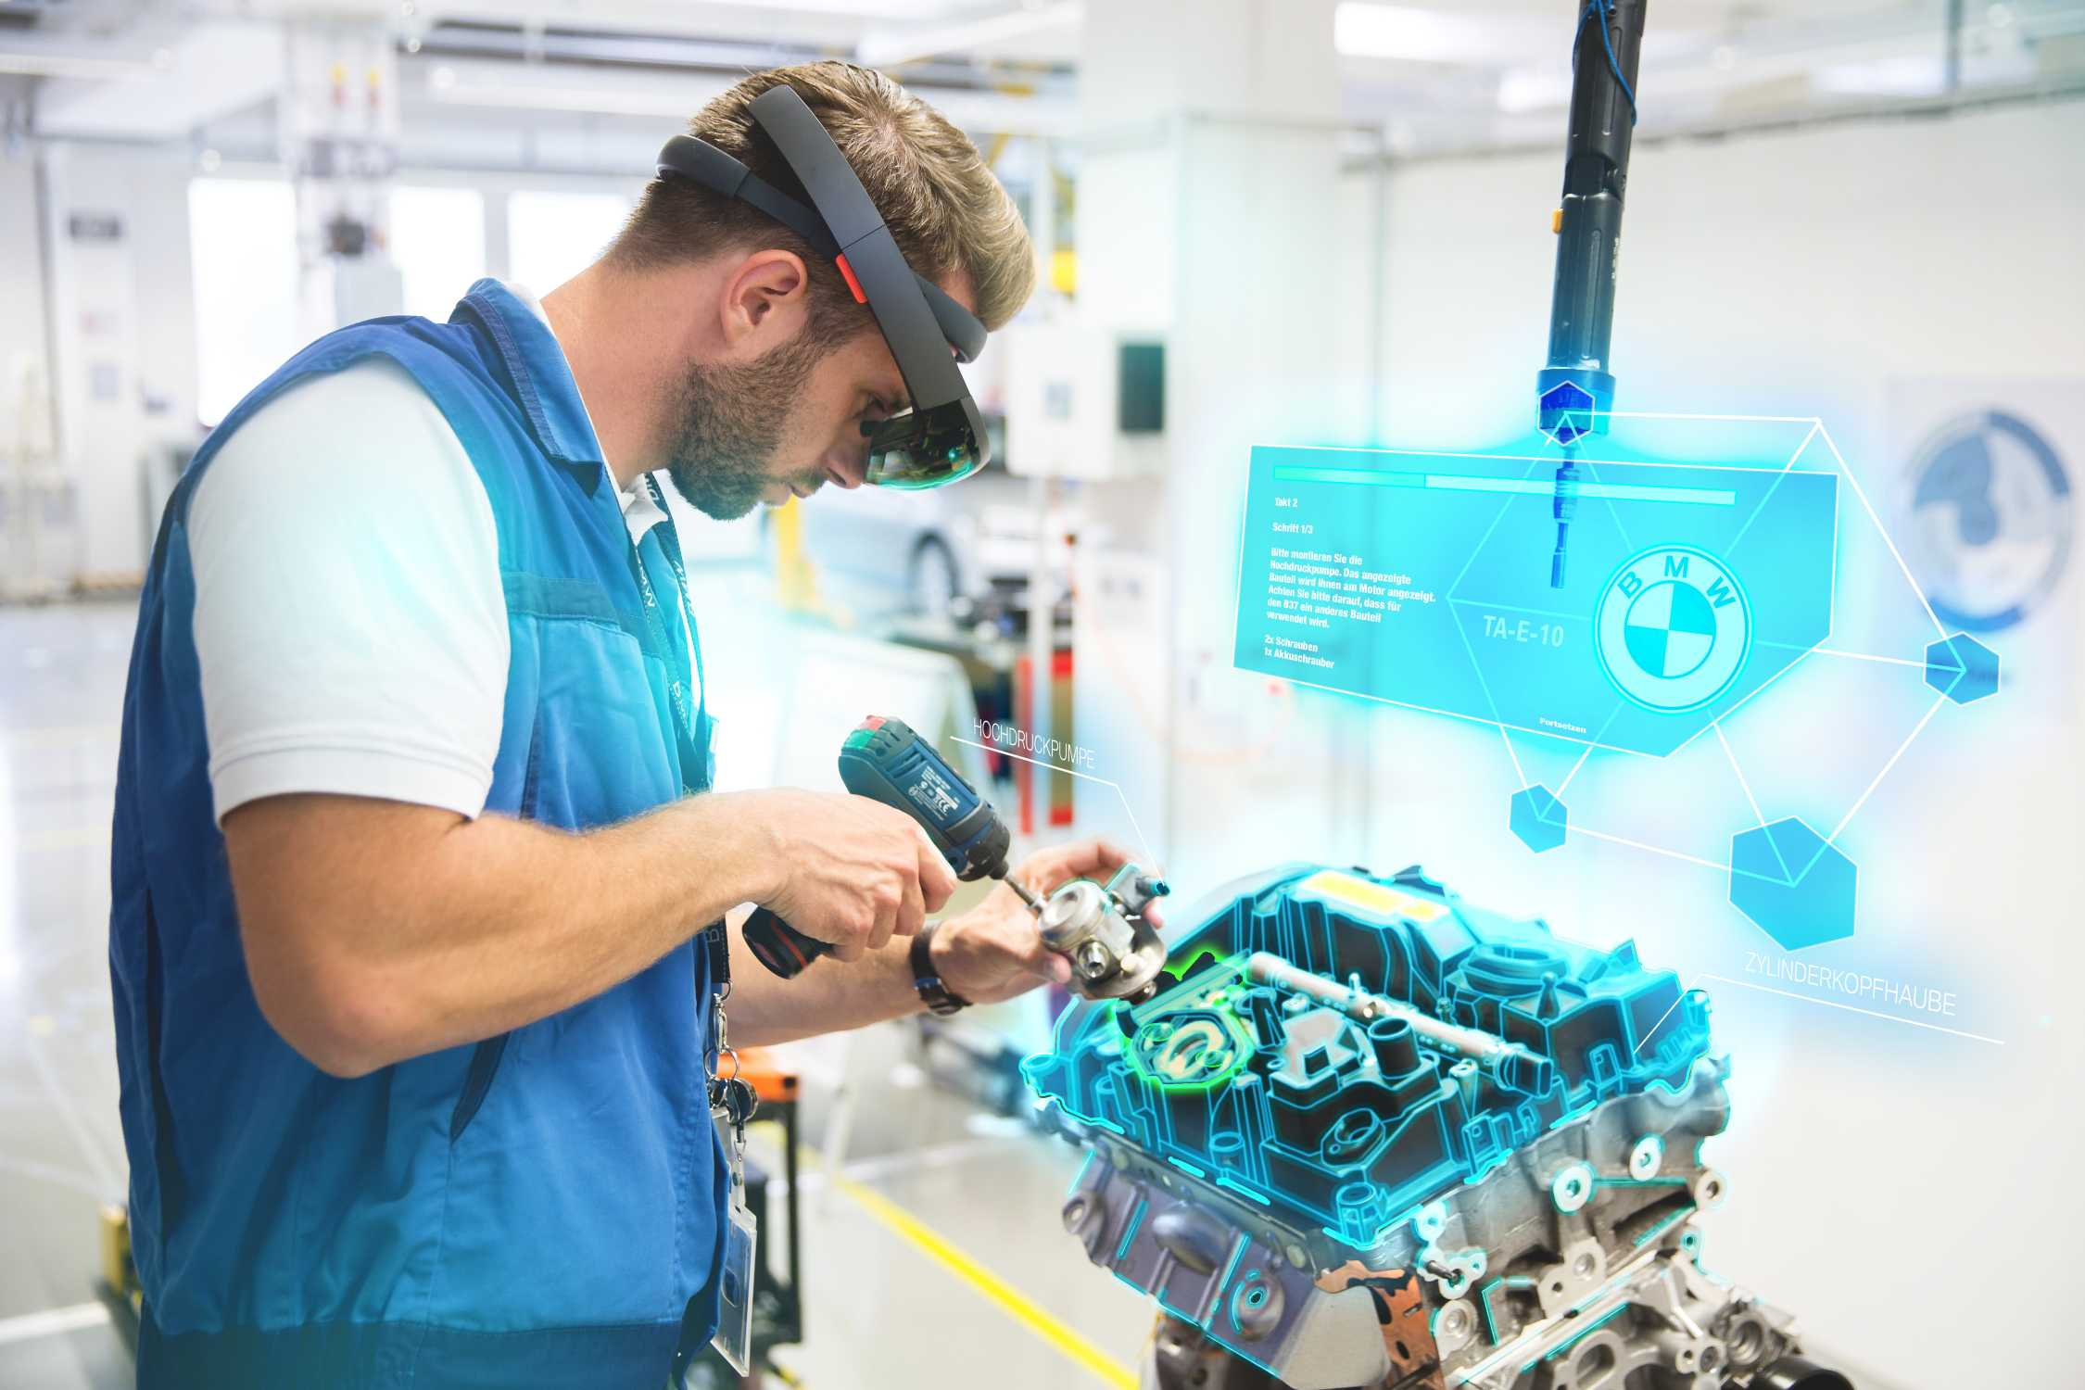

Slide 40
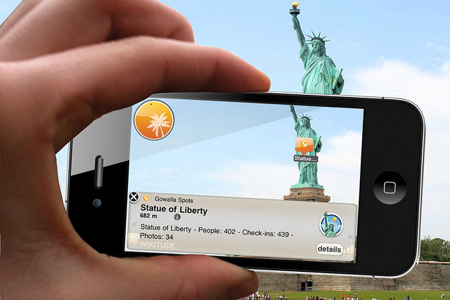
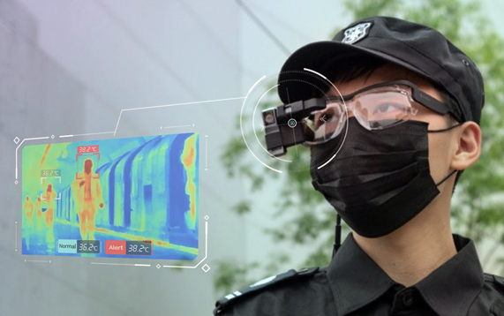

Slide 41
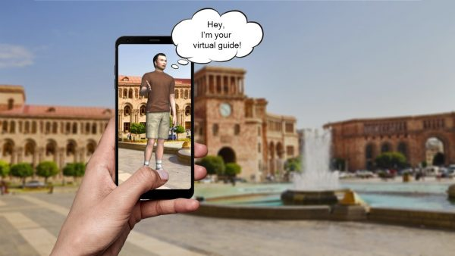

Slide 42


Slide 43
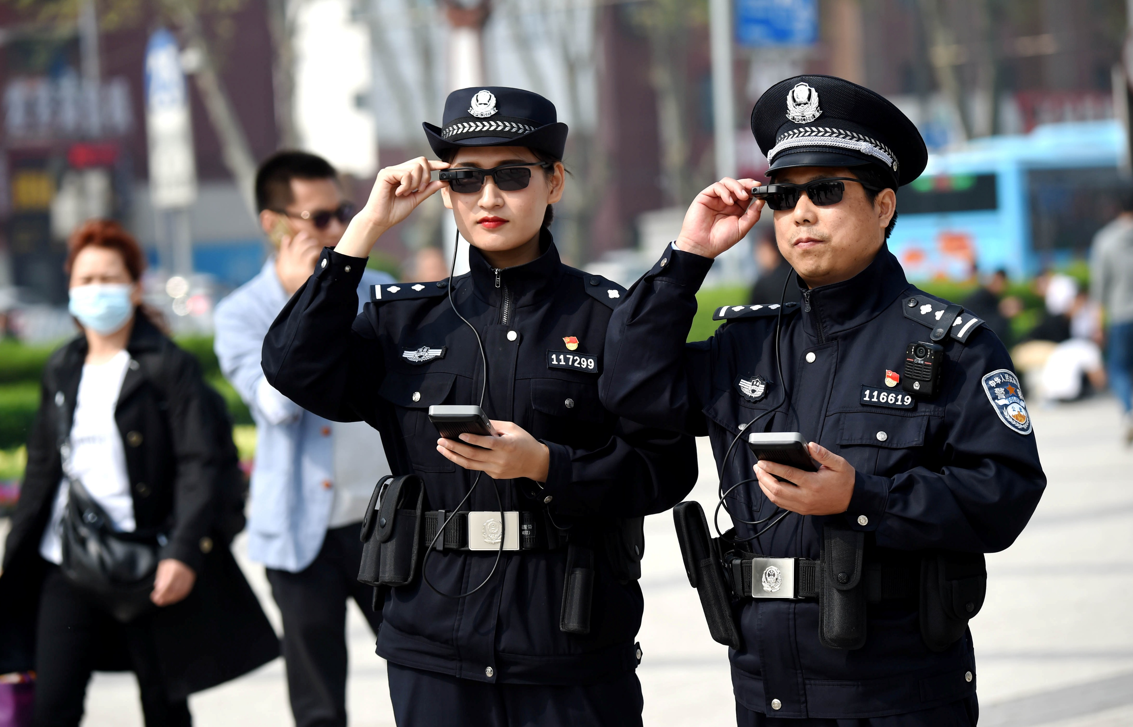

Slide 44
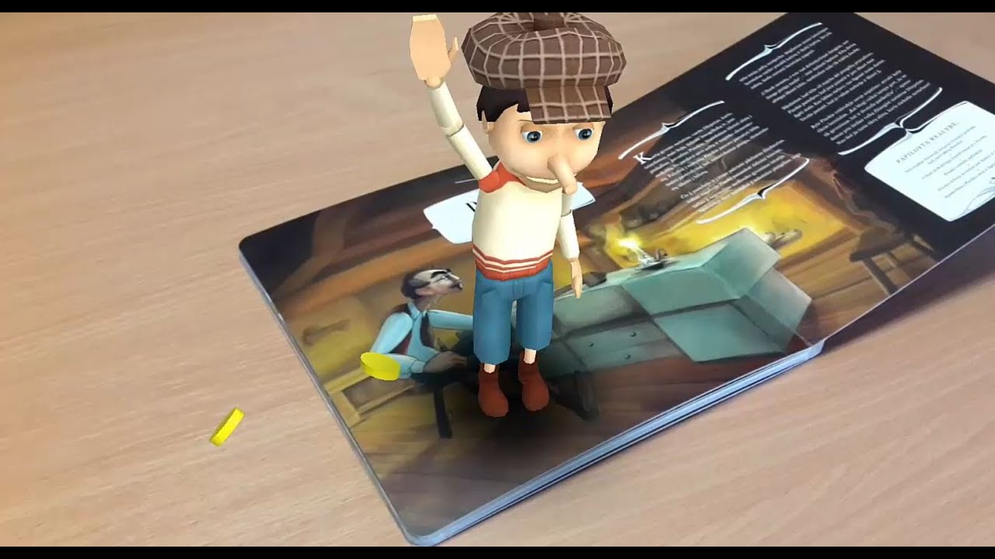

Slide 45


Slide 46

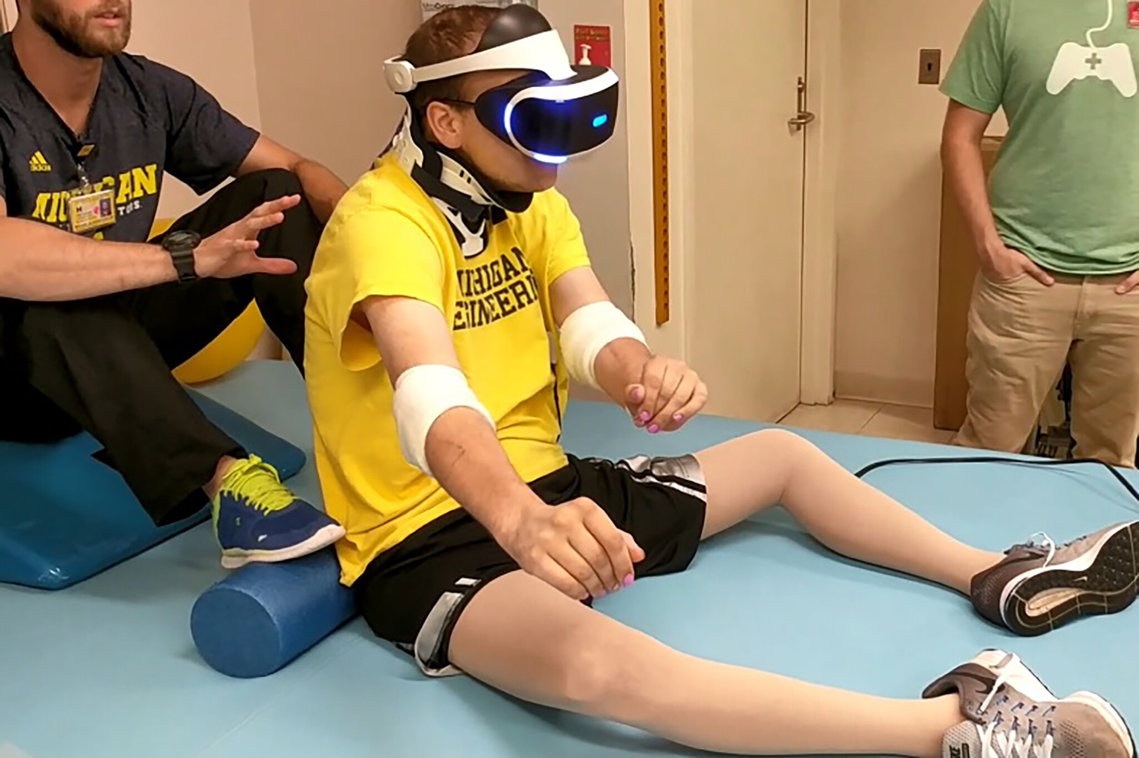

Slide 47
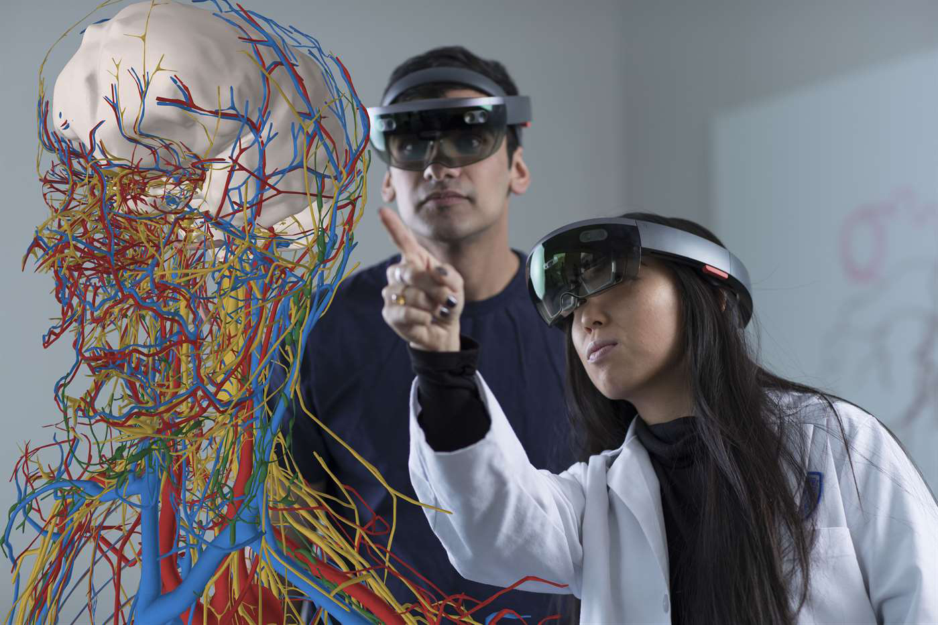
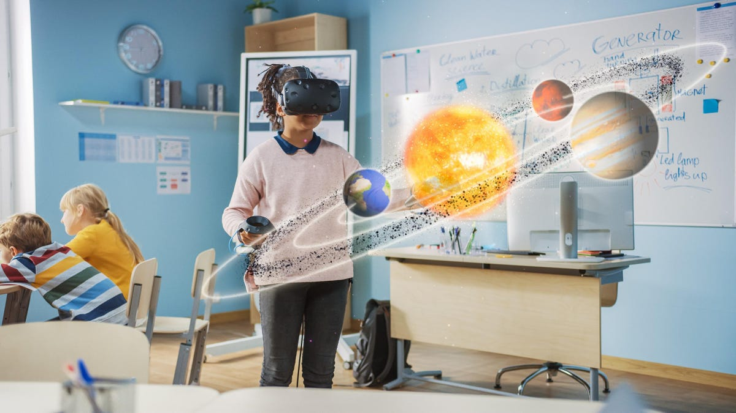

Slide 48

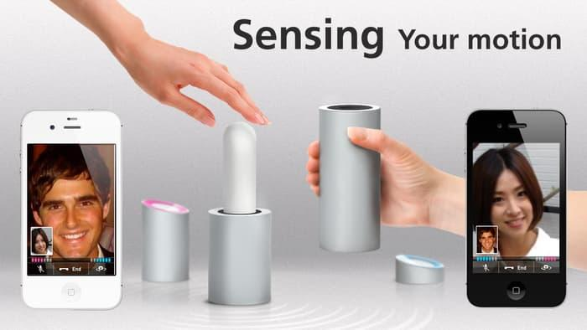

Slide 49


Slide 50


Slide 51
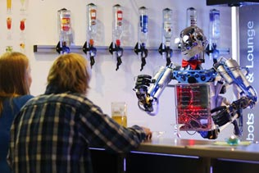

Slide 52
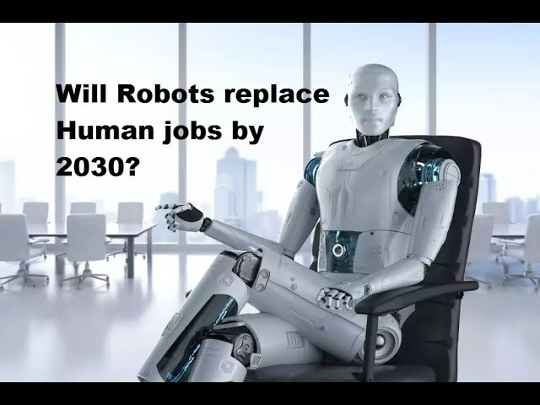

Slide 53
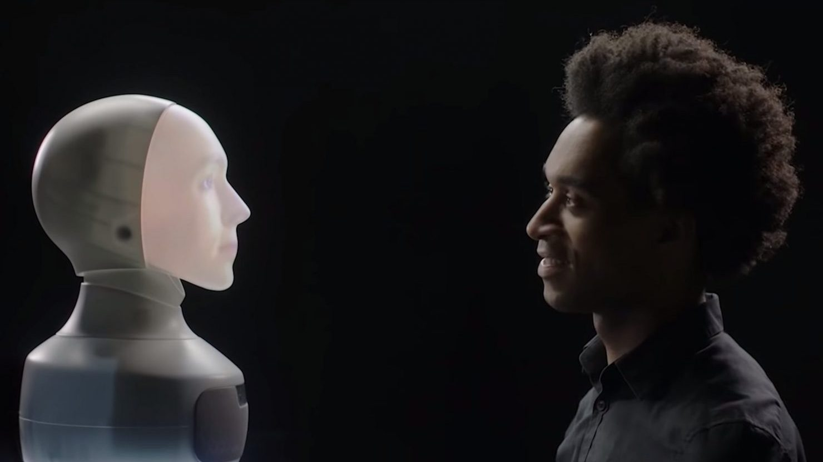

Slide 54
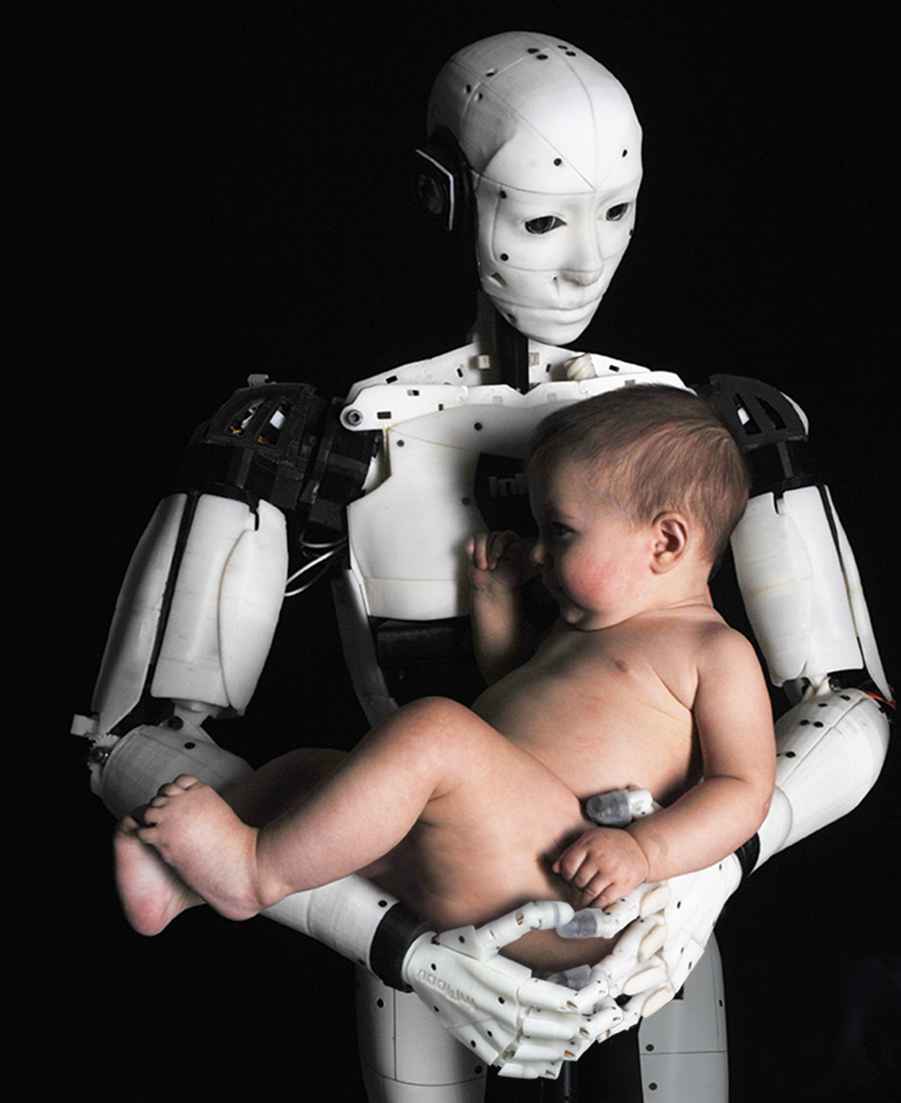

Slide 55


Slide 56


Slide 57


Slide 58


Slide 59
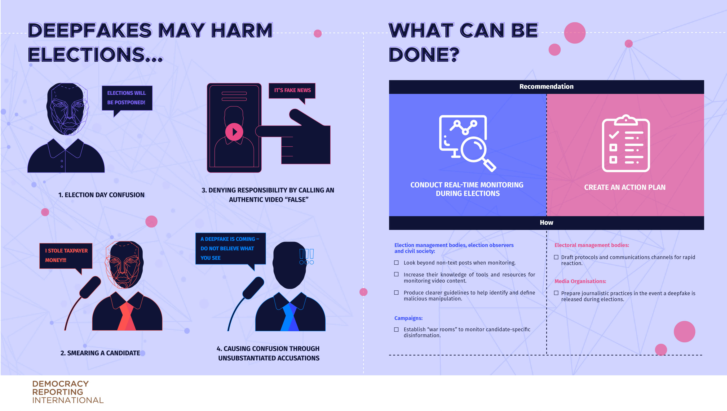

Slide 61
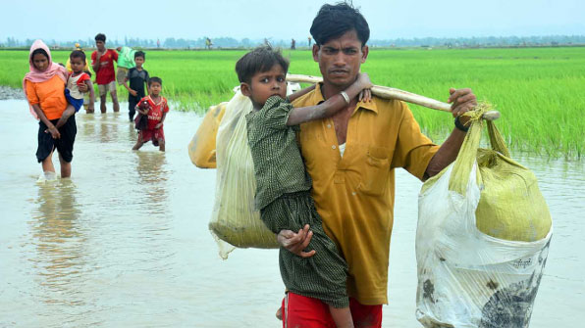

Slide 62
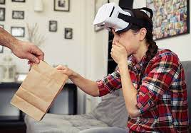


Slide 63
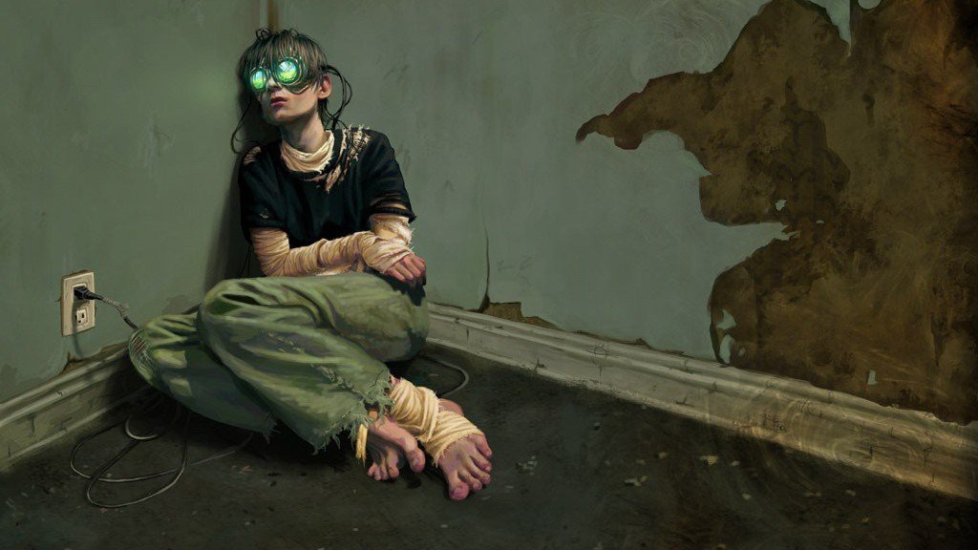

Slide 64
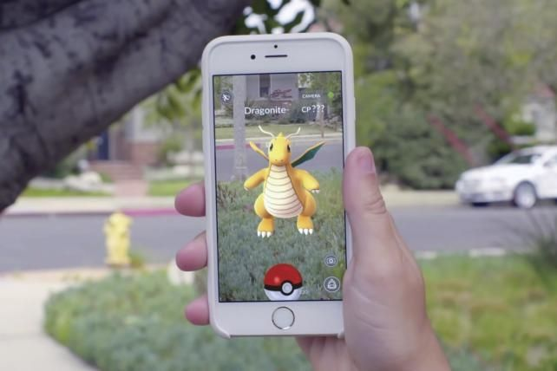
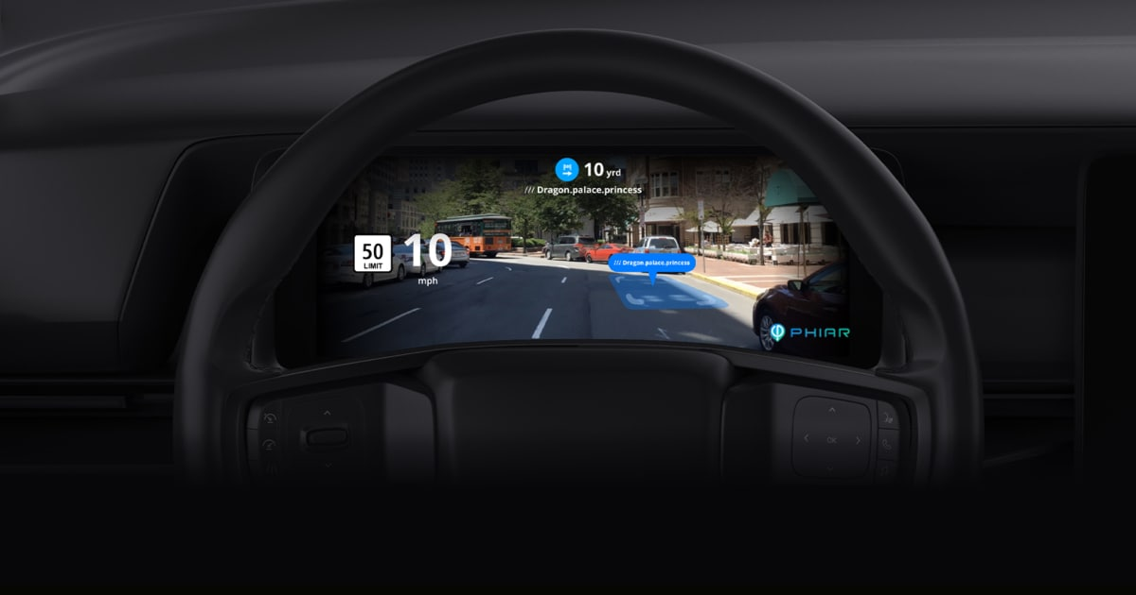

Slide 65


Slide 66
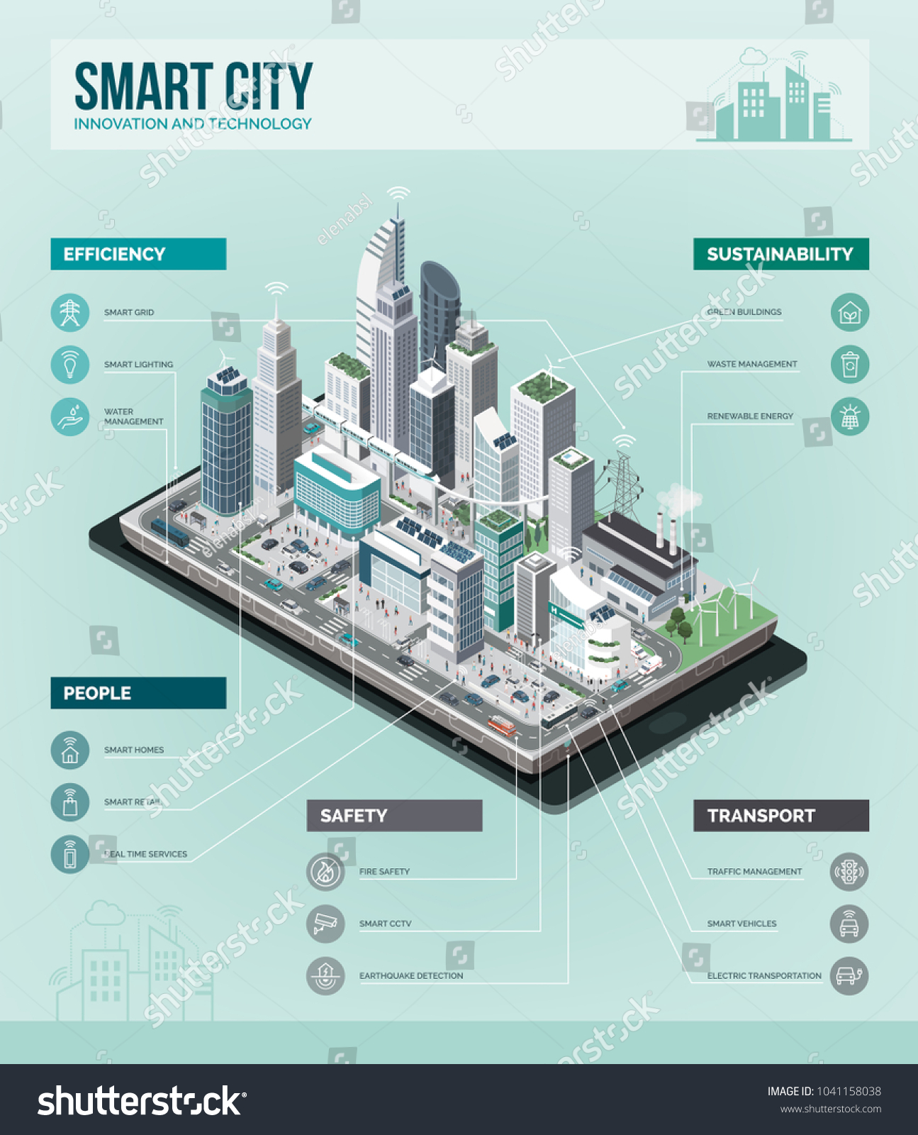

Slide 67


Slide 68


Slide 69


Slide 70

Physical Reality (PR)
Natural people, natural world
Inacurate PR representation with real effects on PR
Deepfake leading to violence, theft, etc.
Treatment in VR; AR omiting parts of PR
AI-generted content (non representative) with real impact on PR
Chat GPT essay; AI generated art; etc.
AI generated avatar influencer
AI-generated content being placed in PR
HRs
AI-generated content allowing better perception of reality
AR allowing perception of ultra-violet, sonar signals, etc.

Slide 71



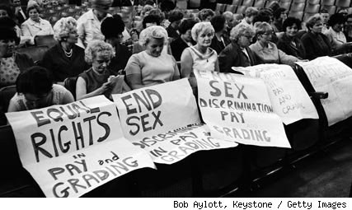

Slide 72
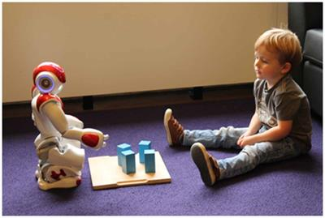

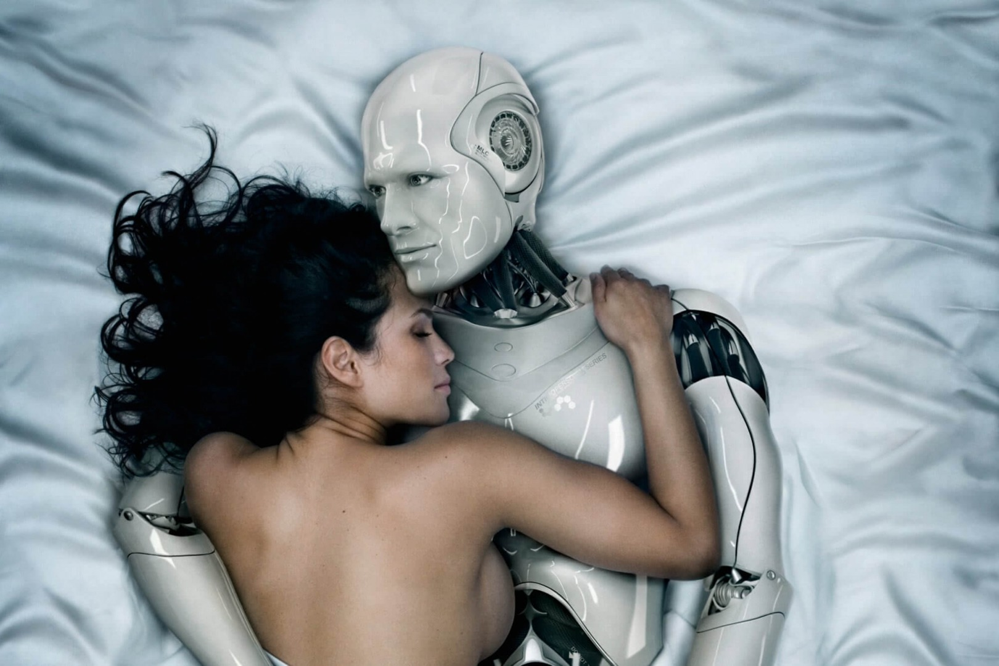

Slide 73
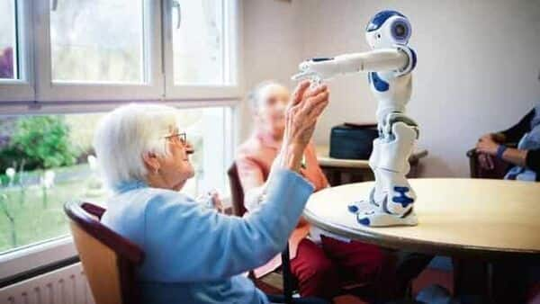

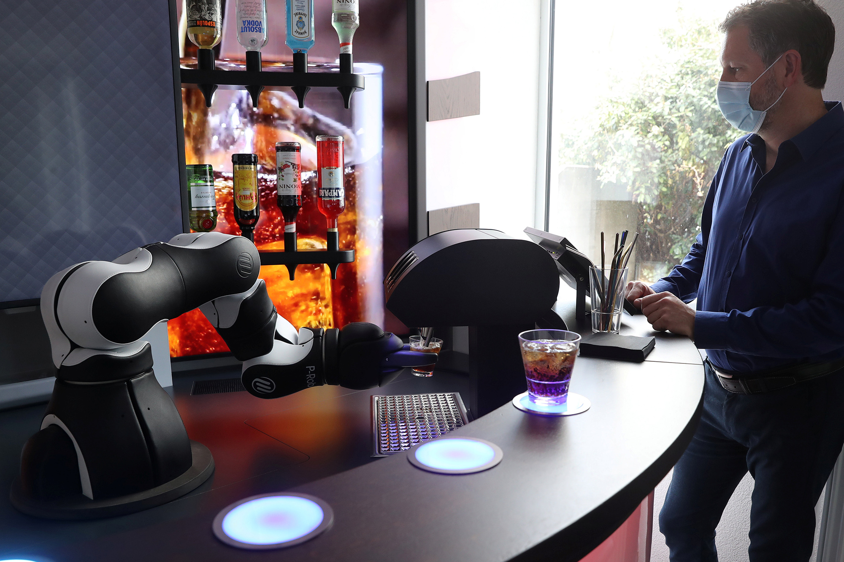

Slide 74
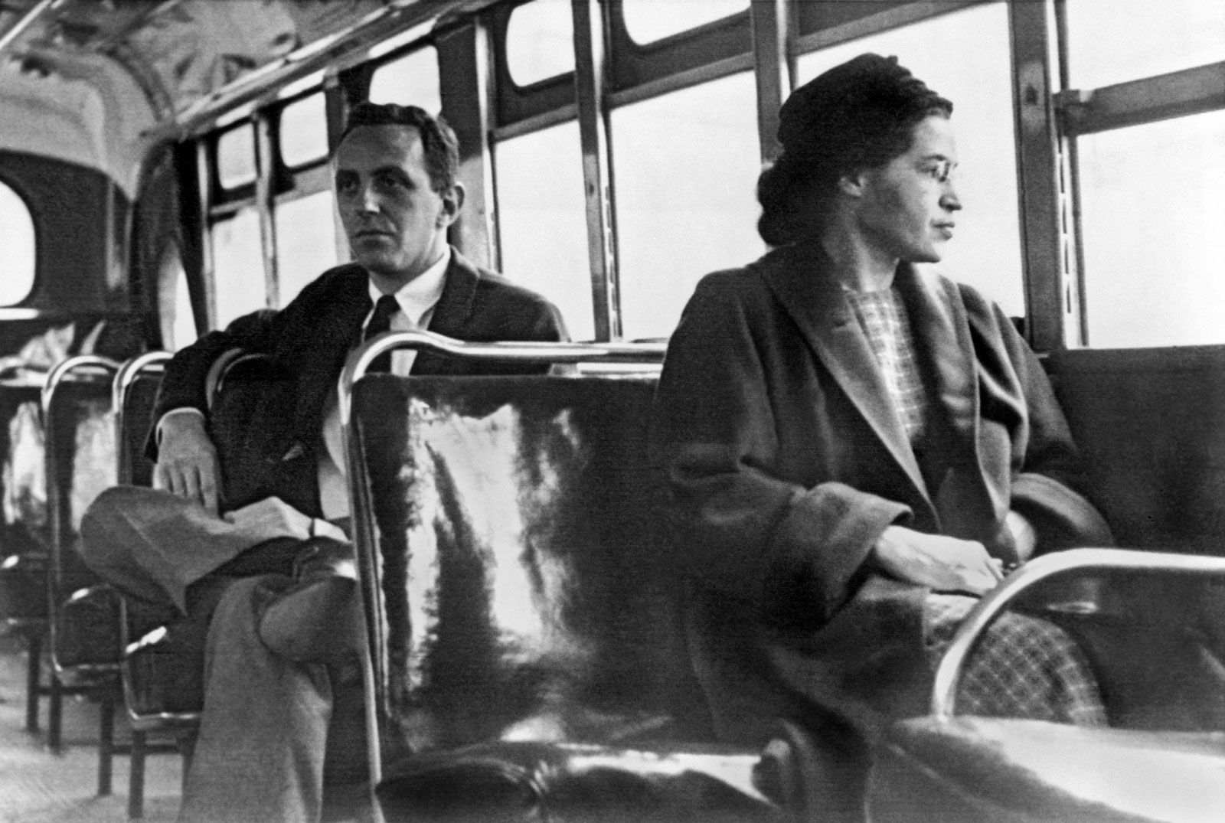

Slide 75



Slide 76


Slide 77


Slide 78


Slide 79


Slide 80


Slide 81


Slide 82


Slide 83
Juridische regimes
Data Protection
  Personal Data
  Data Quality
  Tranparancy
  Purpose specification/limitation, legitimate ground, household exemption
Human Rights
  Non-Human Rights
  Property
  Privacy
  Freedom of expression

Slide 84
Juridische regimes
3. Technology Regulation
  EU Device Regulations
  AI Act
  Dual Use Regulation & import export data
  E-Privacy & data portability
4. Procedural Law/Law enforcement
  Procedural law/evidence
  Law Enforcement/ex-ante vs. Ex post regulation
  AI Liability Act
  Liability Internet Providers

Slide 85
1. Data Protection – personal data
There are several borderline cases, however, where it may not always be clear whether data processing falls under the GDPR or not, such as, but no limited to:
When one HR is owned by multiple families or a neighbourhood, most likely the data about the HR will not indirectly relate to a specific person, as it is unsure to which natural person it indirectly relates, but this assessment entails a gradual rather than a binary distinction.
With HRs that are controlled by a person using teleoperation, the actions of the HR could be seen as actions of the person herself. Such a scenario raises complex questions. A person might argue that she navigates life through her HR as she would through her own body. This can be an especially powerful argument for people that are homebound, due to physical inabilities.
When DF-technology is used to conduct live anonymous conversations, where, for example, a person assumes the voice and/or face of a non-existent person, such will most likely fall outside the scope of the GDPR. Yet even then, from a person’s choice of words or the information she is sharing, it might be possible for someone to relate the communication back to her. In that case, personal data will be processed.
As the GDPR does not apply to deceased persons, in principle, a DF about a person no longer alive does not constitute the processing of personal data. Yet oftentimes, the data may indirectly refer to a natural person, such as a relative. Again, such is a matter of scale. In general, the more sensitive the data, the more recent the person has passed away, the more the DF concerns or reflects current state of affairs, etc., the more likely the data are to be qualified as personal data.

Slide 86
1. Data Protection – personal data
DFs about legal persons, in principle, will not qualify as personal data. An example could be a DF in which the pumpjacks of Shell appear to spill most of the oil on the ground near a natural reserve and leaking it to the nearby river. Yet if the company is a one-man company, such a DF will generally qualify as personal data, because the conduct of a legal person is directly linked to the conduct of the natural person.
DFs may also be used to merge the faces or voices of two or more persons. In general, the fewer persons of whom data are used, the more likely the DF is to hold personal data. In general, when the facial features of say 20 people or more are merged to create a new image, such will not contain personal data, yet even then, a person’s nose may be so unique that it might stand out and allow for identification.
DFs of non-existent persons will in principle not fall under the regulatory scope of the GDPR, but it raises questions as to whether it perhaps should. More importantly, it may often not be known to a subsequent data controller whether, for example, a photo is or is not a depiction of an existing person. A scenario might arise were a data controller puts forward that she did not abide by the GDPR because she was convinced that the data she was processing related to a non-existent person.
AR can be used to alter reality, such as the audio-visual feedback received. In general, such AR-devices will process both the personal data of the user (e.g., through eye tracking technology) and those of people in the vicinity of the user. Yet when an AR-device only records the shapes of objects the user encounters and every time the shape of a human is detected, the object is shown as a cat or merely a silhouette, in principle, no personal data will be processed.
For VR, when an avatar directly resembles a physical person, data about the avatar will in principle qualify as personal data. When it is known who operates an avatar not resembling its user, data about the avatar will also qualify as indirect personal data. Like with HRs, the more people that operate or control an avatar, the less likely it is that data about the avatar will qualify as personal data. Also like HRs, a complicated question might emerge revolving around personhood and identity when people identify more with their (non-resemblant) avatar than with their own physical body or when they use the avatar to navigate life, because they are mostly homebound.

Slide 87


1. Data Protection – personal data

Slide 88
1. Data Protection – personal data
Non-personal – personal data continuum
Non-personal data | Personal data
HR/avatar operated by neighbourhood/group | HR/avatar operated by one person
Person does not identify with HR/avatar | Person identifies most with HR/avatar
Natural person and HR distinct | Natural person and HR merge
Trivial DF about historical figure | Sensitive DF about recently deceased person with heirs
General DF about large cooperation | Specific DF about one-man firm
AR which replaces/blocks out humans | AR which adds personal information to PR

Slide 89
1. Data Protection – Data Quality
For HRs, the data quality principle raises complex questions, as seems primarily coined for situations in which data (attempt or suggest to) represent reality, while HRs are a physical reality. Potentially, when the HRs are truly indistinguishable from humans, situations might emerge in which an HR pretends to be a human. An example could be where an HR poses as a student (natural person) and takes the exam on her behalf. Although the data produced by the HR are not inaccurate in themselves, rather, the answers to the exams may be more accurate than when the natural person would have taken the exam, the suggestion that the natural person has produced the data is inaccurate.
It should be stressed that when a person is put in a better, unrealistic daylight through DF technology, such may also conflict with the data accuracy principle. Although no harm may be done to the data subject directly, others may be deceived and take different actions then they would have otherwise.
For AR, the representation of reality is not accurate. When a person is bleeding, but AR blocks the sight of blood for the AR user, per sé this might have an impact on the person viewing reality and how she perceives others. More complicated is the question of adding information to reality using AR. A person who sees through her AR device that the person she is interacting with is active for a right-wing political party does not process inaccurate information but is not seeing reality as others see it either. Similarly, when an AR device allows a person to process infrared signals, such is not inaccurate, but it does alter her reality.
For VR, it is most likely that the data quality principle will not apply, because it is not a representation of reality. As such, it is best compared to a movie. Yet a question may emerge when a VR becomes so intuitive and so real that people start to believe VR to be PR and when both their brain and their body responds to it as such. This is especially so when people have mental problems, such as when VR triggers a trauma or when people suffering from dementia are placed in VR to take them back to a happy place in their youth.

Slide 90
1. Data Protection - Transperancy
When an HR or a person wearing an AR device interacts with people, each and every one must be informed in full of which data are collected, why, how and to what end. It is difficult to see how that could work in practice, as it would take a minute at a bare minimum to provide all relevant information. In addition, one of the underlying rationales of the duty to inform a data subject the moment that her data are collected is that she can either not consent to it or, in case her consent is not. It is difficult to see how, in practice, such back and forth of arguments between the data controller and the data subject would take place.
Moreover, the HR or person using an AR device must be able to differentiate between those people they interact with that consent to their data being processed and those that object. An additional complicating factor is that the provision of information should be tailored to the data subject in question.
When an HR scans the internet for additional information about a person it encounters or an AR device projects information next to a person found on the internet (e.g., her LinkedIn profile), such would fall under the second information category. DFs can be based on material that are collected from a person directly, such as where a porn actress uses her DF to perform the most sexually perverse requests from fans, or where a DF of an actor is used in a movie to perform dangerous stunts. In general, most DFs created by professional parties for professional use fall into the first information category and most DFs created by citizens, who take the raw material from online sources, fall in the second information category. Still, when one person asks another person to take her photo in order for her to make a DF, such will fall under the first information category.
When the second information regime applies, even more data need to be provided to the data subject, such as where the information was retrieved from. The most important difference between the two regimes, however, is the moment the information should be provided. While under the first regime, the information should be provided the moment the data processing begins, under the second regime, information should be provided within a reasonable period after obtaining the personal data, but at the latest within one month. However, if the data are to be used for communication with the data subject, which is arguably the case when a person uses an AR device, or when an HR interacts with a person, such should be at the latest at the time of the first communication to that data subject, and when a disclosure to another recipient is envisaged, which will be the case when a DF is published online or shared with a large crowd, the information should be provided at the latest when personal data are first disclosed.

Slide 91
1. Data Protection – Purpose/ground
When an AR-device is used in a public setting, it is difficult to avoid processing sensitive data, such as when she walks by two men kissing on a bench, a person in a wheelchair or a woman of colour wearing a headscarf. It would be for a judge or a Data Protection Authority to decide whether such ‘accidental’ or ‘unintended’ processing of data falls under the strict regime for processing sensitive data, but most likely it will. The GDPR lays emphasis on the factual situation – are sensitive data processed – not on the intended state of affairs.
The requirement of purpose specification may be difficult to uphold with respect to synthetic technologies because it requires a data controller to formulate a specific goal before gathering personal data and then assess in concrete contexts, which data can be gathered in light of that goal and which not. Synthetic technologies such as HRs and ARs, however, simply by default process the data in their surroundings, without pre-determining or -selecting which data is relevant.
Next to the purpose specification principle there is the purpose limitation principle. This principle entails that data collected for one specific purpose may, in principle, only be processed for that purpose and not for purposes that are incompatible with the original purpose for processing data. For DFs generated by professional parties, e.g., the porn industry, the film industry or the retail sector, mostly, such DFs are based on material collected specifically for producing DFs. It is clear, however, that by far most DFs that are generated by non-professional parties involves taking existing audio-visual material, usually from the internet, to create new audio-visual material. The original material is typically not published for the purpose of generating a DF nor would the purpose of the DF, for example for satire or porn, align with that original purpose. When AR devices or HRs find data on the internet and either project those as a visual for the user or for taking appropriate action vis-à-vis a person that is encountered, such may run into conflict with the purpose limitation principle as well.

Slide 92
1. Data Protection – Purpose/ground
In the context of synthetic technologies, three important questions emerge for the household exemption:
Where personal data are shared on the internet or with a large group of unselected people, the household exemption does not apply. When data are not shared with anyone, or only disclosed to one other person via a private channel, the exemption might apply. Yet when data is disclosed to a medium sized group, which may be the case, for example, when an HR collects data about grandma and those that visit her, and such data is only disclosed to one of her children, or, when a DF about a classmate is shared with only 10 friends, such is more difficult to establish. Like with the concept of personal data, the legal approach to the household exemption is a binary one while a factual assessment depends on various gradual factors.
If data are collected in the private sphere, the household exemption may apply, yet when data are gathered from the public domain, such as on the street or from the internet, it will not. Again, there will be intermediated zones, such as, for example, when a group of retired citizens has acquired an HR that operates in their retirement home or when an AR device is used in the hallway of an apartment building. Should such be considered a semi-public or a semi-private domain?
In many cases, there will be multiple parties involved in processing the personal data, each for their own purposes, such as an AR-device or HR owner and the company processing the data. The household exemption only applies to data processing by a natural person for private (non-commercial) activities. It is unclear what the household exemption would mean if a natural person processed personal data for personal reasons, but uses a technology-provider to process the data on her behalf, the latter having a commercial interest.

Slide 93
1. Data Protection – Purpose/ground
Private-Public continuum
Household exemption applies | Household exemption does not apply
Data gathered in the private sphere | Data gathered from the public domain/web
Data not shared or only to a small group | Data shared with large group or with anyone
Data shared via a private channel | Data shared via an open medium
Purely private or household activities | Purely commercial activities
No harm inflicted | Substantial harm inflicted

Slide 94
Overal
Legal doctrine | Limits imposed on synthetic technologies
Transparency | If personal data are gathered, data subjects must be informed in full
Purpose specification | The data controller should have a specific reason for gathering the personal data
Purpose limitation | The data controller can only use the data for that specific purpose
Lawful ground for processing | There must be a lawful basis for processing personal data, such as consent, a legal basis, or a weighty interest
Security & Confidentiality | Third party access must be prevented, data need to be safe
Interoperability | At the request of the data subject, data must be transported to a new provider, in a way that the data are re-usable
Risk of physical or psychological harm | Technologies must be so designed that there is no or virtually no risks for physically or psychologically harming the user or third parties
Export prohibition | When technologies or data can be abused for human rights violations, export prohibitions may be applicable
Accuracy & Reproducible | AI needs to produce accurate and reproducible results
Accounting & Oversight | Providers and distributers must put in place adequate mechanisms for documentation, evaluation and oversight

Slide 95
Overal
Legal doctrine | Case by case basis analysis
Privacy as personality right | Article 8 ECHR provides a broad personality right to flourish as a human being; to what extent this applies to synthetic technologies will be assessed on a case-by-case basis
Chilling effect | Article 8 ECHR offers protection against a chilling effect; to what extent such an effect exists and meets the de minimis rule will be assessed on a case-by-case basis
Reasonable expectation of privacy | Article 8 ECHR may conflict with the freedom of expression; whether citizens have a reasonable expectation of privacy vis-à-vis online material and public conduct will be determined on a case-by-case basis
Legitimate expectation of privacy | Article 10 may conflict with the right to privacy when a publication about a public figure contains intimate details; whether the public figure has a legitimate expectation of privacy will need to be determined on a case-by-case basis
Property and Business rights | Several parties may hold various rights to synthetic technologies and media; how these play out against each other will be determined on a case by case basis
Procedural fairness | Citizens need to be informed and involved in decisions that affect them; the extent to which these principles apply and have been respected will be assessed on a case-by-case basis

Slide 96
Overal
Legal doctrine | Uncertainty as to application
Personal data | The GDPR places a binary distinction between non-personal data and personal data, while the way in which synthetic technologies and media relate to a specific person depends on gradual factors
Data quality | What data quality means in terms of synthetic media is unclear
Df transparency obligation | How the DF transparency requirement in the AI Act should be interpreted and relates to the transparency requirement in the GDPR is not yet clear
Physical or psychological harm and detriment | What various terms in the AI Act, such as harm and detriment, should be interpreted considering synthetic technologies and media will need to be clarified in the future
Mental and psychological integrity | There are various doctrines in the jurisprudence of the ECtHR, in the DSA, the AI Act, the CFEU and other legal instruments that aim at safeguarding integrity, but how they map onto synthetic technologies is not yet clear
Liability | How the current rules for fault and liability should be interpreted considering the responsibility for non-human actors in a complex web of parties involved is unclear
Authentic evidence | How the prevailing rules on evidence and their authenticity should be interpreted considering synthetic media and AI detection programs, e.g., that attribute an authenticity score to content, is uncertain at this point

Slide 97
Overal
Legal doctrine | Potentially in need of revision
Household exemption | It is questionable whether the household exemption should be maintained in its current form, as the boundaries between the private and the public sphere are less and less absolute
Automated decision-making | It is clear that limits on automated decision-making are more relevant than ever, while the provision in the GDPR is framed in such narrow wording that it plays almost no role of significance in practice
Human rights for non-human entities | A question is whether non-human actors should be attributed rights and legal standing
Discrimination and bias | The current doctrine on discrimination seems on many accounts unsuited to counter the many problems of bias, Matthew-effects and systemic discrimination connected to the use of AI
Disinformation | It can be questioned whether telling untruths and disseminating disinformation should be covered by the freedom of expression or should be sanctioned, even when no harm is done
Democracy | There are arguments to be made for better protecting civil servants and politicians against synthetic technologies, and against those technologies, in particular DF, being used during election times
Importing data and technology | There are relatively few rules on importing data and technology into Europe, though such might be necessary in light of synthetic technologies
Active hosting providers/search engines | There are pleas to revise the rules exempting active internet providers from liability, as these rules were designed for passive intermediaries
Ex post regulation | Though the EU has proposed several regimes that introduce ex ante rules, by and large, the current legal regime consist of ex post regulation. It can be questioned whether this is viable considering the pressure this puts on law enforcement organisations and on citizens to effectuate their rights

Slide 98
Overall
Ex ante – Ex post
Prevention – Freedom
Post truth – Big Brother
Private sphere – Big Brother
Societal Interests – Indivdiual Interests
Governmental control – Individual control
Correctness - serendipity

Slide 99


