Slide 1


Privacy and Big Data
Bart van der Sloot
Tilburg Institute for Law, Technology, and Society (TILT)
www.bartvandersloot.com

Slide 2


Slide 3
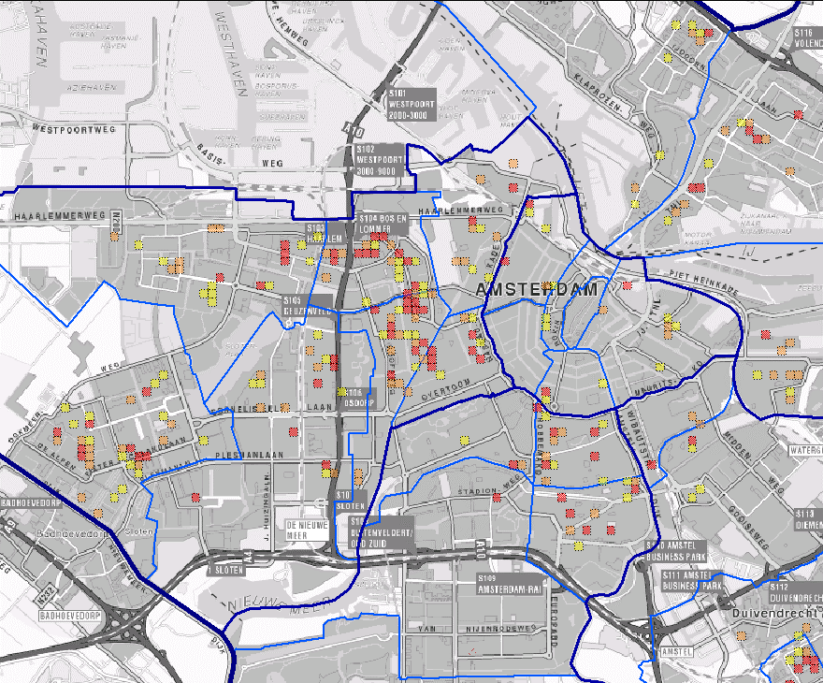

Slide 4

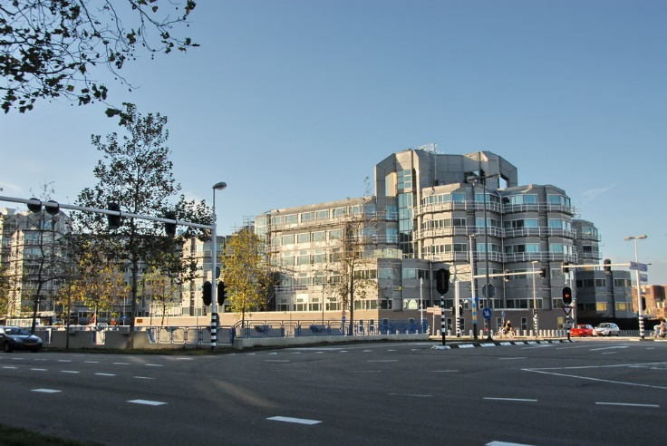

Slide 5
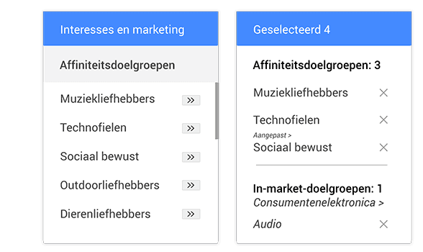
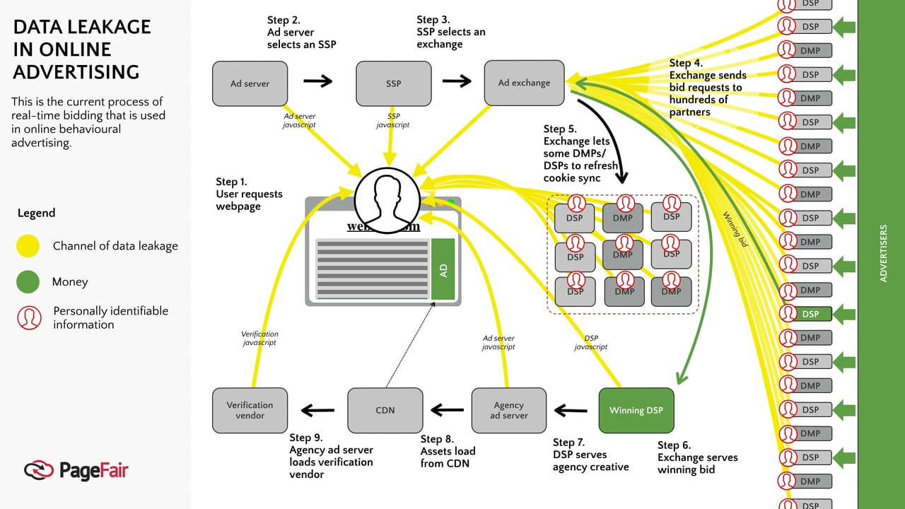

Slide 6


Slide 7

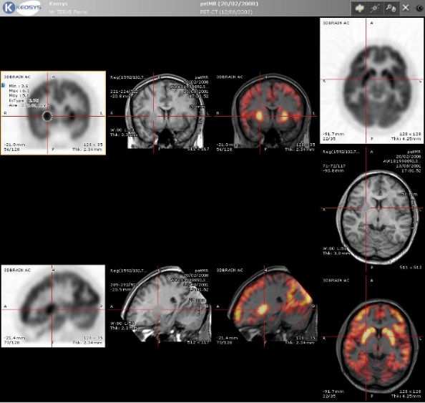
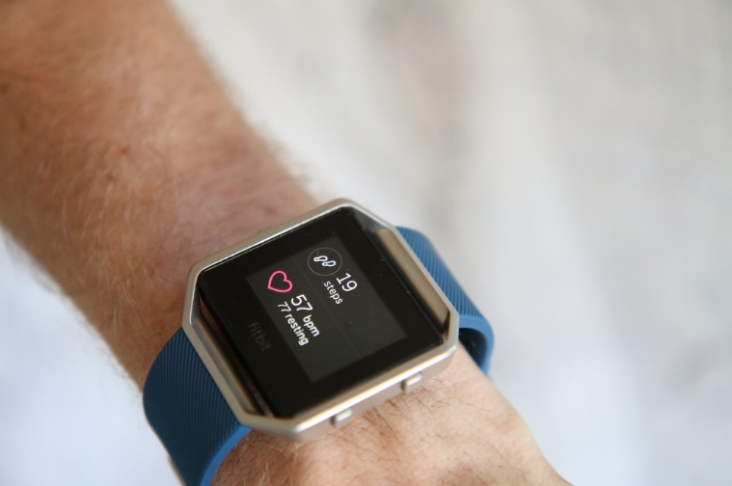

Slide 8

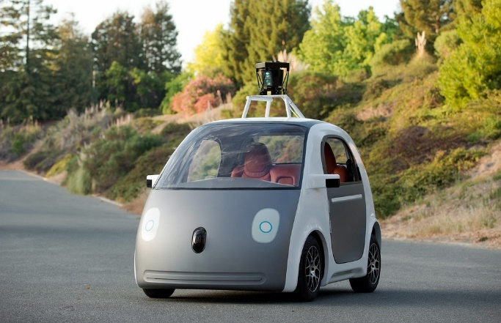


Slide 9
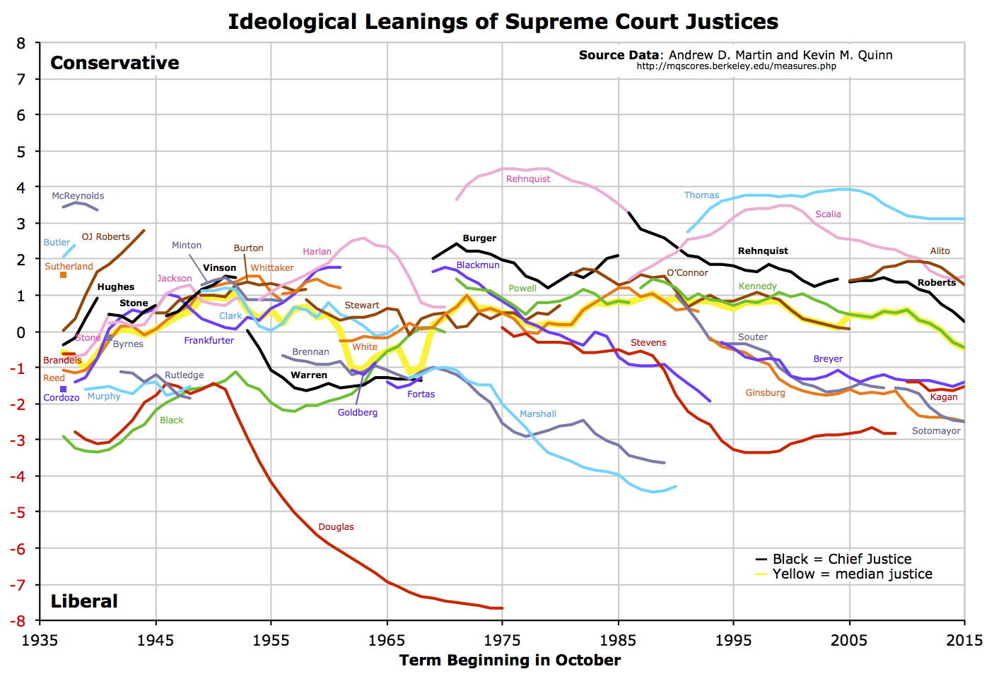

Slide 10
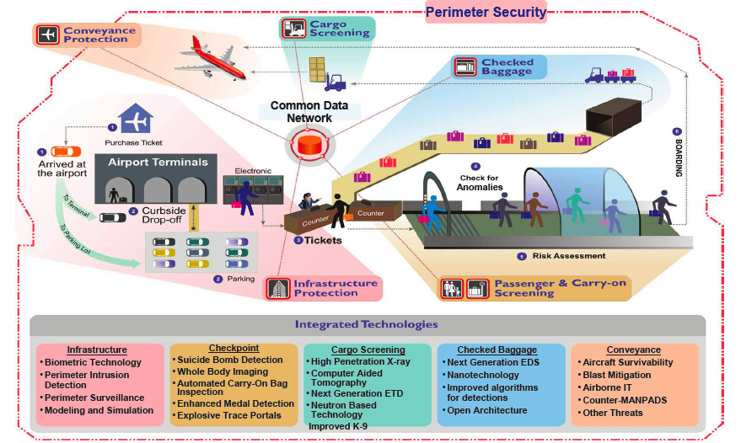
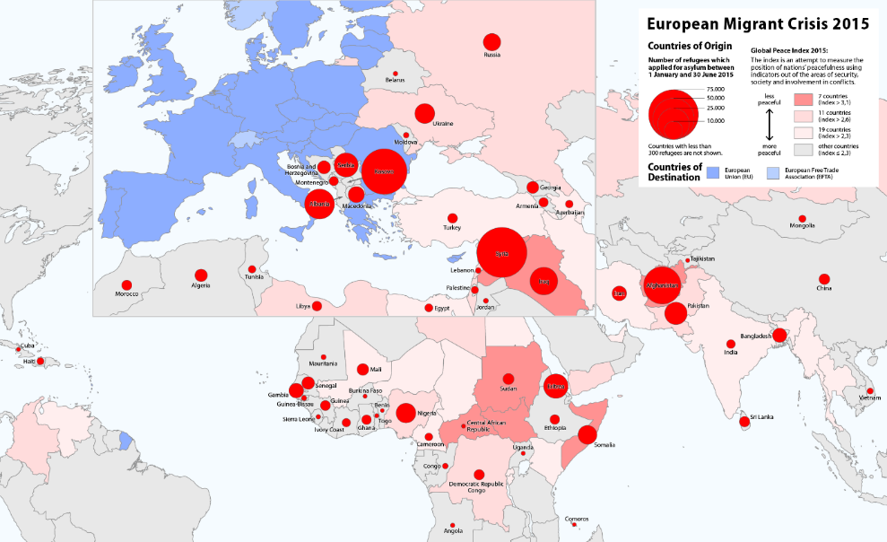

Slide 11
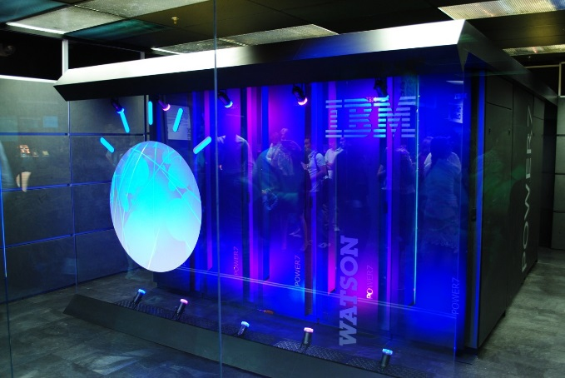

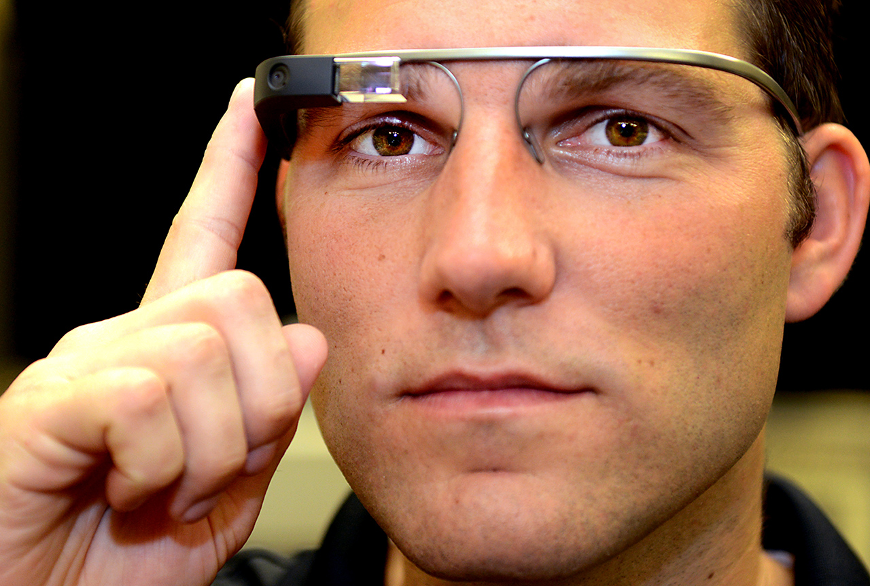

Slide 12
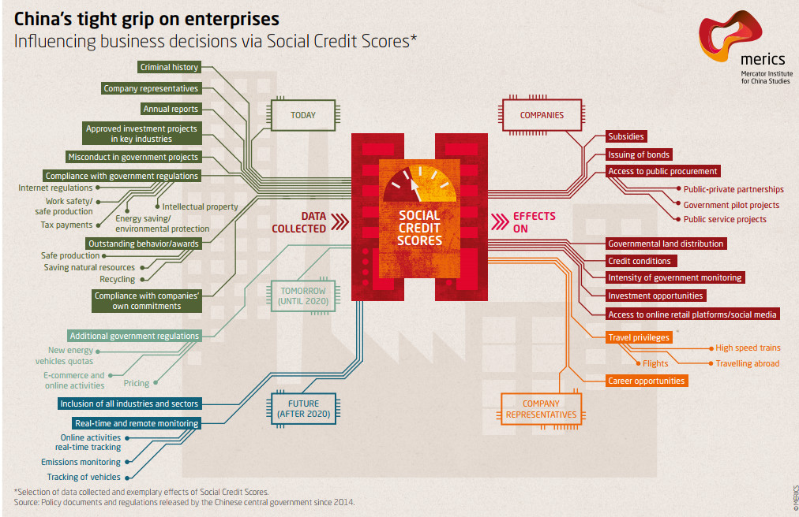

Slide 13
There is no uniform definition of Big Data
‘Big Data refers to the exponential growth both in the availability and in the automated use of information: it refers to gigantic digital datasets held by corporations, governments and other large organisations, which are then extensively analysed (hence the name: analytics100) using computer algorithms. Big Data can be used to identify more general trends and correlations but it can also be processed in order to directly affect individuals.’
Article 29 Working Party
‘Big Data is a term which refers to the enormous increase in access to and automated use of information. It refers to the gigantic amounts of digital data controlled by companies, authorities and other large organizations which are subjected to extensive analysis based on the use of algorithms. Big Data may be used to identify general trends and correlations, but it can also be used such that it affects individuals directly.’
International Working Group on Data Protection in Telecommunication
“Big Data means large amounts of different types of data produced at high speed from multiple sources, whose handling and analysis require new and more powerful processors and algorithms. Not all of these data are personal, but many players in the digital economy increasingly rely on the large scale collection of and trade in personal information. As well as benefits, these growing markets pose specific risks to individual’s rights to privacy and to data protection.’
European Data Protection Supervisor
“There are many definitions of ‘Big Data’ which may differ depending on whether you are a computer scientist, a financial analyst, or an entrepreneur pitching an idea to a venture capitalist. Most definitions reflect the growing technological ability to capture, aggregate, and process an ever-greater volume, velocity, and variety of data. In other words, ‘data is now available faster, has greater coverage and scope, and includes new types of observations and measurements that previously were not available.’
Podesta Report
“Big Data refers to datasets whose size is beyond the ability of typical database software tools to capture, store, manage and analyze.”
Het McKinsey Global Institute (2011: 1) http://ec.europa.eu/justice/data-protection/article-29/documentation/opinion-recommendation/

Slide 14
Big Data is defined “collected and processed open datasets, which are defined by quantity, plurality of data formats and data origination and processing speed.”
De autoriteit gegevensbescherming van Estland
“In August 2014, a definition of the term ‘Big Data’ was adopted by the French General Commission on terminology and neology (Commission générale de terminologie et de néologie). The official translation of this term in French is ‘mégadonnées’ and the definition is “data, structured or otherwise, whose very large volume require appropriate analytical tools.”
De autoriteit gegevensbescherming van Frankrijk
“Big Data stems from the collection of large structured or unstructured datasets, the possible merger of such datasets as well as the analysis of these data through computer algorithms. It usually refers to datasets which cannot be stored, managed and analysed with average technical means due to their size. Personal data can also be a part of Big Data but Big Data usually extends beyond that, containing aggregated and anonymous data.”
De autoriteit gegevensbescherming van Luxemburg
“Big Data is all about collecting as much information as possible; storing it in ever larger databases; combining data that is collected for different purposes; and applying algorithms to find correlations and unexpected new information.”
De autoriteit gegevensbescherming van Nederland
“Big Data is a broad term for processing of large amounts of different types of data, including personal data, acquired from multiple sources in various formats. Big Data revolves around predictive analytics – acquiring new knowledge from large data sets which requires new and more powerful processing applications.”
De autoriteit gegevensbescherming van Slovenië
Big Data is “repurposing data; using algorithms to find correlations in datasets rather than constructing traditional queries; and bringing together data from a variety of sources, including structured and unstructured data.”
De autoriteit gegevensbescherming van het Verenigd Koninkrijk
“the concept is used for situations where large amounts of data are gathered in order to be made available for different purposes, not always precisely determined in advance.”
De autoriteit gegevensbescherming van Zweden

Slide 16
Umbrella term
Open Data
Re-use
Internet of things
Smart applications
Profiling
Algorithms
Cloud Computing
Machine learning
Datafication
Commodification
Securitisation

Slide 17

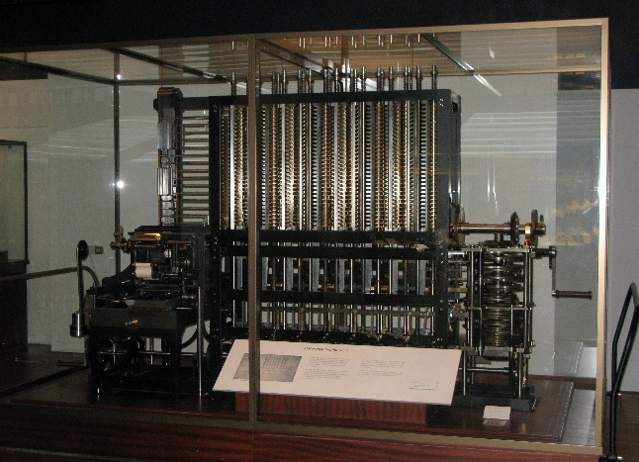


Slide 18
Fluid
Few data --------------------------------------- Many data
Few data sources --------------------------------------- Many data sources
Slow processing speed --------------------------------------- High processing speed

Slide 19
Three phases
Gathering
Analysing
Using

Slide 20
Ten principles
The more, the merrier:
Quantity over quality:
Dirty data is hot:
Old data is new data:
Gathering data is cheap, storing is cheaper, analysing is cheapest:
Correlation over causation:
Anything can say something about everything and everything can say something about anything:
The future is now:
No harm in trying:
No mountain too high:

Slide 21
Risks
Effectiveness
  Mass Surveillance
  Predictive Policing:
  Taxs authority: ‘Uit analyse van de 42 projecten in de Investeringsagenda-projectportfolio blijkt dat 36% van de projecten de status ‘vertraagd’ of ‘geannuleerd’ heeft. Als we meer in detail kijken naar wijzigingen van planningsdata (ook van inmiddels afgeronde projecten), dan blijkt dat bijna 60% van de projecten vertraging heeft opgelopen of is geannuleerd.’
  Reclames
  Google Flu

Slide 22
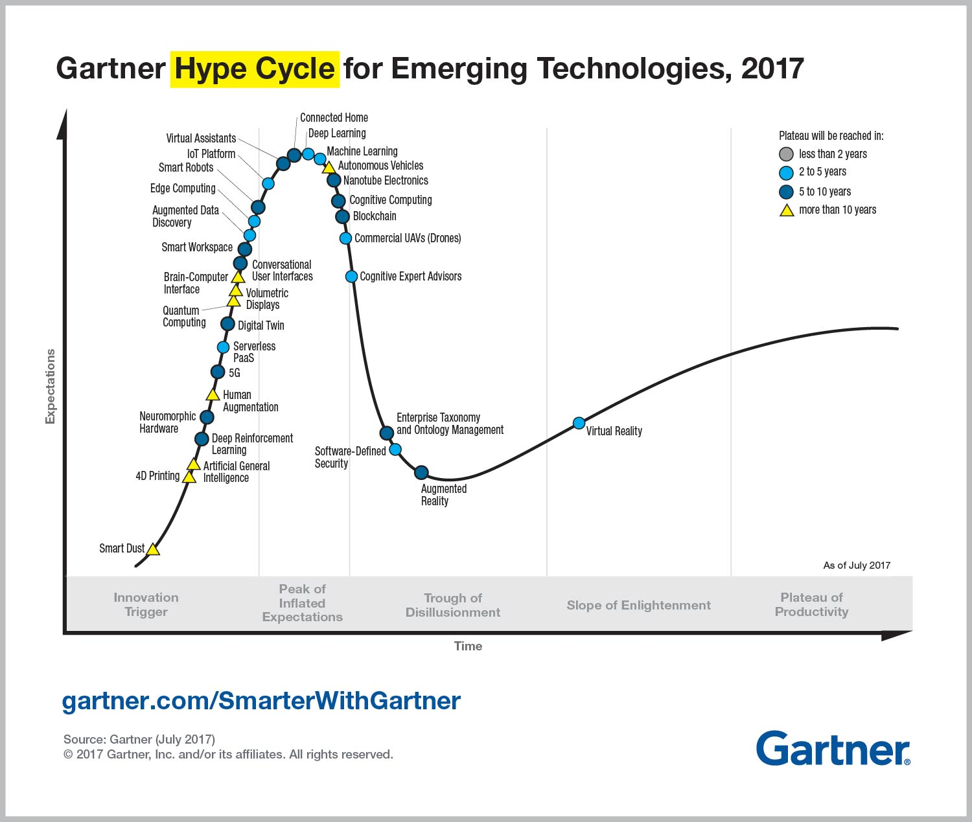

Slide 23
Data analytics
Data
Methodology
Open source
Algorithms
Updating datasets
No meta-data
Categorising data
Dirty data does not work
Correlation is not causality
No falsification

Slide 24
Predictions
Borges
Predictive
  Fals positives
  Fals negatives
Predictions become absolute

Slide 25
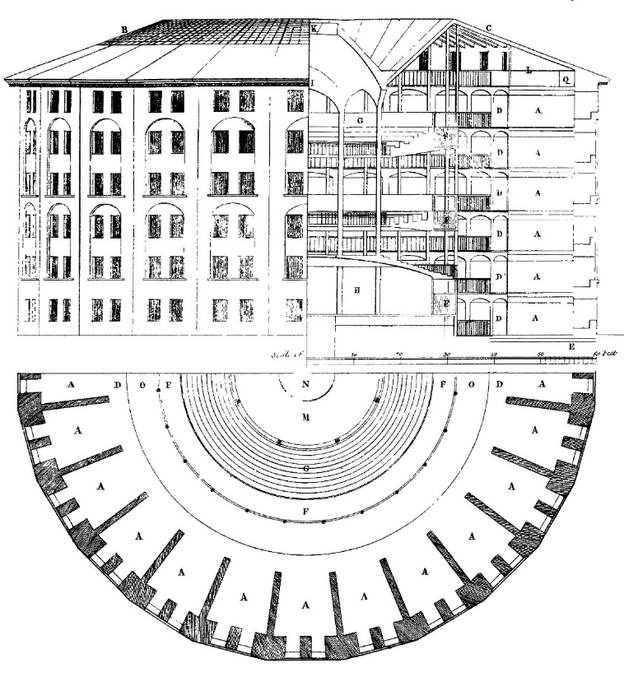

Slide 26
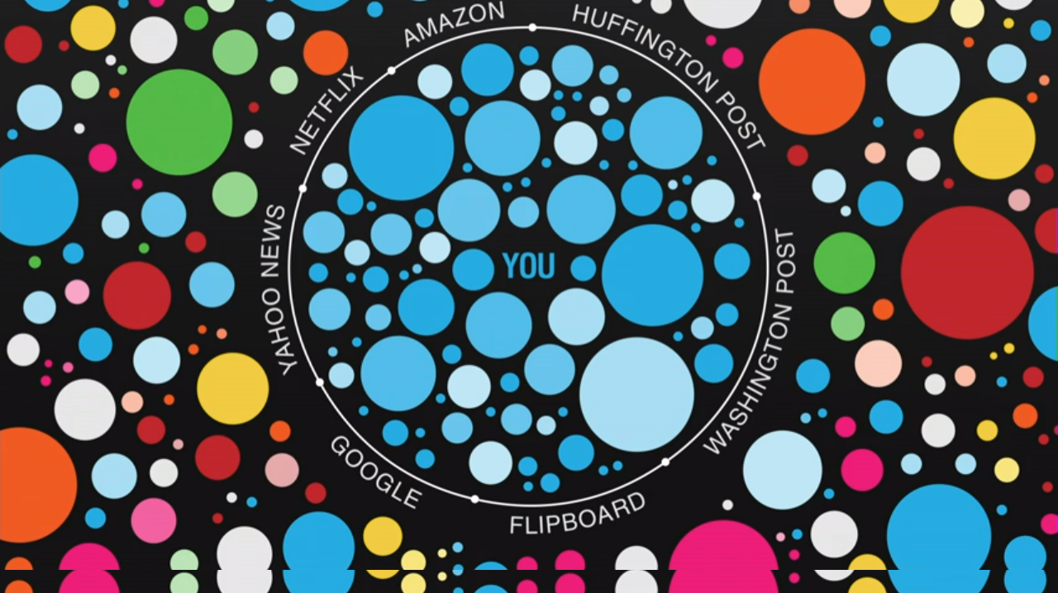

Slide 27


Slide 28


Slide 29


Slide 30
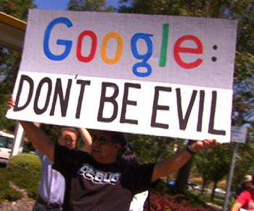



Slide 31

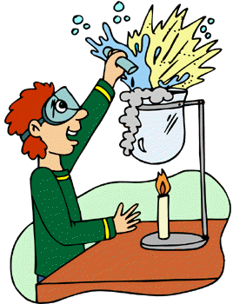

Slide 32
United Nations
OECD
Council of Europe
  European Convention on Human Rights 1950
  Convention for the Protection of Individuals with regard to Automatic Processing of Personal Data 1981
European Union
  Charter of Fundamental Rights 2000
  Data Protection Directive 1995 > General Data Protection Regulation 2016
  E-privacy Directive 2002 > amended in 2009

Slide 33
Ten misunderstandings about the GDPR
The GDPR aims at restricting data processing operations
The GDPR framework is complicated
The GDPR codifies new rules and obligations
The GDPR is about informed consent
If data are encrypted, the data protection framework does not apply
The GDPR is already outdated
The GDPR will hamper economic progress
The GDPR places an unfair burden on SMEs
Data protection infringements will lead to high fines
Data protection is privacy on steroids

Slide 34
Data Protection ≠ Privacy
EU Charter of Fundamental Rights
Article 7 Respect for private and family life
Everyone has the right to respect for his or her private and family life, home and communications.
Article 8 Protection of personal data
1. Everyone has the right to the protection of personal data concerning him or her.
2. Such data must be processed fairly for specified purposes and on the basis of the consent of the person concerned or some other legitimate basis laid down by law. Everyone has the right of access to data which has been collected concerning him or her, and the right to have it rectified.
3. Compliance with these rules shall be subject to control by an independent authority.

Slide 35
Personal data
Article 4 Definitions
For the purposes of this Regulation:
(1) ‘personal data’ means any information relating to an identified or identifiable natural person (‘data subject’); an identifiable natural person is one who can be identified, directly or indirectly, in particular by reference to an identifier such as a name, an identification number, location data, an online identifier or to one or more factors specific to the physical, physiological, genetic, mental, economic, cultural or social identity of that natural person;

Slide 36
Processing
Article 4 Definitions
For the purposes of this Regulation:
(2) ‘processing’ means any operation or set of operations which is performed on personal data or on sets of personal data, whether or not by automated means, such as collection, recording, organisation, structuring, storage, adaptation or alteration, retrieval, consultation, use, disclosure by transmission, dissemination or otherwise making available, alignment or combination, restriction, erasure or destruction;

Slide 37
Data controller
Article 4 Definitions
For the purposes of this Regulation:
(7) ‘controller’ means the natural or legal person, public authority, agency or other body which, alone or jointly with others, determines the purposes and means of the processing of personal data; where the purposes and means of such processing are determined by Union or Member State law, the controller or the specific criteria for its nomination may be provided for by Union or Member State law;

Slide 38
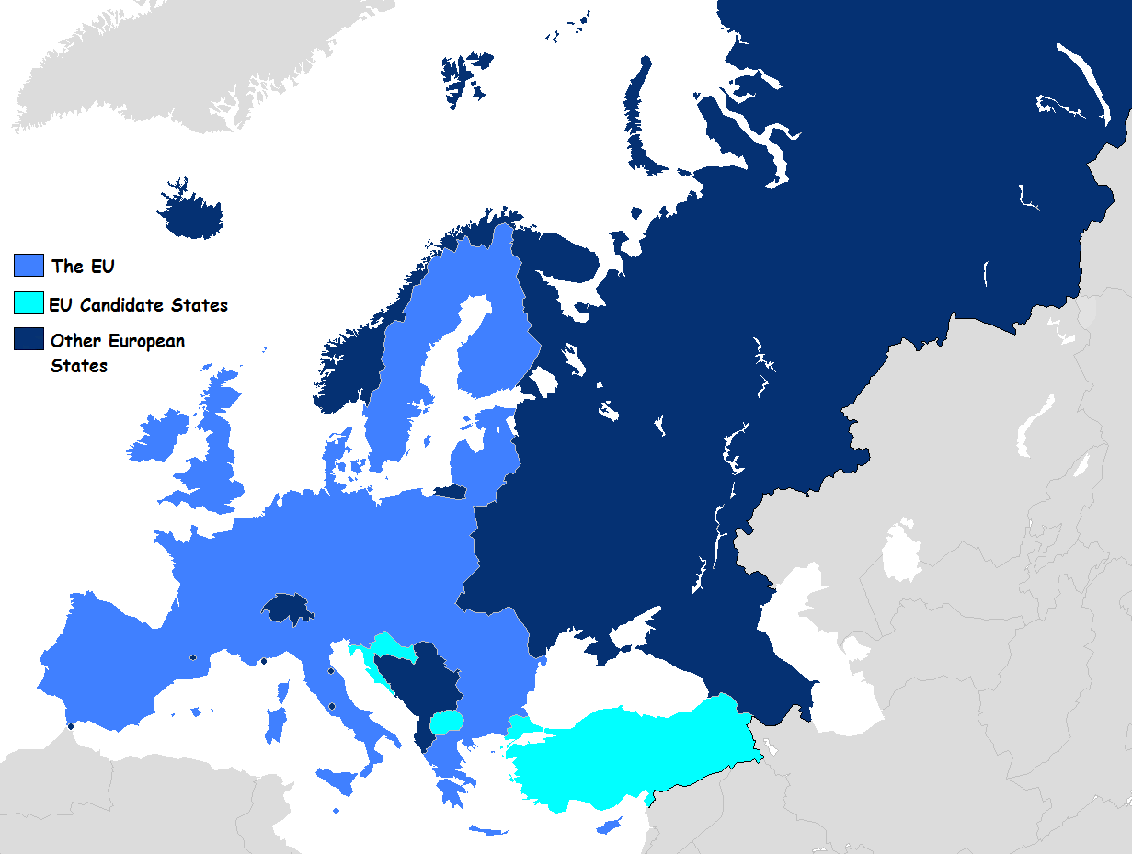
EU has competence

Slide 39
EU has competence
Article 3 Territorial scope
1.This Regulation applies to the processing of personal data in the context of the activities of an establishment of a controller or a processor in the Union, regardless of whether the processing takes place in the Union or not.
2.This Regulation applies to the processing of personal data of data subjects who are in the Union by a controller or processor not established in the Union, where the processing activities are related to:
(a) the offering of goods or services, irrespective of whether a payment of the data subject is required, to such data subjects in the Union; or
(b) the monitoring of their behaviour as far as their behaviour takes place within the Union.
3.This Regulation applies to the processing of personal data by a controller not established in the Union, but in a place where Member State law applies by virtue of public international law.

Slide 40
Exceptions
Article 2 Material scope
2.This Regulation does not apply to the processing of personal data:
(a) in the course of an activity which falls outside the scope of Union law;
(b) by the Member States when carrying out activities which fall within the scope of Chapter 2 of Title V of the TEU;
(c) by a natural person in the course of a purely personal or household activity;
(d) by competent authorities for the purposes of the prevention, investigation, detection or prosecution of criminal offences or the execution of criminal penalties, including the safeguarding against and the prevention of threats to public security.

Slide 41
GDPR requires prior legitimate purpose
Article 5 Principles relating to processing of personal data
1.Personal data shall be:
(a) processed lawfully, fairly and in a transparent manner in relation to the data subject (‘lawfulness, fairness and transparency’);
(b) collected for specified, explicit and legitimate purposes and not further processed in a manner that is incompatible with those purposes;

Slide 42
GDPR requires prior legitimate purpose
Article 6 Lawfulness of processing
1.Processing shall be lawful only if and to the extent that at least one of the following applies:
(a) the data subject has given consent to the processing of his or her personal data for one or more specific purposes;
(b) processing is necessary for the performance of a contract to which the data subject is party or in order to take steps at the request of the data subject prior to entering into a contract;
(c) processing is necessary for compliance with a legal obligation to which the controller is subject;
(d) processing is necessary in order to protect the vital interests of the data subject or of another natural person;
(e) processing is necessary for the performance of a task carried out in the public interest or in the exercise of official authority vested in the controller;
(f) processing is necessary for the purposes of the legitimate interests pursued by the controller or by a third party, except where such interests are overridden by the interests or fundamental rights and freedoms of the data subject which require protection of personal data, in particular where the data subject is a child. Point (f) of the first subparagraph shall not apply to processing carried out by public authorities in the performance of their tasks.

Slide 43
GDPR underlines data minimization
Article 5
1. Member States shall provide that personal data must be:
(c) adequate, relevant and limited to what is necessary in relation to the purposes for which they are processed (‘data minimisation’);

Slide 44
GDPR limits data storage
Article 5
1. Member States shall provide that personal data must be:
(e) kept in a form which permits identification of data subjects for no longer than is necessary for the purposes for which the personal data are processed; personal data may be stored for longer periods insofar as the personal data will be processed solely for archiving purposes in the public interest, scientific or historical research purposes or statistical purposes in accordance with Article 89(1) subject to implementation of the appropriate technical and organisational measures required by this Regulation in order to safeguard the rights and freedoms of the data subject (‘storage limitation’);

Slide 45
GDPR limmits re-use of data
Article 5 Principles relating to processing of personal data
1.Personal data shall be:
(b) collected for specified, explicit and legitimate purposes and not further processed in a manner that is incompatible with those purposes; further processing for archiving purposes in the public interest, scientific or historical research purposes or statistical purposes shall, in accordance with Article 89(1), not be considered to be incompatible with the initial purposes (‘purpose limitation’);

Slide 46
GDPR requires data accuracy
Article 5
1. Member States shall provide that personal data must be:
(d) accurate and, where necessary, kept up to date; every reasonable step must be taken to ensure that personal data that are inaccurate, having regard to the purposes for which they are processed, are erased or rectified without delay (‘accuracy’);

Slide 47
GDPR requires transparancy
Article 13 Information to be provided where personal data are collected from the data subject
1.Where personal data relating to a data subject are collected from the data subject, the controller shall, at the time when personal data are obtained, provide the data subject with all of the following information:
(a) the identity and the contact details of the controller and, where applicable, of the controller's representative;
(b) the contact details of the data protection officer, where applicable;
(c) the purposes of the processing for which the personal data are intended as well as the legal basis for the processing;
(d) where the processing is based on point (f) of Article 6(1), the legitimate interests pursued by the controller or by a third party;
(e) the recipients or categories of recipients of the personal data, if any;
(f) where applicable, the fact that the controller intends to transfer personal data to a third country or international organisation and the existence or absence of an adequacy decision by the Commission, or in the case of transfers referred to in Article 46 or 47, or the second subparagraph of Article 49(1), reference to the appropriate or suitable safeguards and the means by which to obtain a copy of them or where they have been made available.

Slide 48
GDPR requires transparancy
2.In addition to the information referred to in paragraph 1, the controller shall, at the time when personal data are obtained, provide the data subject with the following further information necessary to ensure fair and transparent processing:
(a) the period for which the personal data will be stored, or if that is not possible, the criteria used to determine that period;
(b) the existence of the right to request from the controller access to and rectification or erasure of personal data or restriction of processing concerning the data subject or to object to processing as well as the right to data portability;
(c) where the processing is based on point (a) of Article 6(1) or point (a) of Article 9(2), the existence of the right to withdraw consent at any time, without affecting the lawfulness of processing based on consent before its withdrawal;
(d) the right to lodge a complaint with a supervisory authority;
(e) whether the provision of personal data is a statutory or contractual requirement, or a requirement necessary to enter into a contract, as well as whether the data subject is obliged to provide the personal data and of the possible consequences of failure to provide such data;
(f) the existence of automated decision-making, including profiling, referred to in Article 22(1) and (4) and, at least in those cases, meaningful information about the logic involved, as well as the significance and the envisaged consequences of such processing for the data subject.

Slide 49
GDPR requires confidentiality and security
Article 5
1. Member States shall provide that personal data must be:
(f) processed in a manner that ensures appropriate security of the personal data, including protection against unauthorised or unlawful processing and against accidental loss, destruction or damage, using appropriate technical or organisational measures (‘integrity and confidentiality’).

Slide 50
GDPR prohibits in principle processing sensitive data
Article 9 Processing of special categories of personal data
1.Processing of personal data revealing racial or ethnic origin, political opinions, religious or philosophical beliefs, or trade union membership, and the processing of genetic data, biometric data for the purpose of uniquely identifying a natural person, data concerning health or data concerning a natural person's sex life or sexual orientation shall be prohibited.
2.Paragraph 1 shall not apply if one of the following applies: ………..

Slide 51
GDPR limits legitimacy of profiling
Article 22 Automated individual decision-making, including profiling
1.The data subject shall have the right not to be subject to a decision based solely on automated processing, including profiling, which produces legal effects concerning him or her or similarly significantly affects him or her.
2.Paragraph 1 shall not apply if the decision:
(a) is necessary for entering into, or performance of, a contract between the data subject and a data controller;
(b) is authorised by Union or Member State law to which the controller is subject and which also lays down suitable measures to safeguard the data subject's rights and freedoms and legitimate interests; or (c) is based on the data subject's explicit consent.
3.In the cases referred to in points (a) and (c) of paragraph 2, the data controller shall implement suitable measures to safeguard the data subject's rights and freedoms and legitimate interests, at least the right to obtain human intervention on the part of the controller, to express his or her point of view and to contest the decision.
4.Decisions referred to in paragraph 2 shall not be based on special categories of personal data referred to in Article 9(1), unless point (a) or (g) of Article 9(2) applies and suitable measures to safeguard the data subject's rights and freedoms and legitimate interests are in place.

Slide 52
GDPR limits data transfer
Article 44 General principle for transfers
Any transfer of personal data which are undergoing processing or are intended for processing after transfer to a third country or to an international organisation shall take place only if, subject to the other provisions of this Regulation, the conditions laid down in this Chapter are complied with by the controller and processor, including for onward transfers of personal data from the third country or an international organisation to another third country or to another international organisation. All provisions in this Chapter shall be applied in order to ensure that the level of protection of natural persons guaranteed by this Regulation is not undermined.

Slide 53
Big Data and privacy
Purpose specification - No predefined purpose
Purpose limmitation - Reuse of data
Data minimisation - The more the merrier
Confidentiality/security - Open Data
Restrictions on transfer - Sharing
Transprancy - Unclear who the data subjects are
Control rights - Individuals often do not know that their data are gathered
Personal data - Often does not revolve around personal data

