Slide 1
Trust in data-analytics
Bart van der Sloot
Senior Researcher
Tilburg University
www.bartvandersloot.com

Slide 2
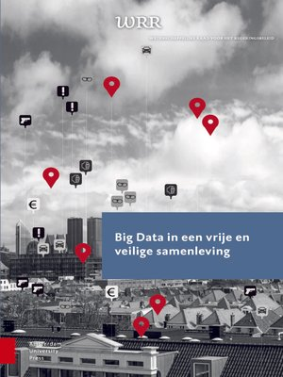
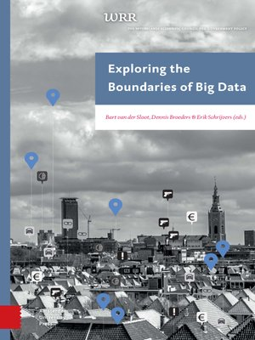

Slide 6
Trust through truth
Developing a hypothesis
Gathering data
Categorizing data
Updating data
Combining data
Falsification of hypothesis
N > 100
Correlation ≠ causality
Horizon-provision

