Slide 1
The right to be let alone … by yourself
Bart van der Sloot Senior Researcher Tilburg Institute for Law, Technology, and Society (TILT) Tilburg University, Netherlands
www.bartvandersloot.com

Slide 2
Common definitions of Privacy
‘These considerations lead to the conclusion that the protection afforded to thoughts, sentiments, and emotions, expressed through the medium of writing or of the arts, so far as it consists in preventing publication, is merely an instance of the enforcement of the more general right of the individual to be let alone. ’ Warren and Brandeis, 1890.
Privacy is the ‘claim of individuals, groups, or institutions to determine for themselves when, how, and to what extent information about them is communicated to others.’ Westin, 1967
‘Privacy is the capacity to negotiate social relationships by controlling access to information about oneself.’ Agre & Rotenberg, 1998.

Slide 3
Common definitions of Privacy
Constitutional protection of privacy in Europe: ‘Everyone has the right to respect for his private and family life, his home and his correspondence. There shall be no interference by a public authority with the exercise of this right except …’. Article 8 European Convention on Human Rights.
Horizontal protection of privacy in Europe: ‘Any person who has suffered material or non-material damage as a result of an infringement of this Regulation shall have the right to receive compensation from the controller or processor for the damage suffered.’ Article 82 General Data Protection Regulation.

Slide 4
Common definitions of Privacy: privacy can be invoked vis-a-vis others
Indivdiuals
Individual Companies
Government

Slide 5
The individual has a right only in so far it correlates with the duties of others and the other way around
Indivdiuals
Individual Companies
Government

Slide 6
Ways to problematize the correlation between rights (indvidual) and duties (others)
Indivdiuals
Individual Companies
Government

Slide 7
The individual has no legitimate claim to privacy (nothing to hide argument)
Indivdiuals
Individual Companies
Government

Slide 8
The individual’s claim to privacy is realy to conceal mischief towards others (e.g. feminist critique)
Indivdiuals
Individual Companies
Other individuals Government

Slide 9
The individual’s claim to privacy is in itself legitimate, but negatively effects others (network effect)
Indivdiuals
Individual Companies
Other individuals Government

Slide 10
Privacy is not about the individual(‘s interests) only, it is about a group of society as a whole
Indivdiuals
Individual Companies
Societal interest Government

Slide 11
The violation of the individual’s privacy is systemic, i.e. there is no concrete other
?
Individual ?
?

Slide 12
Others have (virtue) duties to protect the individual’s privacy, irrespective of rights
Indivdiuals
Individual Companies
Government

Slide 13
The individual has (virtue) duties to protect her own privacy
Individual
Herself

Slide 14
The right to be let alone …. by yourself
Individual
Herself

Slide 15
The right to be let alone …. by yourself

Slide 16
The right to be let alone …. by yourself

Slide 17
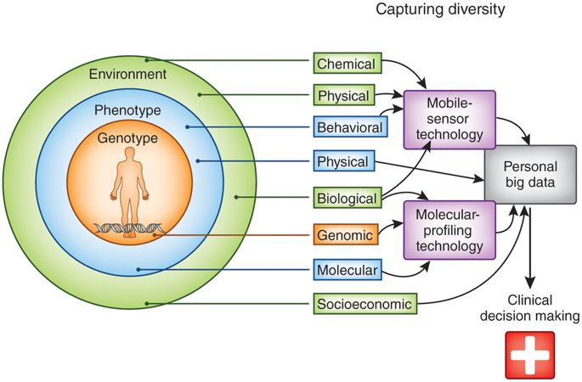
The right to be let alone …. by yourself

Slide 18
The right to be let alone …. by yourself
The problem here is self-conflict
The indivdiual/ the ‘I’ is not uniform/one > the Individual/the ‘I’ is conflicted, consists of different dissimalar parts of the self
Who we perceive as ‘I’, as our identity is a choice/it is the result of internal conflict
Forgetting, blocking and surpessing information about ourselves is an important instrument in identity formation
Privacy in this sense helps us building that identity
And allows us to recover and build a new identity/story about ourselves when we are unmasked

Slide 19
The right to be let alone …. by yourself

Slide 20
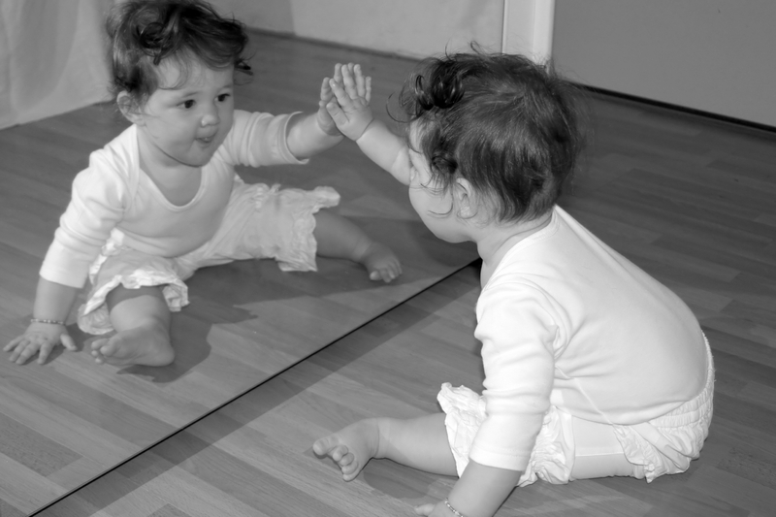
The right to be let alone …. by yourself

Slide 21
The right to be let alone …. by yourself

Slide 22
The right to be let alone …. by yourself
Big Data; profiling; inferred data; predictive analytics
Past: What is put on the internet stays on the internet; costs of storing data increasinly low.
Present: Increased possibilities to profile people; others claim to know the individual better then herself
Future: Profiling and predictive analytics can be used to map an individual’s future, as to health, economic well-being, etc.
A new problem arises: the problem is not (only) that other’s have (acces to) information about me that I do not want them to have
Others may have information about me which I myself do not want to have

Slide 23
The right to be let alone …. by yourself
A problem may be that I do not want the other to know:
I use to be obese/had a experimental gothic fase/was sexually abused/etc.
I can not help myself but eat chocolate/listen to Britney Spears/go to the casino/etc.
I will be sick/I have a high chance of being unemployed/etc.
But an additional problem may be that I myself do not want that:
I use to be obese/had a experimental gothic fase/was sexually abused/etc.
I can not help myself but eat chocolate/listen to Britney Spears/go to the casino/etc.
I will be sick/I have a high chance of being unemployed/etc.

Slide 24
The right to be let alone …. by yourself
Individual
Other Objects
Individual

Slide 25
The right to be let alone …. by yourself
The question is of course how we could envisage such a right
Building blocks could be
Right to be forgotten
Negative informational freedom
Right to be witheld from incidental findings (medical realm)
But granting a claim-right to an individual would mean precisely that she is still conciously engaged with that information she wants to block/surpress
And how can others have a duty not to communicate information about the individual that is true/valid/correct?

