Slide 1
Public Privacy: juridical & ethical perspective
Bart van der Sloot
Institute for Information Law
Amsterdam Platform for Privacy Research

Slide 2
Overview
1. What happens?
2. Personal data as currency?
3. Ethical/juridical restraints

Slide 3
What happens?

Slide 5
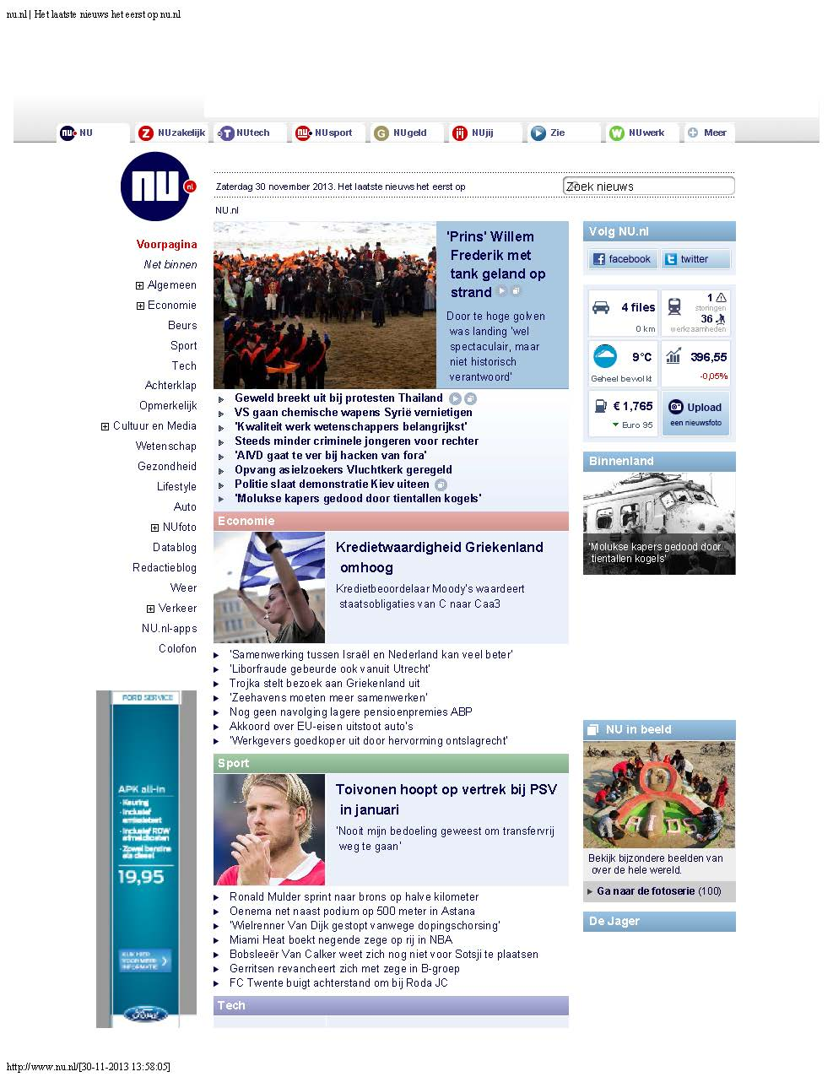

Slide 9
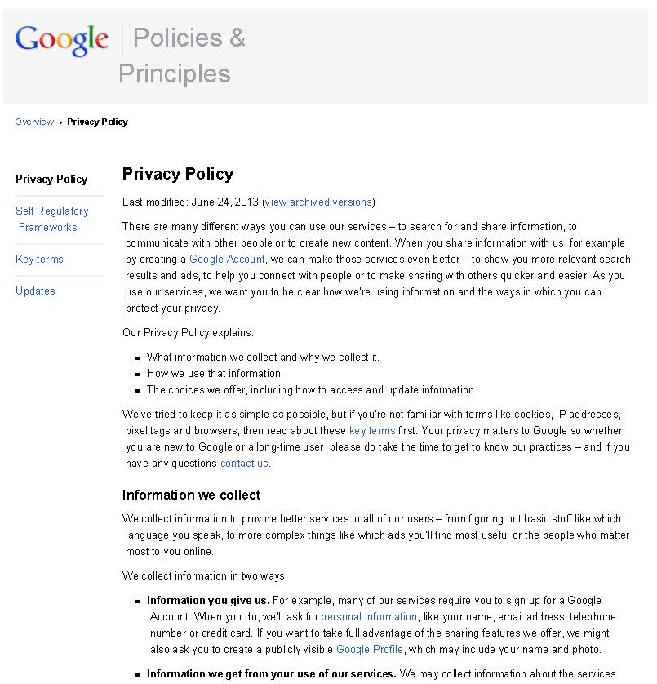

Slide 12
Personal data as currency?

Slide 13
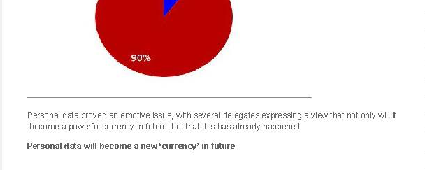
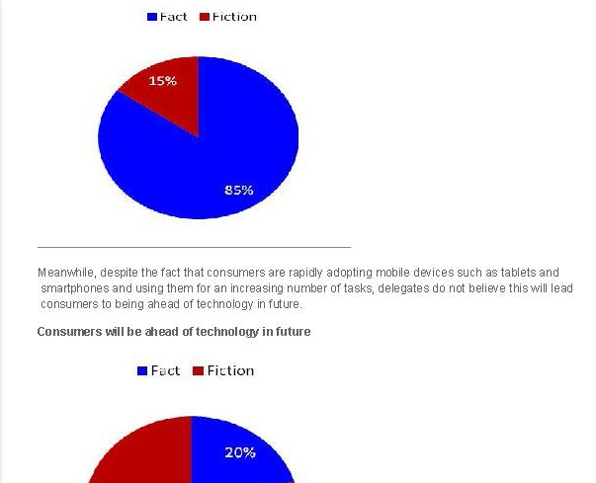

Slide 14
Data Protection Directive: Article 2 - Definitions
For the purposes of this Directive:
(a) 'personal data' shall mean any information relating to an identified or identifiable natural person ('data subject'); an identifiable person is one who can be identified, directly or indirectly, in particular by reference to an identification number or to one or more factors specific to his physical, physiological, mental, economic, cultural or social identity;

Slide 15
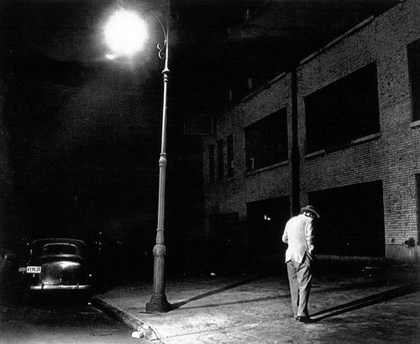

Slide 18
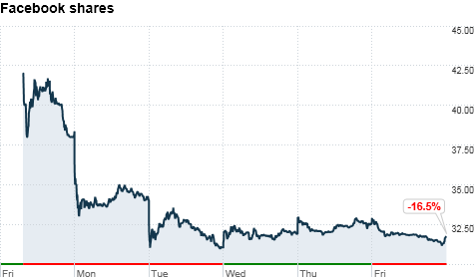
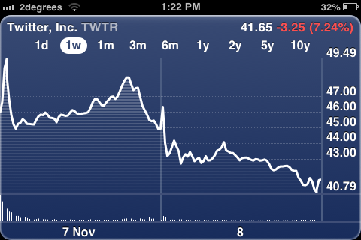

Slide 19
Ethical/juridical restraints

Slide 20
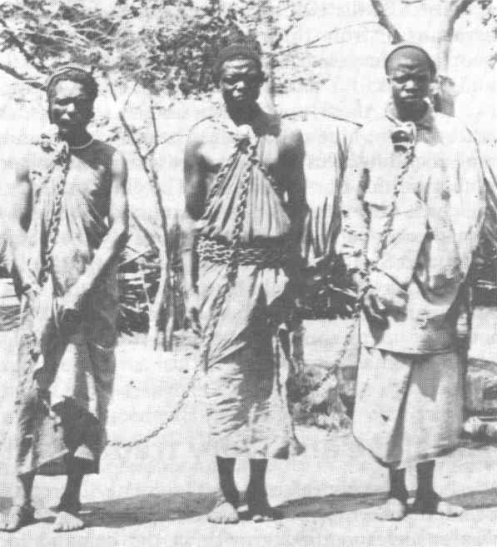

Slide 23
Data Protection Directive:
Article 7 Member States shall provide that personal data may be processed only if:
(a) the data subject has unambiguously given his consent;
Article 2 – Definitions
For the purposes of this Directive:
(h) 'the data subject's consent' shall mean any freely given specific and informed indication of his wishes by which the data subject signifies his agreement to personal data relating to him being processed.

Slide 24
Article 8
The processing of special categories of data
1. Member States shall prohibit the processing of personal data revealing racial or ethnic origin, political opinions, religious or philosophical beliefs, trade-union membership, and the processing of data concerning health or sex life.
2. Paragraph 1 shall not apply where:
(a) the data subject has given his explicit consent to the processing of those data, except where the laws of the Member State provide that the prohibition referred to in paragraph 1 may not be lifted by the data subject's giving his consent;
(e) the processing relates to data which are manifestly made public by the data subject or is necessary for the
establishment, exercise or defence of legal claims.

Slide 25
Data Protection Directive Article 6
1. Member States shall provide that personal data must be:
(a) processed fairly and lawfully;
(b) collected for specified, explicit and legitimate purposes and not further processed in a way incompatible with those purposes. Further processing of data for historical, statistical or scientific purposes shall not be considered as incompatible provided that Member States provide appropriate safeguards;
(c) adequate, relevant and not excessive in relation to the purposes for which they are collected and/or further processed;
(d) accurate and, where necessary, kept up to date; every reasonable step must be taken to ensure that data which are inaccurate or incomplete, having regard to the purposes for which they were collected or for which they are further processed, are erased or rectified;
(e) kept in a form which permits identification of data subjects for no longer than is necessary for the purposes for which the data were collected or for which they are further processed. Member States shall lay down appropriate safeguards for personal data stored for longer periods for historical, statistical or scientific use.

Slide 26
ARTICLE 8 ECHR
Everyone has the right to respect for his private and family life, his home and his correspondence.
There shall be no interference by a public authority with the exercise of this right except such as is in accordance with the law and is necessary in a democratic society in the interests of national security, public safety or the economic well-being of the country, for the prevention of disorder or crime, for the protection of health or morals, or for the protection of the rights and freedoms of others.

Slide 27
Civil Code: Article 3:40 Violation of law (statutes), public morality or public order
A juridical act that, by its content or necessary implications, violates public morality or public order, is null and void.
A juridical act that violates a statutory provision of mandatory law is null and void; yet, if this statutory provision merely intends to protect one of the parties to a more-sided (multilateral) juridical act, then such a juridical act is voidable, provided that this is in line with the underlying principle of the violated statutory provision.
The previous paragraph does not concern statutory provisions that do not purport to make a conflicting juridical act invalid.

Slide 28
Civil Code: Article 3:44 Defective will for performing a juridical act
A juridical act is voidable when it has been performed under the influence of threat, fraud or abuse of circumstances.
Threat is legally present when someone induces another person to perform a juridical act under the influence of an unlawful intimidation to hurt him or a third party in person or property. The threat must be of such a degree that reasonable evaluating people could have been influenced by it in a similar way.
Fraud is legally present when someone induces another person to perform a juridical act by deliberately making an incorrect statement, by deliberately concealing a fact that had to be revealed or by another artifice. However, generally described presentations or offers do not in itself result in fraud, even when they are incorrect.
Abuse of circumstances is legally present when someone who knows or should have known that another person might be induced to perform a juridical act because he is under the influence of particular circumstances, like a state of emergency, dependency, thoughtlessness, an addiction, an abnormal mental condition or inexperience, nevertheless has stimulated this other person to perform this juridical act, although what this someone knew or should have known, should have refrained him from doing so.
If a statement has been made under the influence of threat, fraud or abuse of circumstances caused by someone who is not a party to a juridical act, then it is not possible to appeal to this legal defect towards a counterparty who had no reason to assume that it existed.

Slide 29
Civil Code: Article 6:228 Fundamental mistake
An agreement which has been entered into under the influence of a mistake with regard to the facts or legal rights and which would not have been concluded by the mistaken party if he would have had a correct view of the situation, is voidable: a. if the mistake is caused by information given by the opposite party, unless this party could assume that the agreement would be concluded even without this information; b. if the opposite party, in view of what he knew or ought to have known about this mistake, should have informed the mistaken party about his error; c. if the opposite party, at the moment on which the agreement was entered into, had the same incorrect assumption as the mistaken party, unless he could have believed that the mistaken party, if this party had known the mistake, still would have entered into the agreement.
A nullification on the ground of a fundamental mistake cannot be based on a mistake which is exclusively related to a fact that, at the moment on which the agreement was entered into, still had to happen (fact in future) or that should remain for account of the mistaken party in view of the nature of the agreement, the general principles of society (common opinion) or the circumstances of the case.

