Slide 1
Proportionality and balancing under the ECHR
Bart van der Sloot
www.bartvandersloot.com

Slide 2
Agenda
Background
ECHR
Proportionality case law ECtHR
Balancing case law ECtHR
Conclusion

Slide 3
Background

Slide 4
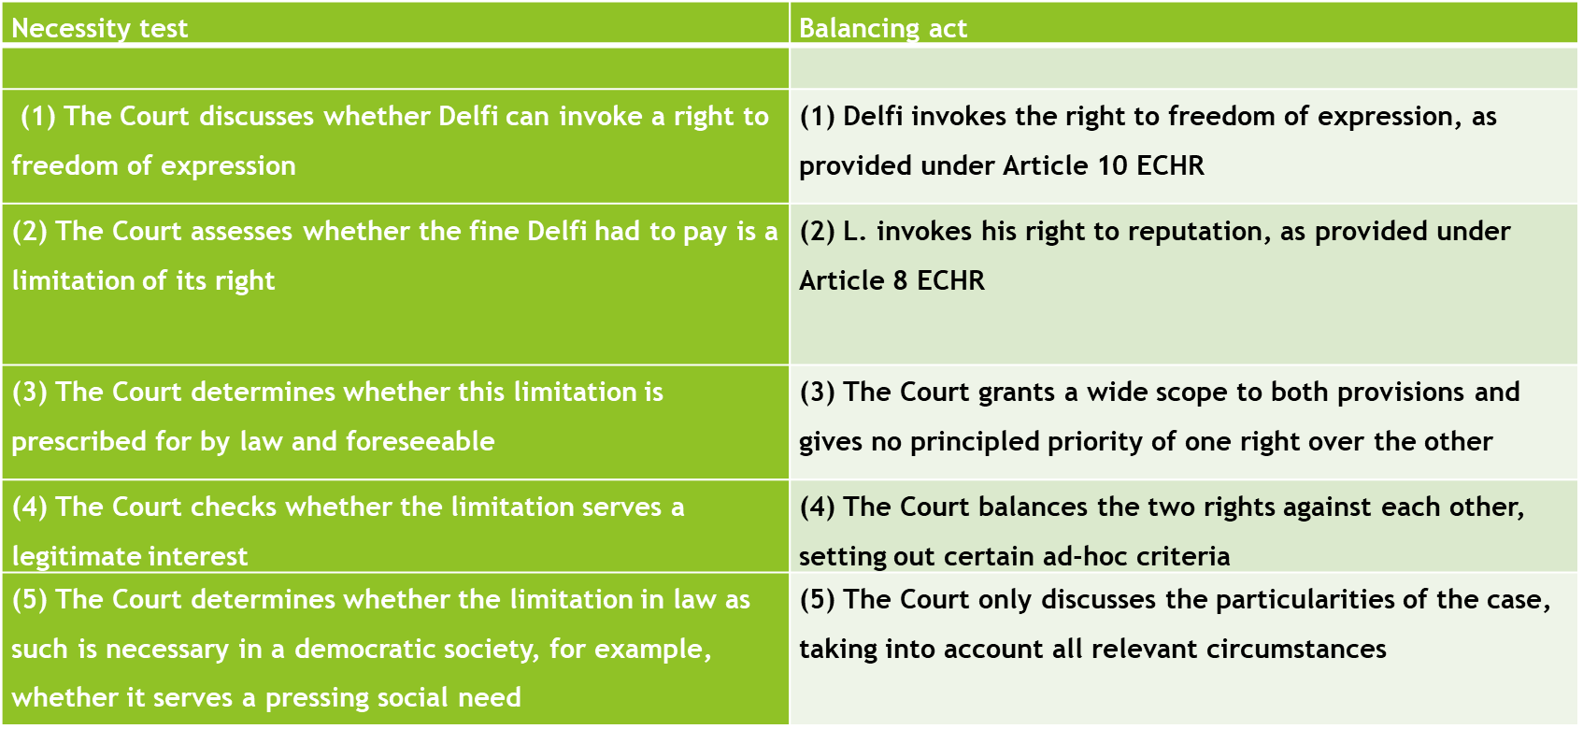
Delfi ECtHR (2013/2015)

Slide 5
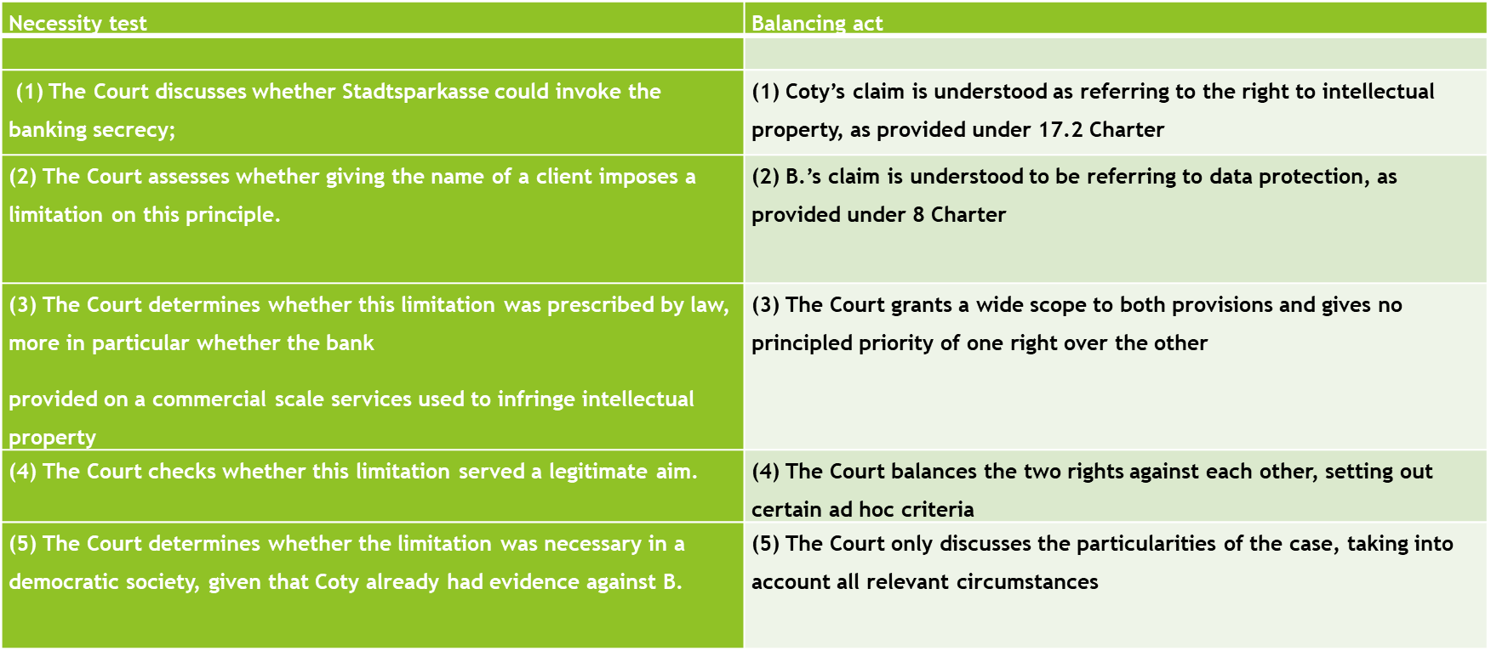
Coty CJEU 2015

Slide 6
Analysis
Necessity > Balancing
Vertical > Horizontal
Legal > Holistic
Objective > subjective
Minimum Standards > utilitarian thinking

Slide 7
Remarks I got
Human rights protection depend on necessity test
Necessity test entails a proportionality test
Proportionality test entails a balancing act

Slide 8
My intuition
Three tests are distinctly different
Necessity test does not per sé entail proportionality; proportionality test does not per sé entail balancing
Proportionality and balancing did not play a role when adopting the ECHR, but were introduced by the ECtHR
Why are proportionality and balancing so much discussed in privacy and data protection field?

Slide 9
Necessity, Proportionality and Balancing in the ECHR

Slide 10
The ECHR
Proposal I
Art 1 = list of rights
Art 3: The rights specified in Articles 1 and 2 shall be subject only to such limitations as are in conformity with the general principles of law recognized by civilized nations and as are prescribed by law for:
Protecting the legal rights of others;
Meeting the just requirements of morality, public order (including the safety of the community), and general welfare.
Proposal II
Current version: precise definition;
Included reference to necessity
Favored if no Court
What does necessity mean: little discussion, seems more restrictive, but TP also suggest that the precise definition lays down clearly the discretionary power of governments
No reference to proportionality
No reference to balancing

Slide 11
The ECHR
Court optional
Interstate complaints; no right individual to go to Court
This bears on the necessity test
Prevent abuse of power
Negative obligations
Negative rights
Civil and political rights
Socio-Economic rights moved to Protocol
Protocol optional

Slide 12
The ECHR
Article 8 (2) | Article 9 (2) | Article 10 (2) | Article 11 (2) | Article 6 (1) | Article 15 (1) | Article 2 (2)
There shall be no interference by a public authority with the exercise of this right except such as is in accordance with the law and is necessary in a democratic society in the interests of national security, public safety or the economic well-being of the country, for the prevention of disorder or crime, for the protection of health or morals, or for the protection of the rights and freedoms of others. | Freedom to manifest one’s religion or beliefs shall be subject only to such limitations as are prescribed by law and are necessary in a democratic society in the interests of public safety, for the protection of public order, health or morals, or for the protection of the rights and freedoms of others. | The exercise of these freedoms, since it carries with it duties and responsibilities, may be subject to such formalities, conditions, restrictions or penalties as are prescribed by law and are necessary in a democratic society, in the interests of national security, territorial integrity or public safety, for the prevention of disorder or crime, for the protection of health or morals, for the protection of the reputation or rights of others, [] | No restrictions shall be placed on the exercise of these rights other than such as are prescribed by law and are necessary in a democratic society in the interests of national security or public safety, for the prevention of disorder or crime, for the protection of health or morals or for the protection of the rights and freedoms of others. [] | [] Judgment shall be pronounced publicly but the press and public may be excluded from all or part of the trial in the interests of morals, public order or national security in a democratic society, where the interests of juveniles or the protection of the private life of the parties so require, or to the extent strictly necessary in the opinion of the court in special circumstances where publicity would prejudice the interests of justice. | In time of war or other public emergency threatening the life of the nation any High Contracting Party may take measures derogating from its obligations under this Convention to the extent strictly required by the exigencies of the situation, provided that such measures are not inconsistent with its other obligations under international law. | 2. Deprivation of life shall not be regarded as inflicted in contravention of this Article when it results from the use of force which is no more than absolutely necessary: (a) in defence of any person from unlawful violence; (b) in order to effect a lawful arrest or to prevent the escape of a person lawfully detained; (c) in action lawfully taken for the purpose of quelling a riot or insurrection.

Slide 13
The ECHR
Article 5 (1) | Article 14 | Article P1-1 | Article P1-2
Everyone has the right to liberty and security of person. No one shall be deprived of his liberty save in the following cases and in accordance with a procedure prescribed by law: (a) the lawful detention of a person after conviction by a competent court; (b) the lawful arrest or detention of a person for non-compliance with the lawful order of a court or in order to secure the fulfilment of any obligation prescribed by law; (c) the lawful arrest or detention of a person effected for the purpose of bringing him before the competent legal authority on reasonable suspicion of having committed an offence or when it is reasonably considered necessary to prevent his committing an offence or fleeing after having done so; (d) the detention of a minor by lawful order for the purpose of educational supervision or his lawful detention for the purpose of bringing him before the competent legal authority; (e) the lawful detention of persons for the prevention of the spreading of infectious diseases, of persons of unsound mind, alcoholics or drug addicts or vagrants; (f) the lawful arrest or detention of a person to prevent his effecting an unauthorised entry into the country or of a person against whom action is being taken with a view to deportation or extradition. | The enjoyment of the rights and freedoms set forth in this Convention shall be secured without discrimination on any ground such as sex, race, colour, language, religion, political or other opinion, national or social origin, association with a national minority, property, birth or other status. | Every natural or legal person is entitled to the peaceful enjoyment of his possessions. No one shall be deprived of his possessions except in the public interest and subject to the conditions provided for by law and by the general principles of international law. The preceding provisions shall not, however, in any way impair the right of a State to enforce such laws as it deems necessary to control the use of property in accordance with the general interest or to secure the payment of taxes or other contributions or penalties. | No person shall be denied the right to education. In the exercise of any functions which it assumes in relation to education and to teaching, the State shall respect the right of parents to ensure such education and teaching in conformity with their own religious and philosophical convictions.

Slide 14
Proportionality in the case law of the ECtHR 1950-1990

Slide 15
Belgian Linguistic Case 1968
5. The right to education guaranteed by the first sentence of Article 2 of the Protocol (P1-2) by its very nature calls for regulation by the State, regulation which may vary in time and place according to the needs and resources of the community and of individuals. It goes without saying that such regulation must never injure the substance of the right to education nor conflict with other rights enshrined in the Convention.
The Court considers that the general aim set for themselves by the Contracting Parties through the medium of the European Convention on Human Rights, was to provide effective protection of fundamental human rights, and this, without doubt not only because of the historical context in which the Convention was concluded, but also of the social and technical developments in our age which offer to States considerable possibilities for regulating the exercise of these rights. The Convention therefore implies a just balance between the protection of the general interest of the Community and the respect due to fundamental human rights while attaching particular importance to the latter.

Slide 16
Belgian Linguistic Case 1968
7. According to the express terms of Article 8 (1) (art. 8-1) of the Convention, "everyone has the right to respect for his private and family life, his home and his correspondence".
This provision by itself in no way guarantees either a right to education or a personal right of parents relating to the education of their children: its object is essentially that of protecting the individual against arbitrary interference by the public authorities in his private family life.
However, it is not to be excluded that measures taken in the field of education may affect the right to respect for private and family life or derogate from it; this would be the case, for instance, if their aim or result were to disturb private or family life in an unjustifiable manner, inter alia by separating children from their parents in an arbitrary way.
As the Court has already emphasised, the Convention must be read as a whole. Consequently a matter specifically dealt with by one of its provisions may also, in some of its aspects, be regulated by other provisions of the Convention.

Slide 17
Belgian Linguistic Case 1968
8. According to Article 14 (art. 14) of the Convention, the enjoyment of the rights and freedoms set forth therein shall be secured without discrimination ("sans distinction aucune") on the ground, inter alia, of language; and by the terms of Article 5 of the Protocol (P1-5), this same guarantee applies equally to the rights and freedoms set forth in this instrument. It follows that both Article 2 of the Protocol (P1-2) and Article 8 (art. 8) of the Convention must be interpreted and applied by the Court not only in isolation but also having regard to the guarantee laid down in Article 14 (art. 14+P1-2, art. 14+8).

Slide 18
Belgian Linguistic Case 1968
It is important, then, to look for the criteria which enable a determination to be made as to whether or not a given difference in treatment, concerning of course the exercise of one of the rights and freedoms set forth, contravenes Article 14 (art. 14). On this question the Court, following the principles which may be extracted from the legal practice of a large number of democratic States, holds that the principle of equality of treatment is violated if the distinction has no objective and reasonable justification. The existence of such a justification must be assessed in relation to the aim and effects of the measure under consideration, regard being had to the principles which normally prevail in democratic societies. A difference of treatment in the exercise of a right laid down in the Convention must not only pursue a legitimate aim: Article 14 (art. 14) is likewise violated when it is clearly established that there is no reasonable relationship of proportionality between the means employed and the aim sought to be realised.

Slide 19
Belgian Linguistic Case 1968
The enjoyment of the right to education as the Court conceives it, and more precisely that of the right of access to existing schools, is not therefore on the point under consideration secured to everyone without discrimination on the ground, in particular, of language. In other words, the measure in question is, in this respect, incompatible with the first sentence of Article 2 of the Protocol, read in conjunction with Article 14 (art. 14+P1-2) of the Convention. In these circumstances, the Court does not consider it necessary to examine whether the said measure respects Article 8 (art. 8) of the Convention, read in conjunction with Article 14 (art. 14+8) or in isolation.

Slide 20
SVENSKA 1974
VI . Proportionality Finally, there appears to be no contravention of the principle of proportionality between the effects of the measures under consideration and the aim sought to be realised. The Commission recalls in this respect that the applicant participates effectively in regular consultations . Due tc its independent status and its specialised structure, it h«s some influence on the determination of the working conditions of its members . Pioreover, its members have free access to the civil and administrative courts . In the light o- this situation, the rest~ictions imposed upon it do not seem to be out of proportion with the legitimate aim of centralisation which may be considered by the State as an overriding interest .
96 . It may be added that the Freedom of Association Committee of the ILO, when examining legislative restrictions of the capacity to bargain collectively, has corisistently accepted distinctions in this respect based on the degree of representativeness, provided that objective and pre-established criteria were a-oplied in the determination of representativenes s. The policy at issue in the present case would therefore conform to ILO standards even if it were implemented by legislative measures .
VII . Con clusion . The different treatment of the applicant and the federations with regard to the enjoyment of the freedom of association is reasonably and objectively justified and does not therefore contravene Art . 11 read in conjunction with Art . 14 .

Slide 21
Handyside 1976
These observations apply, notably, to Article 10 para. 2 (art. 10-2). In particular, it is not possible to find in the domestic law of the various Contracting States a uniform European conception of morals. The view taken by their respective laws of the requirements of morals varies from time to time and from place to place, especially in our era which is characterised by a rapid and far-reaching evolution of opinions on the subject. By reason of their direct and continuous contact with the vital forces of their countries, State authorities are in principle in a better position than the international judge to give an opinion on the exact content of these requirements as well as on the "necessity" of a "restriction" or "penalty" intended to meet them. The Court notes at this juncture that, whilst the adjective "necessary", within the meaning of Article 10 para. 2 (art. 10-2), is not synonymous with "indispensable" (cf., in Articles 2 para. 2 (art. 2-2) and 6 para. 1 (art. 6-1), the words "absolutely necessary" and "strictly necessary" and, in Article 15 para. 1 (art. 15-1), the phrase "to the extent strictly required by the exigencies of the situation"), neither has it the flexibility of such expressions as "admissible", "ordinary" (cf. Article 4 para. 3) (art. 4-3), "useful" (cf. the French text of the first paragraph of Article 1 of Protocol No. 1) (P1-1), "reasonable" (cf. Articles 5 para. 3 and 6 para. 1) (art. 5-3, art. 6-1) or "desirable". Nevertheless, it is for the national authorities to make the initial assessment of the reality of the pressing social need implied by the notion of "necessity" in this context.

Slide 22
Handyside 1976
The Court's supervisory functions oblige it to pay the utmost attention to the principles characterising a "democratic society". Freedom of expression constitutes one of the essential foundations of such a society, one of the basic conditions for its progress and for the development of every man. Subject to paragraph 2 of Article 10 (art. 10-2), it is applicable not only to "information" or "ideas" that are favourably received or regarded as inoffensive or as a matter of indifference, but also to those that offend, shock or disturb the State or any sector of the population. Such are the demands of that pluralism, tolerance and broadmindedness without which there is no "democratic society". This means, amongst other things, that every "formality", "condition", "restriction" or "penalty" imposed in this sphere must be proportionate to the legitimate aim pursued.
From another standpoint, whoever exercises his freedom of expression undertakes "duties and responsibilities" the scope of which depends on his situation and the technical means he uses. The Court cannot overlook such a person's "duties" and "responsibilities" when it enquires, as in this case, whether "restrictions" or "penalties" were conducive to the "protection of morals" which made them "necessary" in a "democratic society".

Slide 23
Handyside 1976
Finally, at the hearing on 5 June 1976, the delegate expounding the opinion of the minority of the Commission maintained that in any event the respondent State need not have taken measures as Draconian as the initiation of criminal proceedings leading to the conviction of Mr. Handyside and to the forfeiture and subsequent destruction of the Schoolbook. The United Kingdom was said to have violated the principle of proportionality, inherent in the adjective "necessary", by not limiting itself either to a request to the applicant to expurgate the book or to restrictions on its sale and advertisement.
With regard to the first solution, the Government argued that the applicant would never have agreed to modify the Schoolbook if he had been ordered or asked to do so before 1 April 1971: was he not strenuously disputing its "obscenity"? The Court for its part confines itself to finding that Article 10 (art. 10) of the Convention certainly does not oblige the Contracting States to introduce such prior censorship.
59. On the strength of the data before it, the Court thus reaches the conclusion that no breach of the requirements of Article 10 (art. 10) has been established in the circumstances of the present case.

Slide 24
Confirmed in Sunday Times

Slide 25
X. v. Austria 1978
The finding that the forfeiture of smuggled goods is a measure which as such comes under the scope of Article 1(2) of the Protocol does not , however, bring it wholly outside the Commission's control . The correct application of Article 1 (2) of the Protocol like that of any other provision of the Convention is in principle subject to the supervision of the Convention organs. This supervision includes, apart from the examination whether a certain measure is of such a kind that it can at all be reasonably considered as necessary for one of the purposes enumerated in the Article, an examination whether its application in the concrete case is not grossly disproportionate to its aim.

Slide 26
Sporrong 1979
The Commission will now turn to the question whether or not th e length of time during which the expropriation permits and the prohibition on construction have been in force without being used, can be considered as amounting to an interference with the applicants' right to peaceful enjoyment of their possessions as guaranteed by the first sentence of the first paragraph of Article 1 of the Protocol . Any such interference by way of a limitation on the use of the property question would then have to be considered by the Commission under the second paragraph of Article 1 of the Protocol and could only be justified on the conditions set out therein . In connection with such an examination the Commission might also have to consider Articles 17 and 18 of the Convention . The Commission observes that while the necessity for such legislation seems to be left to the discretion of the State, Article 1 appears to provide for a limited supervision of the enforcement measures as regards their lawfulness and purpose. Even where their lawfulness is beyohd doubt and the purpose at the outset appears legitimate, the question may ârise whether the prolonged existence of restrictions amounts to an interference which could become ûnjustified as going beyond or being disproportionate to their legitimate purpose . However, the Commission considers that these questions thus arising under Article 1 of the Protocol No: 1 taken either alone or in conjunction with Articles 17 and 18 of the Convention are complex questions concerning the interpretation of the Convention, the determination of which should depend on an examination of the merits of the case . It follows that this part of the applications cannot be regarded as manifestly ill-founded within the meaning of Article 27 121 of the Convention and must therefore be declared admissible, no other ground for declaring them inadmssible having been established .

Slide 30
Conclusions Proportionality
Proportionality did not arise from necessity
Proportionality was brought in via the protocol
Proportionality had a largely economic background (positive obligation + P1-1)
Article 8 ECHR was the perfect vehicle

Slide 32
Strict Proportionality
STEWART 1984 > Art 2
CHAVE née JULLIEN 1991 > art 8

Slide 34
Balancing in the case law of the ECtHR 1950-1990

Slide 35
Balancing
Belgian Linguistic case 1968 P1-2
Kjeldsen et al. 1975 P1-2 > Commission copies the same balancing language to Article 8 ECHR
Sunday Times 1975 & Handyside 1975
Klass 1978 > 8
Until 1980 just 8 cases
Mostly invoked by governments
Sporong P1-1 1980
Young et al. 1981 applied to 11 ECHR

Slide 38
Conclusions balancing
Brought in through protocol
Used primarily in economic cases (P1-1 + positive obligations)
Article 8 ECHr perfect vehicle

Slide 39
Thanks!

