Slide 1
Is privacy research objective?
Bart van der Sloot
Institute for Information Law, UvA
Amsterdam Platform for Privacy Research
Scientific Council for Government Policy

Slide 2
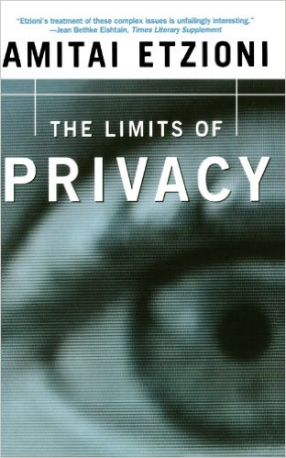
Amsterdam Privacy Conference
Sponsors
NRC: “Conferenties organiseren is duur, dus moeten ook privacyvoorvechters soms pragmatisch zijn. “
Speakers

Slide 3
Are privacy researchers neutral?
Two tendencies in privacy research
Giving policy advise
Defending privacy

Slide 4
Academics against mass surveillance
Last summer it was revealed, largely thanks to Edward Snowden, that American and European intelligence services are engaging in mass surveillance of hundreds of millions of people.
Intelligence agencies monitor people's Internet use, obtain their phone calls, email messages, Facebook entries, financial details, and much more. Agencies have also gathered personal information by accessing the internal data flows of firms such as Google and Yahoo. Skype calls are "readily available" for interception. Agencies have purposefully weakened encryption standards - the same techniques that should protect our online banking and our medical files. These are just a few examples from recent press reports. In sum: the world is under an unprecedented level of surveillance.
This has to stop.

Slide 5
Academics against mass surveillance
The right to privacy is a fundamental right. It is protected by international treaties, including the International Covenant on Civil and Political Rights and the European Convention on Human Rights. Without privacy people cannot freely express their opinions or seek and receive information. Moreover, mass surveillance turns the presumption of innocence into a presumption of guilt. Nobody denies the importance of protecting national security, public safety, or the detection of crime. But current secret and unfettered surveillance practices violate fundamental rights and the rule of law, and undermine democracy.
The signatories of this declaration call upon nation states to take action. Intelligence agencies must be subjected to transparency and accountability. People must be free from blanket mass surveillance conducted by intelligence agencies from their own or foreign countries. States must effectively protect everyone's fundamental rights and freedoms, and particularly everyone's privacy.
January 2014

Slide 6
Academics against mass surveillance
Why this is problematic
This is obviously not a scientific statement
It adds nothing to the academic debate
It doesn’t translate any valuable scientific insights into popular language for a mainstream audience

Slide 7
Academics against mass surveillance
Why this is problematic
It falsely suggests that the nature of mass surveillance is one dimensional
It uses scientific and scholarly position and credit to make a personal point
It diminishes the scientific objectiveness and neutrality and hence the added value of privacy research

Slide 8
Can it be defended?
What claims are made in defense of such petitions?
No science is fully neutral
Earthquake warning
Ivory tower

