Slide 1
Introduction Class

Slide 2
Overview
The Course
Teachers
Classes
Learning goals
Literature
Grade
Contact
Content
European Union and Council of Europe
Background Article 8 ECHR
Background data protection
Difference privacy and data protection

Slide 3
The Course

Slide 4
Teachers
Bart van der Sloot specializes in questions revolving around Privacy and Big Data. He also publishes regularly on topics such as the liability of internet providers, data protection and internet regulation. He works as a senior researcher at the Tilburg Institute for Law, Technology, and Society, Tilburg University, and is the General Editor of the European Data Protection Law Review and the director of the Privacy and Identity Lab.
Prof. Paul De Hert's work addresses problems in the area of privacy & technology, human rights and criminal law. A human rights approach combined with a concern for theory is the common denominator of all his work. He is Director of the Research group on human rights (FRC) and Vice-Dean of the Faculty and former Director of the Research group Law Science Technology & Society (LSTS), and of the Department of Interdisciplinary Studies of Law.

Slide 5
Classes
Introduction class
ECHR – Article 8 (right to privacy)
When is Article 8 ECHR applicable? > Article 8 § 1
Who can invoke Article 8 ECHR?
What falls under the scope of Article 8 ECHR?
Under which conditions can states succesfully curtail Article 8 ECHR? > Article 8 § 2
Prescribed by law
In Public Interest
Necessary in a democratic society
There will be a ‘live session’ for Q&A about the ECHR part
Data Protection

Slide 6
Learning goals
1. Students are able to describe and explain the laws and institutions regarding privacy and data protection within their institutional setting at international, European and national levels.
2. Students are able to use the legal frameworks in a practical setting assessing all legal and non-legal elements with regard to diverse data protection issues that may arise at the workplace, at the level of business or government.
3. Students are able to evaluate the impact of international policy making of data protection rights and laws.
4. Students are able to explore how privacy and data protection rights may be infringed and to discriminate between types of infringements.
5. Students are able to assess the interests that privacy and data protection law protects and assess if it is successful in balancing those interests with other, potentially competing, personal and public interests. 6. Students are able to explain the differences between the current and proposed EU legal framework regarding data protection and between regulatory models of regulation concerning data protection in the world. 7. Students are able to apply their knowledge in a case note.

Slide 7
Literature
For Article 8 ECHR
ECHR & relevant protocols
ECtHR, Stes Colas Est and Others v. France, application no. 37971/97, 16 April 2002.
ECtHR, Ledyayeva, Dobrokhotova, Zolotareva and Romashina v. Russia App nos 53157/99, 53247/99, 56850/00 and 53695/00, 26 October 2006.
ECtHR, Von Hannover v. Germany (no 2.), application nos. 40660/08 and 60641/08, 07 February 2012.
ECtHR, Delfi AS v. Estonia, application no. 64569/09, 16 June 2015.
ECtHR, Zakharov v. Russia, application no. 47143/06, 04 December 2015.
ECtHR, Antovic and Mirkovic, application no. 70838/13, 28 November 2017.
ECtHR, Centrum för Rättvisa v. Sweden, application no. 35252/08, 19 June 2018.
ECtHR, Big Brother Watch and others v. the United Kingdom, application nos. 58170/13 62322/14 24960/15 , 13 September 2018.

Slide 8
Literature
Data protection part
Handbook 'European on data protection law' (last edition) that can be downloaded at https://fra.europa.eu/en/publication/2018/handbook-european-data-protection-law-2018-edition Minus chapter 9
GDPR https://eur-lex.europa.eu/legal-content/EN/TXT/PDF/?uri=CELEX:32016R0679
Modernised Convention for the Protection of Individuals with Regard to the Processing of Personal Data https://search.coe.int/cm/Pages/result_details.aspx?ObjectId=09000016807c65bf
Explanatory Report to the Protocol amending the Convention for the Protection of Individuals with regard to Automatic Processing of Personal Data (*) Strasbourg, 10.X.2018 https://rm.coe.int/cets-223-explanatory-report-to-the-protocol-amending-the-convention-fo/16808ac91a

Slide 9
Grade
Group assignment = 4 (out of 10) points
Write a case note in a group of 2 or 3 persons about the ECtHR, Belgian Linguistic case, application nos. 1474/62 1677/62 1691/62, etc., 23/07/1968
Write a case note in a group of 2 or 3 persons about the ECtHR, Hatton and Others v. UK, application no. 36022/97, 08/07/2003
Structure is as follows
500 words: description of case (parties, facts underlying the case, national legal process, etc.)
1000 words: description and analysis of the judgment of the Court (and any concurring and dissenting opinions)
500 words: your analysis / reflection / criticism
250 words: individual reflection on group collaboration
Hand in via Canvas (dates will be made public on Canvas)
Grade is 0; 0,5; 1; 1,5; or 2 per case note
Resit is possible (1x per case note)

Slide 10
Grade
Written exam 6 (out of 10) points
Resit possible
3 questions about 3 chapters of the book
More information (dates, etc.) on Canvas

Slide 11
Contact
Bart van der Sloot is responsible for
Content of lectures ECHR
Assessment case notes
Paul de Hert is responsible for
Content of data protection lectures
Written exam
Secretariat is responsible for
Access to Canvas
Registration for the course / exam, etc.
Rules of communication
You can always email me, Paul or the secretariat with questions or comments
First, please think for yourself first + read available information on Canvas etc.
Second, inquire if a fellow student might have an answer
Third, be responsible

Slide 12
The Content

Slide 13
European Union & Council of Europe
Council of Europe
Founded in 1949
Primarily focuses on the protection of human rights
Main document: European Convention on Human Rights & Protocols
Other documents: Conventions, Resolutions, etc.
European Court of Human Rights
European Union
Continuation of the European Coal and Steel Community, founded in 1958
Has a primarily economic background and has gradually moved into almost all areas, except state security and, in a more restricted manner, law enforcement/criminal law
Main document: Charter of Fundamental Rights of the European Union and Treaty for the Functioning of the European Union
Other documents: GDPR, Police Directive, e-Privacy Directive, etc.
EU Court of Justice

Slide 14
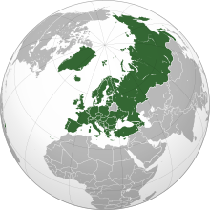
European Union & Council of Europe

Slide 15
Background Article 8 ECHR
Privacy is contained in almost all constitutions
It is perhaps the oldest legal principle> limits to the power of the state
Privacy of the home
Secrecy of correspondence
Inviolability of the body
Family life
Honor and reputation
Personal development, autonomy and human dignity

Slide 16
Background Article 8 ECHR
Article 10 (Dutch consitution) | Article 11 | Article 12 | Article 13
1. Everyone shall have the right to respect for his privacy, without prejudice to restrictions laid down by or pursuant to Act of Parliament. 2. Rules to protect privacy shall be laid down by Act of Parliament in connection with the recording and dissemination of personal data. 3. Rules concerning the rights of persons to be informed of data recorded concerning them and of the use that is made thereof, and to have such data corrected shall be laid down by Act of Parliament. | Everyone shall have the right to inviolability of his person, without prejudice to restrictions laid down by or pursuant to Act of Parliament. | 1. Entry into a home against the will of the occupant shall be permitted only in the cases laid down by or pursuant to Act of Parliament, by those designated for the purpose by or pursuant to Act of Parliament. 2. Prior identification and notice of purpose shall be required in order to enter a home under the preceding paragraph, subject to the exceptions prescribed by Act of Parliament. 3. A written report of the entry shall be issued to the occupant as soon as possible. If the entry was made in the interests of state security or criminal proceedings, the issue of the report may be postponed under rules to be laid down by Act of Parliament. A report need not be issued in cases, to be determined by Act of Parliament, where such issue would never be in the interests of state security. | 1. The privacy of correspondence shall not be violated except in the cases laid down by Act of Parliament, by order of the courts. 2. The privacy of the telephone and telegraph shall not be violated except, in the cases laid down by Act of Parliament, by or with the authorisation of those designated for the purpose by Act of Parliament.

Slide 17
Background Article 8 ECHR
Article 2 [Personal freedoms] (German constitution) | Article 6 [Marriage – Family – Children] | Article 10 [Privacy of correspondence, posts and telecommunications]
(1) Every person shall have the right to free development of his personality insofar as he does not violate the rights of others or offend against the constitutional order or the moral law. (2) Every person shall have the right to life and physical integrity. Freedom of the person shall be inviolable. These rights may be interfered with only pursuant to a law. | (1) Marriage and the family shall enjoy the special protection of the state. (2) The care and upbringing of children is the natural right of parents and a duty primarily incumbent upon them. The state shall watch over them in the performance of this duty. (3) Children may be separated from their families against the will of their parents or guardians only pursuant to a law, and only if the parents or guardians fail in their duties or the children are otherwise in danger of serious neglect. (4) Every mother shall be entitled to the protection and care of the community. (5) Children born outside of marriage shall be provided by legislation with the same opportunities for physical and mental development and for their position in society as are enjoyed by those born within marriage. | (1) The privacy of correspondence, posts and telecommunications shall be inviolable. (2) Restrictions may be ordered only pursuant to a law. If the restriction serves to protect the free democratic basic order or the existence or security of the Federation or of a Land, the law may provide that the person affected shall not be informed of the restriction and that recourse to the courts shall be replaced by a review of the case by agencies and auxiliary agencies appointed by the legislature

Slide 18
Background Article 8 ECHR
Article 13 Personal liberty is inviolable (Italian constitution) | Article14 The home is inviolable. | Article 15 Communicational secrecy
No one may be detained, inspected, or searched nor otherwise subjected to any restriction of personal liberty except by order of the Judiciary stating a reason and only in such cases and in such manner as provided by the law. In exceptional circumstances and under such conditions of necessity and urgency as shall conclusively be defined by the law, the police may take provisional measures that shall be referred within 48 hours to the Judiciary for validation and which, in default of such validation in the following 48 hours, shall be revoked and considered null and void. Any act of physical and moral violence against a person subjected to restriction of personal liberty shall be punished. The law shall establish the maximum duration of preventive detention. | Personal domicile shall be inviolable. Home inspections, searches, or seizures shall not be admissible save in the cases and manners complying with measures to safeguard personal liberty. Controls and inspections for reason of public health and safety, or for economic and fiscal purposes, shall be regulated by appropriate laws. | Freedom and confidentiality of correspondence and of every other form of communication is inviolable. Limitations may only be imposed by judicial decision stating the reasons and in accordance with the guarantees provided by the law

Slide 19
Background Article 8 ECHR
First Amendment (US constitution) | Third Amendment | Fourth amendment
Congress shall make no law respecting an establishment of religion, or prohibiting the free exercise thereof; or abridging the freedom of speech, or of the press; or the right of the people peaceably to assemble, and to petition the Government for a redress of grievances. | No Soldier shall, in time of peace be quartered in any house, without the consent of the Owner, nor in time of war, but in a manner to be prescribed by law | The right of the people to be secure in their persons, houses, papers, and effects, against unreasonable searches and seizures, shall not be violated, and no Warrants shall issue, but upon probable cause, supported by Oath or affirmation, and particularly describing the place to be searched, and the persons or things to be seized.
Fifth Amendment | Eleventh Amendment | Fourteenth Amdendment
No person shall be held to answer for a capital, or otherwise infamous crime, unless on a presentment or indictment of a Grand Jury, except in cases arising in the land or naval forces, or in the Militia, when in actual service in time of War or public danger; nor shall any person be subject for the same offence to be twice put in jeopardy of life or limb; nor shall be compelled in any criminal case to be a witness against himself, nor be deprived of life, liberty, or property, without due process of law; nor shall private property be taken for public use, without just compensation. | The Judicial power of the United States shall not be construed to extend to any suit in law or equity, commenced or prosecuted against one of the United States by Citizens of another State, or by Citizens or Subjects of any Foreign State. | Section. 1. All persons born or naturalized in the United States and subject to the jurisdiction thereof, are citizens of the United States and of the State wherein they reside. No State shall make or enforce any law which shall abridge the privileges or immunities of citizens of the United States; nor shall any State deprive any person of life, liberty, or property, without due process of law; nor deny to any person within its jurisdiction the equal protection of the laws.

Slide 20
Background Article 8 ECHR
First Human Rights Treaties
Magna Carta 1215
Bill of Rights 1689
United States Bill of Rights 1789
The Declaration of the Rights of Man and of the Citizen 1789

Slide 21
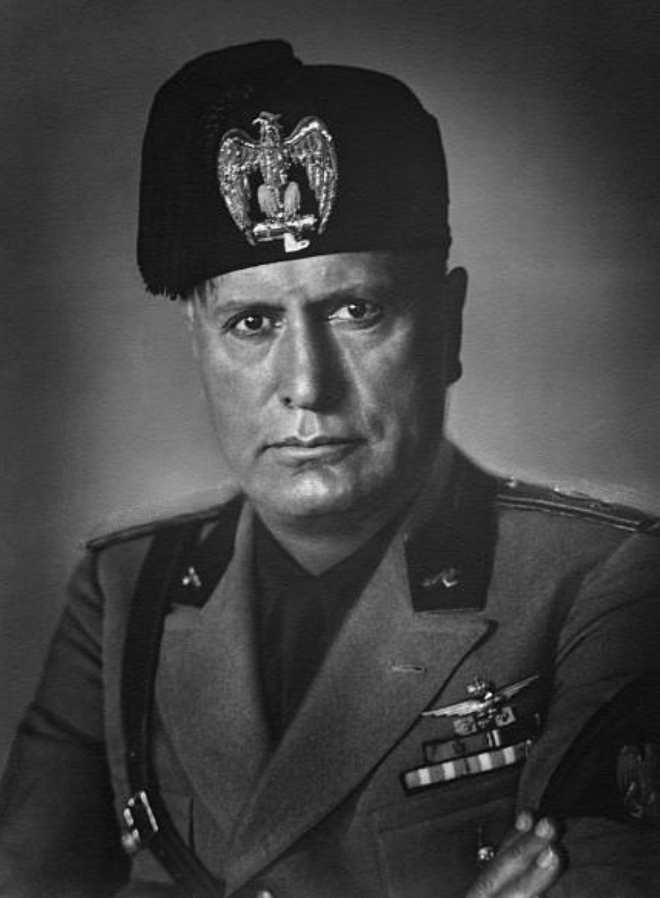
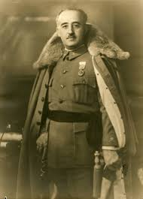
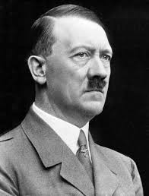
Background Article 8 ECHR

Slide 22
Background Article 8 ECHR
Modern Human Rights Documents
Universal Declaration of Human Rights (UDHR) 1948
International Covenant on Civil and Political Rights 1966
European Convention on Human Rights 1950
American Convention on Human Rights 1969
African Charter on Human and Peoples' Rights 1981
EU Charter of Fundamental Rights 2000
Association of Southeast Asian Nations (ASEAN) Human Rights Declaration 2012

Slide 23
Background Article 8 ECHR
Universal Declaration of Human Rights (UDHR) 1948
Article 12
No one shall be subjected to arbitrary interference with his privacy, family, home or correspondence, nor to attacks upon his honour and reputation. Everyone has the right to the protection of the law against such interference or attacks
Article 16
(1) Men and women of full age, without any limitation due to race, nationality or religion, have the right to marry and to found a family. They are entitled to equal rights as to marriage, during marriage and at its dissolution.
(2) Marriage shall be entered into only with the free and full consent of the intending spouses.
(3) The family is the natural and fundamental group unit of society and is entitled to protection by society and the State.

Slide 24
Background Article 8 ECHR
ARTICLE 8
Right to respect for private and family life
1. Everyone has the right to respect for his private and family life, his home and his correspondence.
2. There shall be no interference by a public authority with the exercise of this right except such as is in accordance with the law and is necessary in a democratic society in the interests of national security, public safety or the economic well-being of the country, for the prevention of disorder or crime, for the protection of health or morals, or for the protection of the rights and freedoms of others.

Slide 25
Background Article 8 ECHR
ARTICLE 33
Inter-State cases
Any High Contracting Party may refer to the Court any alleged breach of the provisions of the Convention and the Protocols thereto by another High Contracting Party.
ARTICLE 34
Individual applications
The Court may receive applications from any person, non-governmental organisation or group of individuals claiming to be the victim of a violation by one of the High Contracting Parties of the rights set forth in the Convention or the Protocols thereto. The High Contracting Parties undertake not to hinder in any way the effective exercise of this right.

Slide 26
Background Article 8 ECHR
Admissibility
Former European Commission for Human Rights
Now task of separate chamber of the European Court of Human Rights
Decisions
Judgment
European Court of Human Rights
Judgments
https://hudoc.echr.coe.int/

Slide 27
Background Article 8 ECHR

Slide 28
Background Article 8 ECHR

Slide 29
Background Article 8 ECHR

Slide 30
Background Article 8 ECHR

Slide 31
Background Article 8 ECHR

Slide 32
Background Article 8 ECHR

Slide 33
Background Article 8 ECHR

Slide 34
Background Article 8 ECHR

Slide 35
Background Article 8 ECHR

Slide 36
Background Article 8 ECHR

Slide 37
Background Article 8 ECHR

Slide 38
Background Article 8 ECHR

Slide 39
Background Article 8 ECHR

Slide 40
Background Article 8 ECHR

Slide 41
Background Article 8 ECHR

Slide 42
Background Article 8 ECHR

Slide 43
Background Article 8 ECHR

Slide 44
Background Article 8 ECHR

Slide 45
Background data protection
In the early 1970s, legislation on data processing was passed in a number of European countries
The so-called Fair Information Principles were developed in the United States in 1973
In 1973 the Council of Europe adopted a resolution on the processing of personal data in the private sector
In 1974 the Council of Europe adopted a resolution on the processing of personal data in the public sector
In 1980 the OECD adopted the Guidelines on the Protection of Privacy and Transborder Flows of Personal Data

Slide 46
Background data protection
In 1981 the Council of Europe issued the Convention for the Protection of Individuals with regard to Automatic Processing of Personal Data
In 1995, the European Union adopted Directive 95/46 / EC Data Protection Directive
In 2016, the European Union adopted Regulation (EU) 2016/679 of the European Parliament General Data Protection Regulation

Slide 47
Background data protection
 | (1) Material scope of the regulations | (2) The substantive provisions of the regulations
 |  | (2a) Obligations | (2b) Rights | (2c) Assessments | (2d) Enforcement
FIPs | - | (1) Transparency (2) Principles of fairness | (1) Access to personal data (2) Marginal rights on rectification and erasure | - | Mainly a matter of good governance
Resolutions | Information relating to individuals (physical persons) | (1) Transparency (Pub. Sec) (2) Principles of fairness | (1) Access right | (1) Lawful, appropriate and relevant | Recommends governments to take all steps necessary
Convention | Information relating to an identified or identifiable individual | (1) - (2) Principles of fairness | (1) Access to and communication of personal data (2) Marginal rights on rectification and erasure | (1) Fairly and lawfully (2) Special rules sensitive data | (1) Parties shall establish sanctions and remedies (2) Cooperation states & DPAs & role CoM (3) Remedy of data subject if data controller denies request

Slide 48
Background data protection
Directive | Information relating to an identified or identifiable natural person; an identifiable person is one who can be identified, directly or indirectly, in particular by reference to an identification number or to one or more factors specific to his physical, physiological, mental, economic, cultural or social identity; | (1) Information to the data subject & Notification DPA (2) Principles of fairness (3) Grounds for legitimate data processing | (1) Access to and communication of personal data (2) Marginal rights on rectification and objection (3) Marginal right against automatic decision making | (1) Fairly and lawfully (2) Special rules sensitive data (3) Limitative grounds for processing personal data, e.g. balancing (4) Limitative grounds for processing sensitive data, balancing not included | (1) Parties shall establish sanctions and remedies (2) Cooperation states & DPAs + harmonisation through Directive and WP 29 (3) Marginal subjective right to remedy and compensation
Regulation | Any information relating to an identified or identifiable natural person (‘data subject’); an identifiable natural person is one who can be identified, directly or indirectly, in particular by reference to an identifier such as a name, an identification number, location data, an online identifier or to one or more factors specific to the physical, physiological, genetic, mental, economic, cultural or social identity of that natural person | (1) Notification in case of data breach (2) Principles of fairness (3) Grounds for legitimate data processing – increased emphasis on consent (4) Accountability duty (multifaceted) | (1) Access to personal data (scope broadened) (2) Right to data portability (3) Rights to rectification and objection (4) Right to be forgotten (5) Right to object against profiling | (1) Fairly and lawfully (2) Special rules sensitive data (3) Limitative grounds for processing personal data, e.g. balancing (4) Limitative grounds for processing sensitive data, balancing not included | (1) High sanctions (2) Total harmonisation trough Regulation; increased powers Commission and EDPB; better cooperation DPAs (3) Several subjective rights to remedy and compensation

Slide 49
Background data protection
1973 and 1974 resolutions consisted of 8 and 10 articles respectively - they were literally one-pagers
The 1981 Convention consisted of 27 provisions
The Directive had 34 articles and 72 recitals
The Regulation has 99 articles and 173 recitals - the GDPR consists of a total of 88 pages

Slide 50
Background data protection
CHARTER OF FUNDAMENTAL RIGHTS OF THE EUROPEAN UNION
Article 7 Respect for private and family life | Article 8 Protection of personal data
Everyone has the right to respect for his or her private and family life, home and communications. | Everyone has the right to the protection of personal data concerning him or her. Such data must be processed fairly for specified purposes and on the basis of the consent of the person concerned or some other legitimate basis laid down by law. Everyone has the right of access to data which has been collected concerning him or her, and the right to have it rectified. Compliance with these rules shall be subject to control by an independent authority.

Slide 51
Background data protection
Treaty on European Union and the Treaty on the Functioning of the European Union
Article 16
1. Everyone has the right to the protection of personal data concerning them. 2. The European Parliament and the Council, acting in accordance with the ordinary legislative procedure, shall lay down the rules relating to the protection of individuals with regard to the processing of personal data by Union institutions, bodies, offices and agencies, and by the Member States when carrying out activities which fall within the scope of Union law, and the rules relating to the free movement of such data. Compliance with these rules shall be subject to the control of independent authorities. The rules adopted on the basis of this Article shall be without prejudice to the specific rules laid down in Article 39 of the Treaty on European Union.

Slide 52
Background data protection
CHARTER OF FUNDAMENTAL RIGHTS OF THE EUROPEAN UNION
Article 7 Respect for private and family life | Article 8 Protection of personal data
Everyone has the right to respect for his or her private and family life, home and communications. | Everyone has the right to the protection of personal data concerning him or her. Such data must be processed fairly for specified purposes and on the basis of the consent of the person concerned or some other legitimate basis laid down by law. Everyone has the right of access to data which has been collected concerning him or her, and the right to have it rectified. Compliance with these rules shall be subject to control by an independent authority.

Slide 53
Background data protection
Article 1 Subject-matter and objectives
1.This Regulation lays down rules relating to the protection of natural persons with regard to the processing of personal data and rules relating to the free movement of personal data. 2.This Regulation protects fundamental rights and freedoms of natural persons and in particular their right to the protection of personal data. 3.The free movement of personal data within the Union shall be neither restricted nor prohibited for reasons connected with the protection of natural persons with regard to the processing of personal data.

Slide 54
Difference privacy and data protection
Scope
Nature
Level of regulatory detail

Slide 55
References
Pictures of countries joining the EU and CoE & of dictators taken from Wikipedia
Pictures about statistical information about ECHR taken from: B. van der Sloot, ‘Where is the harm in a privacy violation? Calculating the damages afforded in privacy cases by the European Court of Human Rights’, JIPITEC, 2017-4.

