Slide 1
Interactive debate on topical privacy questions

Slide 2

Case 1
A mayor of a big city is having an affair outside his marriage. Can a television program secretly film him while he is dating in a bar?

Slide 3
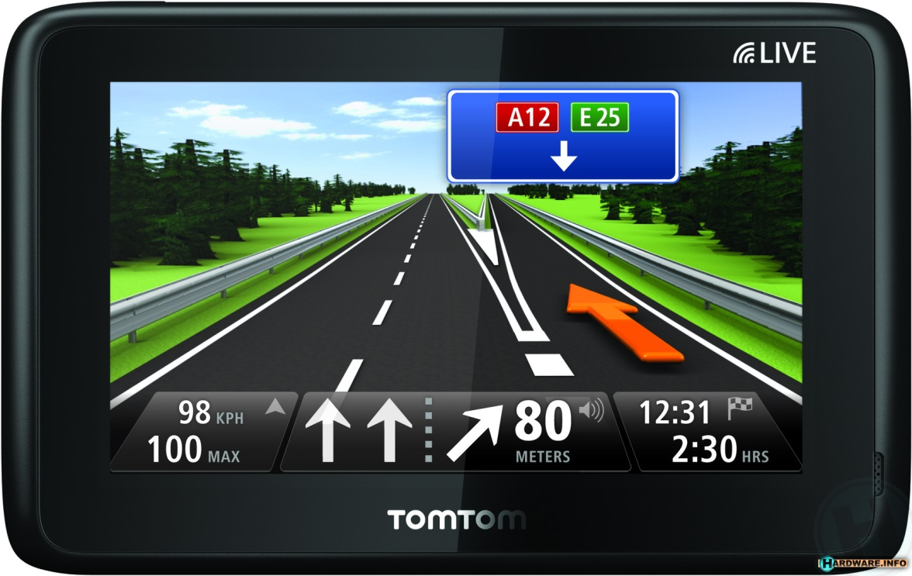
Case 2
Tomtom is collecting real time traffic data without the explicit consent of the users. Can it also sell the data to the police?

Slide 4
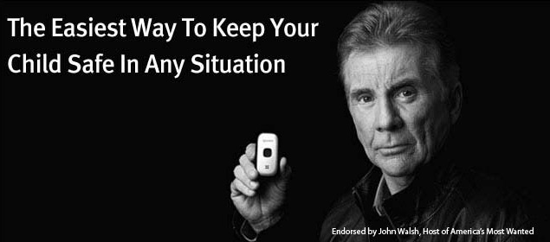
Case 3
A mother suspects that her 15 year old son is smoking pot.
Should she search his room, read his mails and place a tracking device on his telephone so as to keep track of his movements?

Slide 5

Question 1
Would you discuss your income with strangers?

Slide 6
Thesis 1
Privacy is dead, get over it

Slide 7

Case 4
The AIVD gathers data about every Dutch citizen. Can it also share this data with American intelligence agencies?

Slide 8

Case 5
Google is scanning the e-mails sent and received via Gmail. Can it use those data for personalised advertisements?

Slide 9
Thesis 2
The benefits of transparency and access to (personal) information to society outweigh the disadvantages for the individual or: Privacy is theft.

Slide 10

Question 2
Is seeing someone sunbathe nude a privacy violation to you?

Slide 11
Case 6
A 16 year old comes to the doctor and asks for Antidepressants; he/she tells that he/she is being bullied at school
Should the doctor inform the parents and/or the school?

Slide 12
Case 7
The police has been informed that someone in a certain neighborhood (among 300 residents) is planning a murder.
Should the police wire-tap all telecommunications of all residents living in this neighborhood?

Slide 13
Thesis 3
If you’ve got nothing to hide, you’ve got nothing to fear

Slide 14
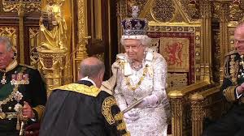
Do you trust the state to protect your privacy?
Question 3

Slide 15
Thesis
I’m confused about privacy.

