Slide 1
Horizontal Privacy: international comparative legal study
Bart van der Sloot

Slide 2
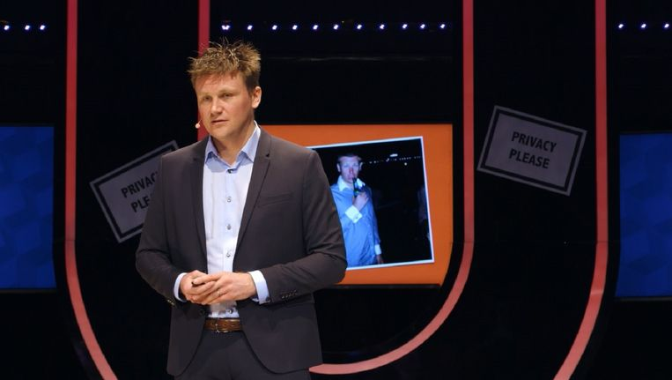

Slide 3



Research Question
• What lessons can be learned from the approach taken by other European countries with regards to the protection of horizontal privacy?
To what extent can these solutions be applied in the context of the Netherlands?
Are there any undesirable consequences or side-effects associated with the opportunities to provide effective protection to horizontal privacy in the Netherlands?

Slide 4
Countries
Germany,
Poland,
Sweden
the United Kingdom.

Slide 5
Guiding questions for research
What is ‘horizontal privacy’ and how is it conceptualized in the Netherlands and the investigated European countries?
What are the protected interests that may be affected by the impairment or violation of horizontal privacy?
What are the current impairments to these interests?
What are the various forms of prevention, enforcement and prosecution of violations currently used?
What forms of cooperation exist between citizens, businesses and the government to combat the violations of horizontal privacy?
How has the protection of horizontal privacy been designed in Germany, Poland, Sweden, and the United Kingdom?
To what extent are protective measures from these countries useful in the context of the Netherlands?
What are the potential negative effects of implementing these measures to better protect horizontal privacy?

Slide 8
Constitution
“We conclude that on the basis of both developments in the national legal order and the operation of the ECHR, the horizontal application of fundamental rights has been accepted both in the Netherlands and the European countries in our analysis.
Poland and Germany have the most explicit recognition of the horizontal application of the right to privacy. We doubt whether further constitutional codification of the horizontal application of the right to privacy (based on the Polish model) or the introduction of an independent right to informational self-determination (based on the German model) is necessary or useful. Explicit recognition of the horizontal application of fundamental rights in the Dutch Constitution would appear to primarily be symbolic because of the already present recognition at the level of the ECtHR. The same applies to a right to informational self-determination.
The right to privacy is not absolute and can be restricted by other rights. Introducing a right to informational self-determination is therefore, in the words of the Franken Commission, little more than a question of ‘giving a lot and then taking a lot back’. In addition, it should also be borne in mind that, with the binding European data protection legislation (the General Data Protection Regulation), the room for introducing a national right to informational selfdetermination is very limited.”

Slide 9
Data protection law
The high degree of harmonization within the field of data protection law has left this research with an absence of any noteworthy differences that could be relevant for this research.

Slide 10
Criminal law
Unlike Germany and Sweden, the filming of individuals in need of help is not independently punishable in the Netherlands. Although under certain circumstances, the failure to provide assistance can lead to a criminal charge. This should concern a situation in which the individual filming could have provided assistance and was aware of this. This does not solve the problem of bystanders who film victims, where emergency services are already at the scene. It is possible to be charged with an offense of obstruction, under Article 426bis of the Criminal Code, although the individual filming would have to have obstructed others in their freedom of movement. A possible negative consequence of criminalizing the filming of individuals in need of assistance (e.g. traffic accident victims) is that it may make it more difficult to clarify offenses. The captured images of bystanders may also play a role with regards to relevant liability and insurance issues. This should be taken into account in the context of potential criminalization.

Slide 11
Criminal law
The extent to which offensive behavior and obscenity is criminalized is in large part culturally determined. On one hand, the aim is to protect morality within society and, on the other hand, to prevent individuals from being shocked or offended by certain behavior or information. The United Kingdom and Poland have regulations in place that allow the government to take action against the dissemination of offensive or obscene images, especially when they are aimed at causing irritation or unnecessary stress. In the Netherlands, the sending of offensive material may violate the honor of an individual (Article 240 Sr), but its application is limited to the sending of pornographic material. In both Poland and the United Kingdom, the absence of this limitation means that there are more opportunities to take action against unacceptable online behavior. For example, serious forms of pranking or trolling could fall within the scope of the offense and its definition if the public is sufficiently offended. In the Netherlands, this type of behavior is not independently punishable. However, depending on the circumstances of the case, this type of behavior may be punishable, in particular when maltreatment or destruction is involved. Whether the unacceptable behavior should be subject to broader criminalization in the Netherlands is ultimately a political issue.

Slide 12
Criminal law
Wider criminalization for the disclosure or dissemination of information does offer more possibilities to counter horizontal privacy violations. Although on the other hand, freedom of expression might be threatened if there is no clear definition of what is considered obscene, harmful, or otherwise hurtful. In addition, there is also a danger this broader criminalization might lead to arbitrary application. Furthermore, in the European countries analyzed for this research, it is clear that many crimes of expression are not crimes conditional on a complaint like in the Netherlands. This offers the government more possibilities to act autonomously in setting standards. Even here, the question surrounding whether this is desirable with a view on safeguarding the freedom of expression, because it provides the government with more leeway to take direct action against (minor) violations of privacy. Finally, in a number of countries the penalties for crimes against expression crimes (e.g. libel and slander) are higher than in the Netherlands.

Slide 13
Consumer protection law, administrative law and competition law
German competition law case against Facebooks

Slide 14
Civil law

Slide 15
The role of producers, distributors, and internet intermediaries
Germany appears to take a much stricter approach to dealing with illegal online content; through the Netzwerkdurchsetzungsgesetz (the Network Enforcement Act). Sweden, through its interpretation of the old BBS legislation, also has legal possibilities to hold internet platforms liable for criminal violations of horizontal privacy. It can be said that the legal ‘stick’ through which rapid and effective action can be taken against violations committed on internet platforms is more readily present in Sweden and Germany, as opposed to the Netherlands. However, it remains dependent on whether it concerns a violation of horizontal privacy that is criminalized.

Slide 16
Other Mechanisms: Self-regulation & Self-regulation

Slide 19
What is the real problem?
1. Products are cheap
2. Distribution is easy
3. Copy pasting is easy
4. Distribution can be done anonymous
5. Data collection/production/dissemination is manyfold

Slide 20
What is the real problem?
Regulation is almost exclusively ex post facto
Citizens: Unaware; uploader unkown; two legal procedures; Barbra Streisand effect; time & money; difficult legal questions; little damage awarded
Internet intermediaries: dificult legal questions; consent?; different interest of citizens at stake; own interest; time & money; various potentially clashing legal jurisdictions
DPA: ibid + Big Brother

Slide 21
What is the real problem?
Consequence: small privacy violations will be left unadressed
Consequence: normalisation small privacy violations
Cummalative effect?
Ex ante regulation viable option

