Slide 1
Google Street View
The Role of Object-Identification in Privacy-Abuse

Slide 2
Privacy

Slide 3
Privacy violations

Slide 4
Exceptions

Slide 5
Purpose

Slide 6
Prior information

Slide 7
Prior consent

Slide 8
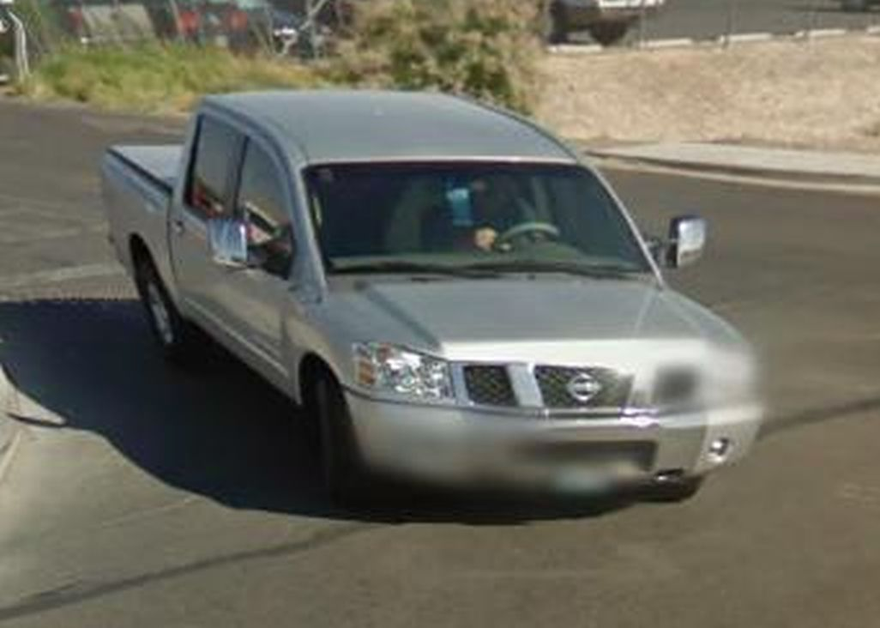
Identification

Slide 9
Data minimization & Data quality

Slide 10
Third parties

Slide 11
Posterior consent

Slide 12
Posterior information

