Slide 1
Druglabs, botnets & terrorist: how big data can solve it all
Bart van der Sloot
www.bartvandersloot.com

Slide 2
Overview
1. Examples of Big Data
2. And the law?
3. Fighting drug labs
4. And the law?
5. Fighting botnets
6. And the law?
7. Fighting terrorists
8. And the law?

Slide 3
Privacy is dead, get over it

Slide 4
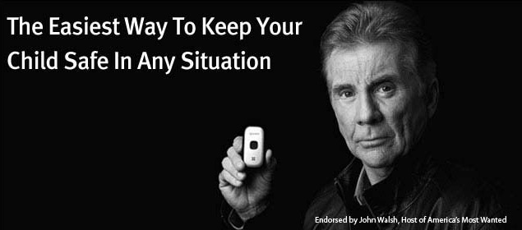
A mother suspects that her 15 year old son is smoking pot.
Should she search his room, read his mails and place a tracking device on his telephone so as to keep track of his movements?

Slide 5
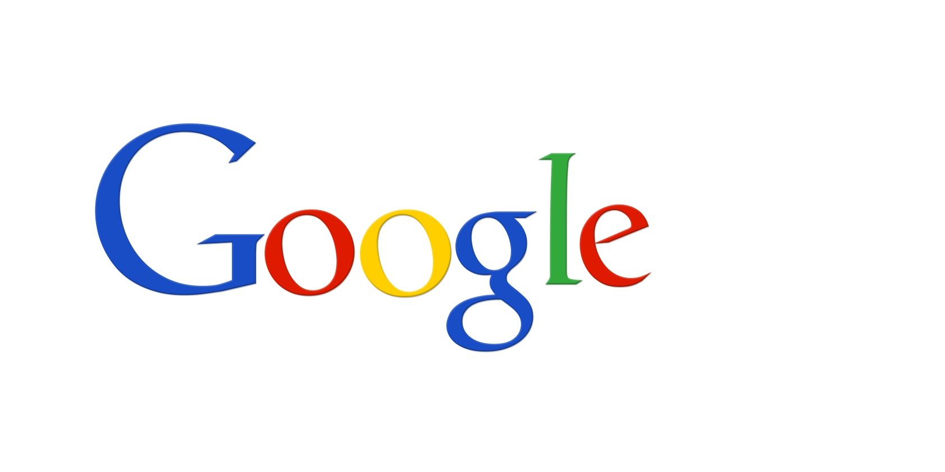
Google is scanning the e-mails sent and received via Gmail. Can it use those data for personalised advertisements?

Slide 6
I have nothing to hide

Slide 7
1. Examples of Big Data

Slide 8
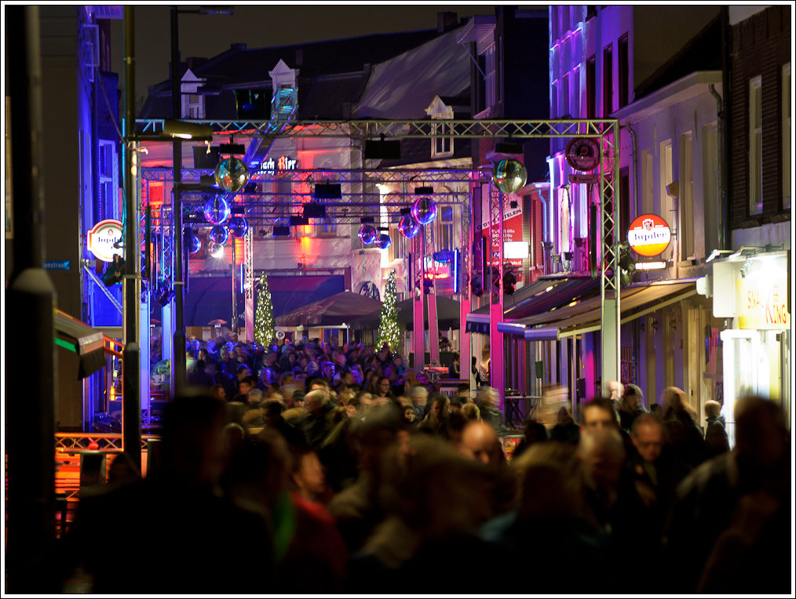

Slide 9
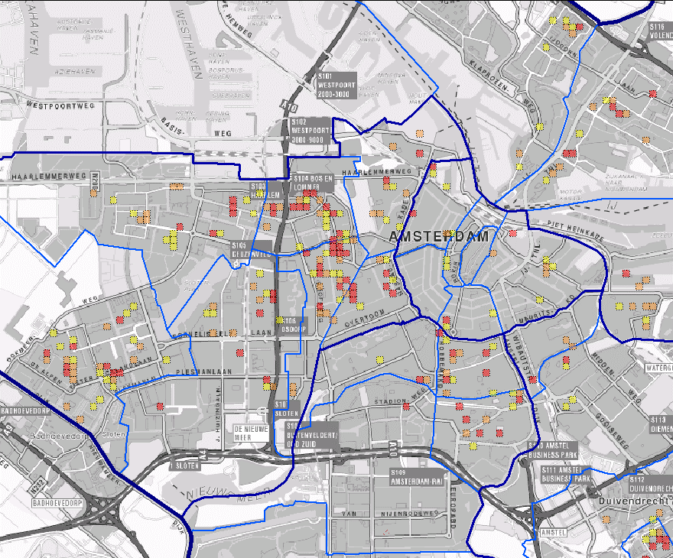

Slide 10
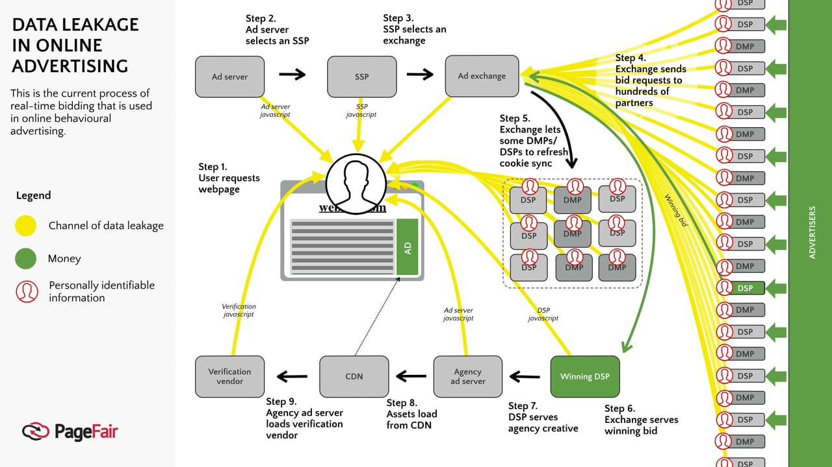

Slide 11
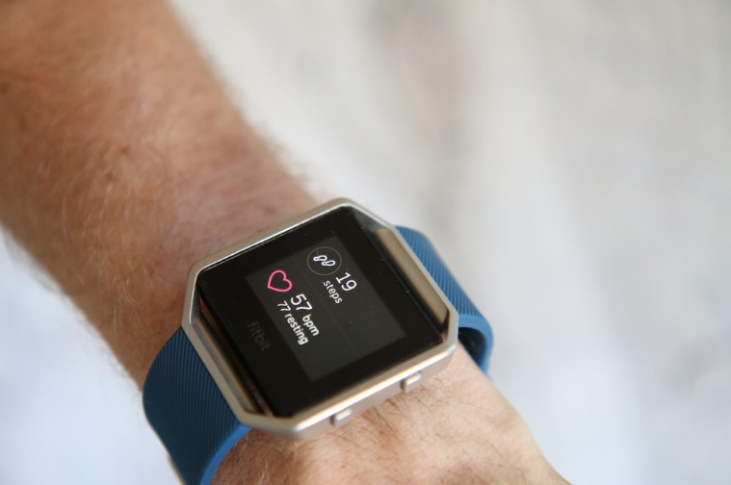

Slide 12
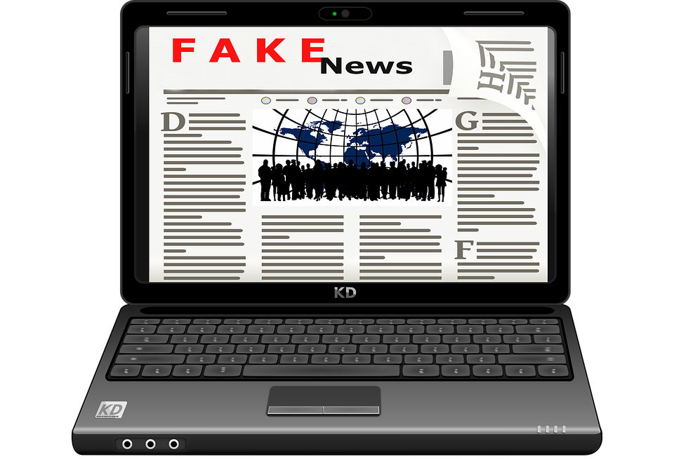

Slide 13
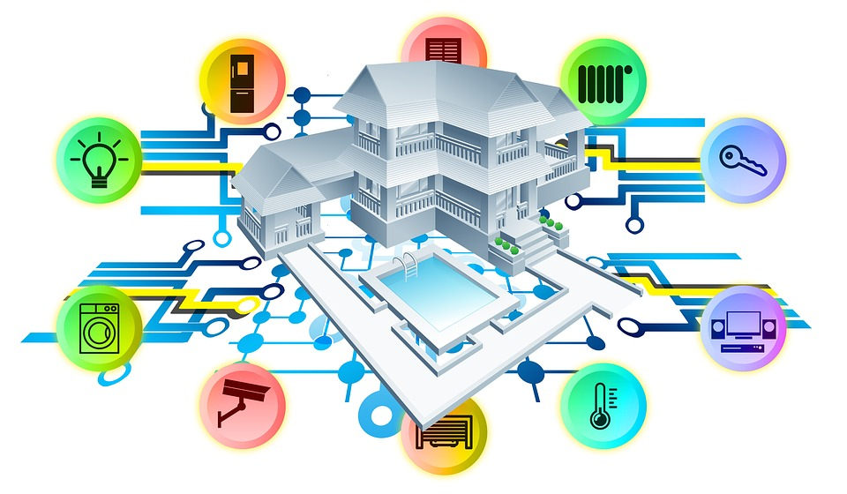

Slide 14
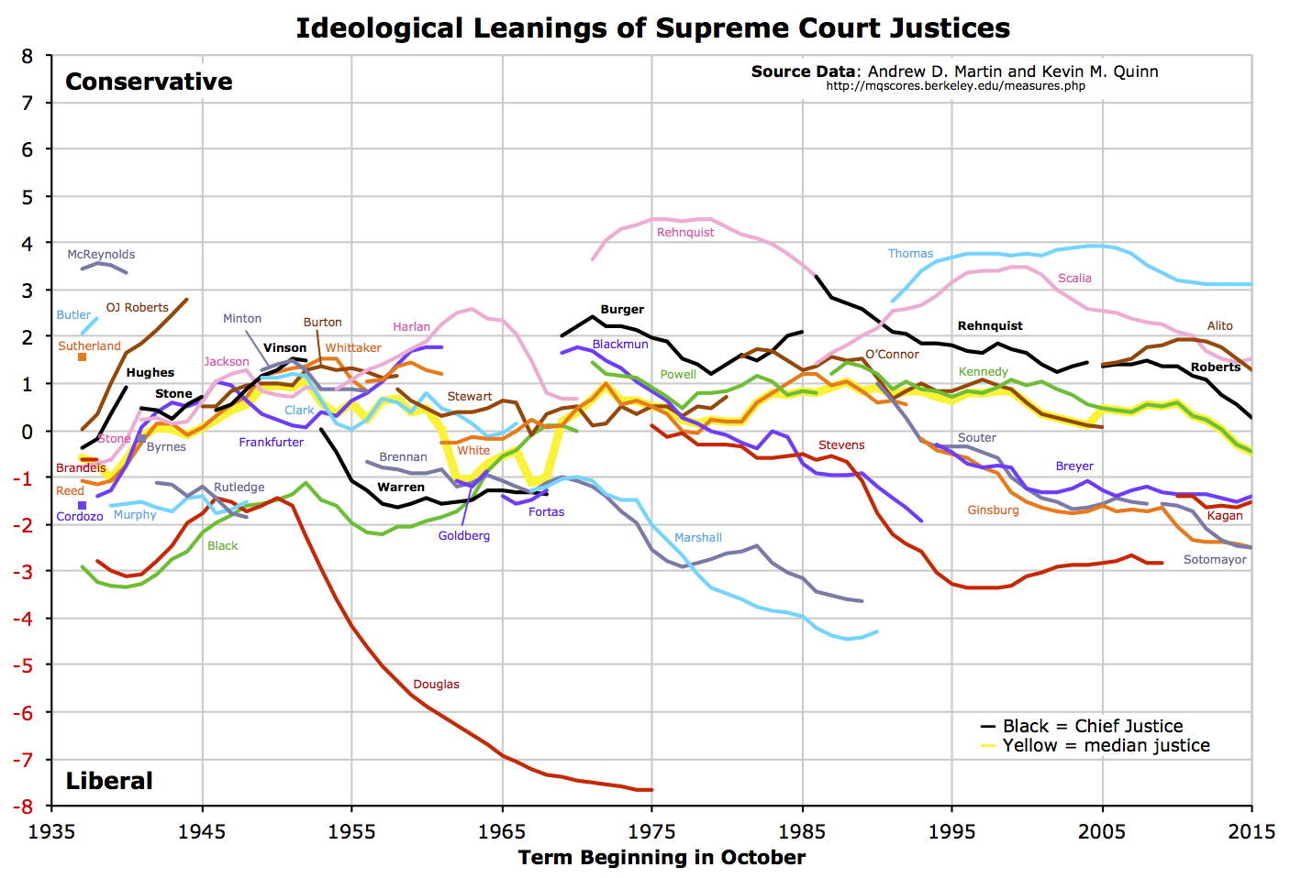

Slide 15
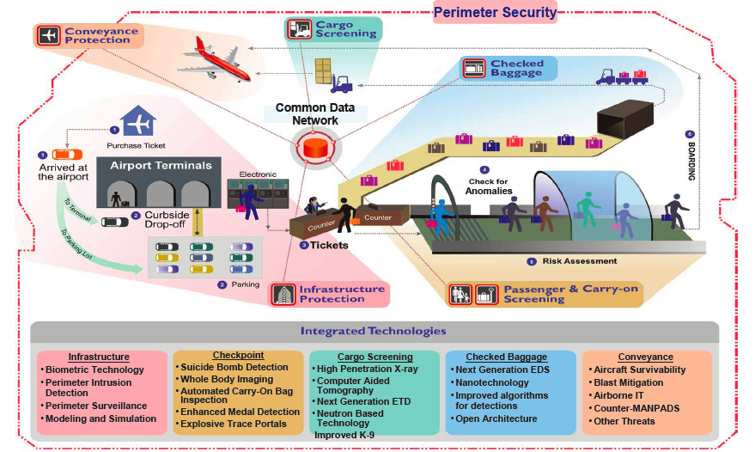

Slide 16
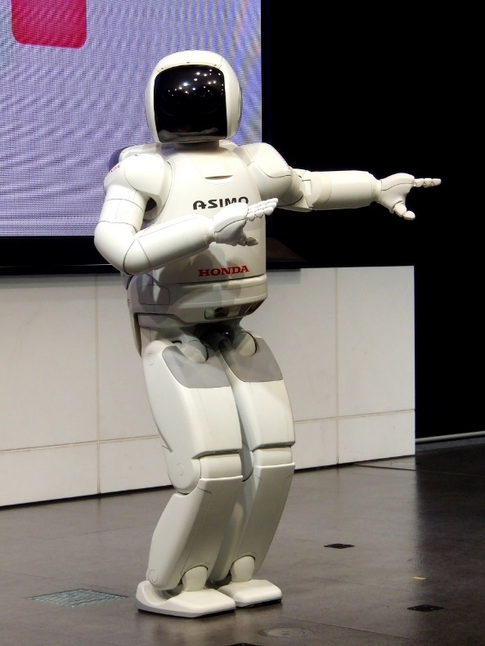

Slide 17
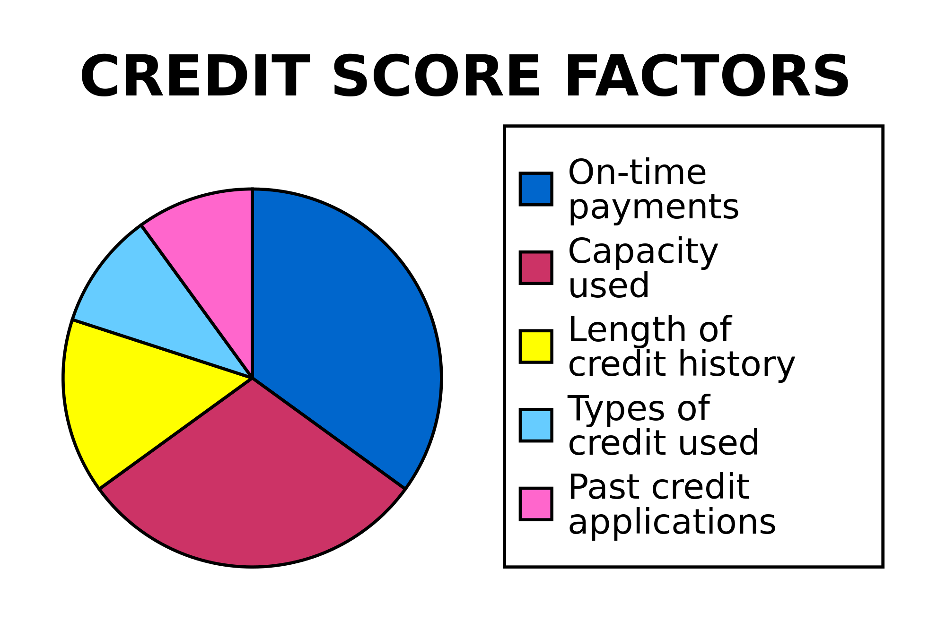

Slide 18
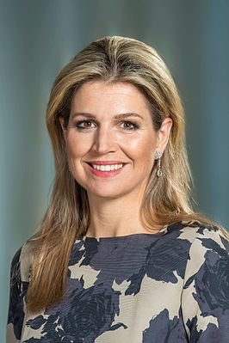

Slide 19
What is Big Data?
Big Data refers to the exponential growth both in the availability and in the automated use of information: it refers to gigantic digital datasets held by corporations, governments and other large organisations, which are then extensively analysed (hence the name: analytics100) using computer algorithms. Big Data can be used to identify more general trends and correlations but it can also be processed in order to directly affect individuals.’
Article 29 Working Party

Slide 20
What is Big Data?
‘Big Data is a term which refers to the enormous increase in access to and automated use of information. It refers to the gigantic amounts of digital data controlled by companies, authorities and other large organizations which are subjected to extensive analysis based on the use of algorithms. Big Data may be used to identify general trends and correlations, but it can also be used such that it affects individuals directly.’
International Working Group on Data Protection in Telecommunications

Slide 21
What is Big Data?
“Big Data means large amounts of different types of data produced at high speed from multiple sources, whose handling and analysis require new and more powerful processors and algorithms. Not all of these data are personal, but many players in the digital economy increasingly rely on the large scale collection of and trade in personal information. As well as benefits, these growing markets pose specific risks to individual’s rights to privacy and to data protection.’
European Data Protection Supervisor

Slide 22
What is Big Data?
“There are many definitions of ‘Big Data’ which may differ depending on whether you are a computer scientist, a financial analyst, or an entrepreneur pitching an idea to a venture capitalist. Most definitions reflect the growing technological ability to capture, aggregate, and process an ever-greater volume, velocity, and variety of data. In other words, ‘data is now available faster, has greater coverage and scope, and includes new types of observations and measurements that previously were not available.’
Podesta Report

Slide 23
What is Big Data?
“Big Data refers to datasets whose size is beyond the ability of typical database software tools to capture, store, manage and analyze.”
Het McKinsey Global Institute (2011: 1)

Slide 24
What is Big Data?
Big Data is defined “collected and processed open datasets, which are defined by quantity, plurality of data formats and data origination and processing speed.”
De autoriteit gegevensbescherming van Estland

Slide 25
What is Big Data?
“In August 2014, a definition of the term ‘Big Data’ was adopted by the French General Commission on terminology and neology (Commission générale de terminologie et de néologie). The official translation of this term in French is ‘mégadonnées’ and the definition is “data, structured or otherwise, whose very large volume require appropriate analytical tools.”
De autoriteit gegevensbescherming van Frankrijk

Slide 26
What is Big Data?
“Big Data stems from the collection of large structured or unstructured datasets, the possible merger of such datasets as well as the analysis of these data through computer algorithms. It usually refers to datasets which cannot be stored, managed and analysed with average technical means due to their size. Personal data can also be a part of Big Data but Big Data usually extends beyond that, containing aggregated and anonymous data.”
De autoriteit gegevensbescherming van Luxemburg

Slide 27
What is Big Data?
“Big Data is all about collecting as much information as possible; storing it in ever larger databases; combining data that is collected for different purposes; and applying algorithms to find correlations and unexpected new information.”
De autoriteit gegevensbescherming van Nederland

Slide 28
What is Big Data?
“Big Data is a broad term for processing of large amounts of different types of data, including personal data, acquired from multiple sources in various formats. Big Data revolves around predictive analytics – acquiring new knowledge from large data sets which requires new and more powerful processing applications.”
De autoriteit gegevensbescherming van Slovenië

Slide 29
What is Big Data?
Big Data is “repurposing data; using algorithms to find correlations in datasets rather than constructing traditional queries; and bringing together data from a variety of sources, including structured and unstructured data.”
De autoriteit gegevensbescherming van het Verenigd Koninkrijk

Slide 30
What is Big Data?
“the concept is used for situations where large amounts of data are gathered in order to be made available for different purposes, not always precisely determined in advance.”
De autoriteit gegevensbescherming van Zweden

Slide 32
What is Big Data?
- Technological
- Economical
- Social

Slide 33
What is Big Data?
Open data
Re-use
Internet of things
Smart
Profiling
Algorithm
Cloud Computing
Datafication

Slide 34
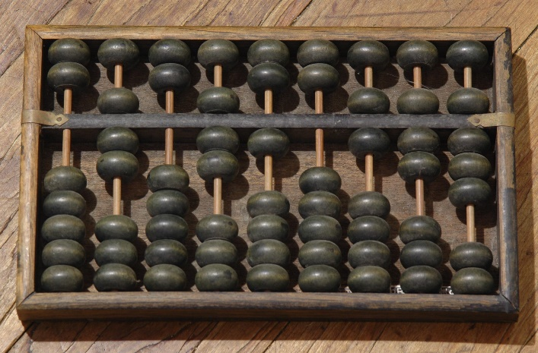
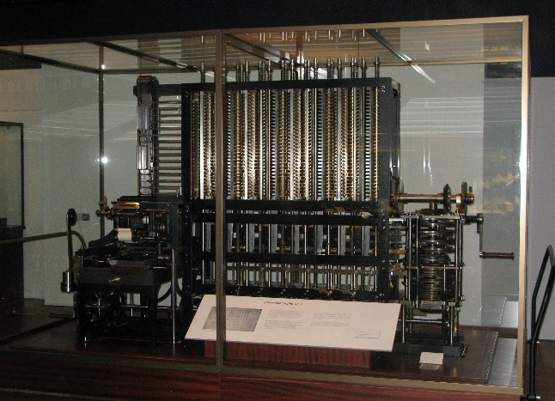
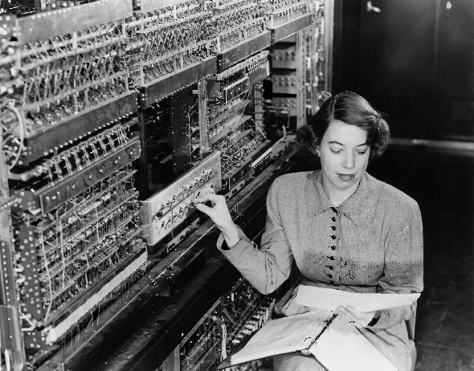
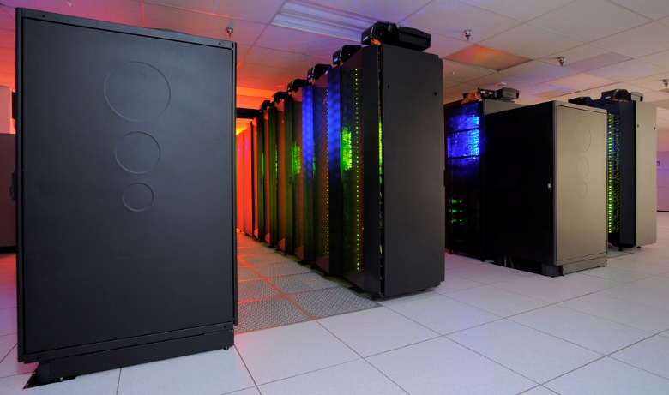
What is Big Data?

Slide 35
What is Big Data?
More or less data
Higher or lower velocity
More or less processing power

Slide 36
What is Big Data?
(1) Gathering
(2) Analysing
(3) Using

Slide 37
What is Big Data?
The more, the merrier:
Quantity over quality:
Dirty data is hot:
Old data is new data:
Gathering data is cheap, storing is cheaper, analysing is cheapest:
Correlation over causation:
Anything can say something about everything and everything can say something about anything:
The future is now:
No harm in trying:
No mountain too high:

Slide 38
And the law?
ARTICLE 8 Right to respect for private and family life
1. Everyone has the right to respect for his private and family life, his home and his correspondence.
2. There shall be no interference by a public authority with the exercise of this right except such as is in accordance with the law and is necessary in a democratic society in the interests of national security, public safety or the economic well-being of the country, for the prevention of disorder or crime, for the protection of health or morals, or for the protection of the rights and freedoms of others.

Slide 39
And the law?
Article 7 Respect for private and family life
Everyone has the right to respect for his or her private and family life, home and communications.
Article 8 Protection of personal data
1. Everyone has the right to the protection of personal data concerning him or her.
2. Such data must be processed fairly for specified purposes and on the basis of the consent of the person concerned or some other legitimate basis laid down by law. Everyone has the right of access to data which has been collected concerning him or her, and the right to have it rectified.
3. Compliance with these rules shall be subject to control by an independent authority.

Slide 40
And the law?
Article 5 Principles relating to processing of personal data 1.Personal data shall be:
(b) collected for specified, explicit and legitimate purposes

Slide 41
And the law?
Article 5 Principles relating to processing of personal data 1.Personal data shall be:
(b) collected for specified, explicit and legitimate purposes and not further processed in a manner that is incompatible with those purposes;

Slide 42
And the law?
Article 5 Principles relating to processing of personal data 1.Personal data shall be:
(c) adequate, relevant and limited to what is necessary in relation to the purposes for which they are processed (‘data minimisation’);

Slide 43
And the law?
Article 5 Principles relating to processing of personal data 1.Personal data shall be:
(d) accurate and, where necessary, kept up to date; every reasonable step must be taken to ensure that personal data that are inaccurate, having regard to the purposes for which they are processed, are erased or rectified without delay (‘accuracy’);

Slide 44
And the law?
Article 5 Principles relating to processing of personal data 1.Personal data shall be:
(e) kept in a form which permits identification of data subjects for no longer than is necessary for the purposes for which the personal data are processed; personal data may be stored for longer periods insofar as the personal data will be processed solely for archiving purposes in the public interest, scientific or historical research purposes or statistical purposes in accordance with Article 89(1) subject to implementation of the appropriate technical and organisational measures required by this Regulation in order to safeguard the rights and freedoms of the data subject (‘storage limitation’);

Slide 45
And the law?
Article 5 Principles relating to processing of personal data 1.Personal data shall be:
(f) processed in a manner that ensures appropriate security of the personal data, including protection against unauthorised or unlawful processing and against accidental loss, destruction or damage, using appropriate technical or organisational measures (‘integrity and confidentiality’).

Slide 46
And the law?
Article 44 General principle for transfers
Any transfer of personal data which are undergoing processing or are intended for processing after transfer to a third country or to an international organisation shall take place only if, subject to the other provisions of this Regulation, the conditions laid down in this Chapter are complied with by the controller and processor, including for onward transfers of personal data from the third country or an international organisation to another third country or to another international organisation. All provisions in this Chapter shall be applied in order to ensure that the level of protection of natural persons guaranteed by this Regulation is not undermined.

Slide 47
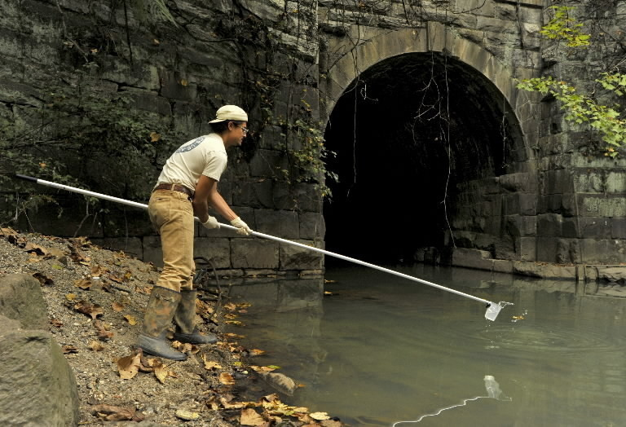
Druglabs

Slide 48
And the law?
Are there personal data/sensitiv personal data?
Bodily integrity?
Home?
Mass surveillance?

Slide 49

Botnets

Slide 50
And the law?
Paternalism?
Obligation to inform?
Function creep?

Slide 51
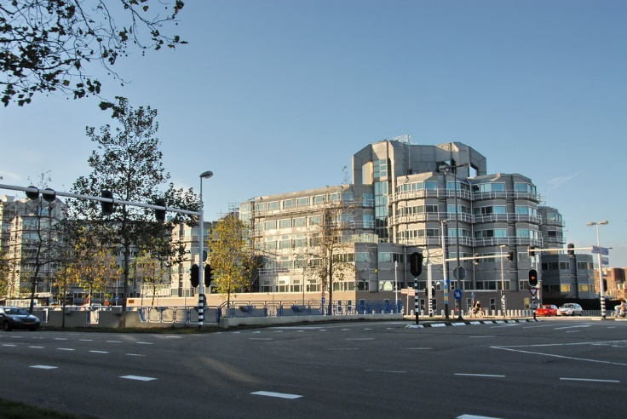
Terrorists

Slide 52
And the law?
I have nothing to hide?
Satefy above everything?
Needle in the haystack?

