Slide 1
Deepfakes
Bart van der Sloot
Tilburg Institute for Law Technology and Society, Tilburg Law School, Tilburg University
www.bartvandersloot.com

Slide 2
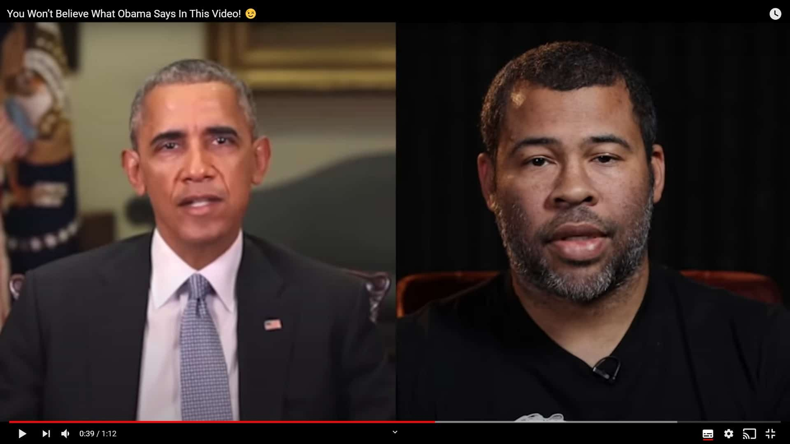
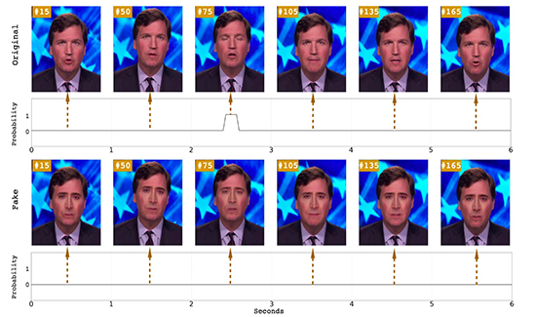
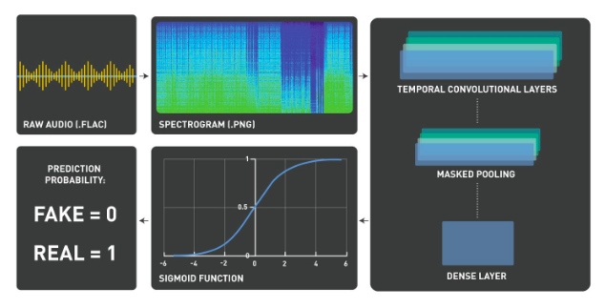

Slide 3
Positive use cases
Humour and satire
Tracking down criminals and infiltrating criminal networks,
Entertainment purposes such as in games and movies
Medical applications
“Trying on" clothes in retail
Giving tours by historical figures in museums/giving classes to children
Communicating by politicians in minority languages
International businesses communication

Slide 4
Negative use cases
(child) pornography,
Fraud and deception,
Sowing hatred and inciting violence
Spreading misinformation
Influencing democratic elections
Bigger societal effects
Post truth
Problems for media, judiciary, democratic elections
Position of women + growing up young girls

Slide 5
AI ACT
Recital 70: Certain AI systems intended to interact with natural persons or to generate content may pose specific risks of impersonation or deception irrespective of whether they qualify as high-risk or not. In certain circumstances, the use of these systems should therefore be subject to specific transparency obligations without prejudice to the requirements and obligations for high-risk AI systems. In particular, natural persons should be notified that they are interacting with an AI system, unless this is obvious from the circumstances and the context of use. Moreover, natural persons should be notified when they are exposed to an emotion recognition system or a biometric categorisation system. Such information and notifications should be provided in accessible formats for persons with disabilities. Further, users, who use an AI system to generate or manipulate image, audio or video content that appreciably resembles existing persons, places or events and would falsely appear to a person to be authentic, should disclose that the content has been artificially created or manipulated by labelling the artificial intelligence output accordingly and disclosing its artificial origin.

Slide 6
AI ACT
Article 52 Transparency obligations for certain AI systems
1.Providers shall ensure that AI systems intended to interact with natural persons are designed and developed in such a way that natural persons are informed that they are interacting with an AI system, unless this is obvious from the circumstances and the context of use. This obligation shall not apply to AI systems authorised by law to detect, prevent, investigate and prosecute criminal offences, unless those systems are available for the public to report a criminal offence.
2.Users of an emotion recognition system or a biometric categorisation system shall inform of the operation of the system the natural persons exposed thereto. This obligation shall not apply to AI systems used for biometric categorisation, which are permitted by law to detect, prevent and investigate criminal offences.
3.Users of an AI system that generates or manipulates image, audio or video content that appreciably resembles existing persons, objects, places or other entities or events and would falsely appear to a person to be authentic or truthful (‘deep fake’), shall disclose that the content has been artificially generated or manipulated.
However, the first subparagraph shall not apply where the use is authorised by law to detect, prevent, investigate and prosecute criminal offences or it is necessary for the exercise of the right to freedom of expression and the right to freedom of the arts and sciences guaranteed in the Charter of Fundamental Rights of the EU, and subject to appropriate safeguards for the rights and freedoms of third parties.
4.Paragraphs 1, 2 and 3 shall not affect the requirements and obligations set out in Title III of this Regulation.

Slide 7
Five questions
(1) Manipulation
(2) Information
(3) Method
(4) Audience
(5) Relation GDPR

Slide 8
(1) Manipulation
r70 ‘who use an AI system to generate or manipulate image, audio or video content that appreciably resembles existing persons, places or events and would falsely appear to a person to be authentic’
a52 ‘Users of an AI system that generates or manipulates image, audio or video content that appreciably resembles existing persons, objects, places or other entities or events and would falsely appear to a person to be authentic or truthful (‘deep fake’)’
- What is manipulation? Prediction that in 5 years’ time, more than 90% of all digital content will be manipulated
- Also including persons, objects, places, events and other entities > does this include an AI-created sun with a smiley face?

Slide 9
(2) Information
r70 ‘that the content has been artificially created or manipulated’
a52 ‘that the content has been artificially generated or manipulated’
- Is stating ‘this information has been manipulated through AI’ enough, or should such description disclose what has been manipulated and how? It seems like the former, but this is very uninformative

Slide 10
(3) Method
R70 ‘by labelling the artificial intelligence output accordingly and disclosing its artificial origin.’
A52 ‘shall disclose’
Mostly, labelling is used (also in AI Act) as adding a type of metadata > if this would be the right interpretation, what does this help? Not general audience, but perhaps platforms that can then block this content

Slide 11
(4) Audience
R70 ‘should disclose’
A52 ‘shall disclose’
To whom? Not the ‘data subject’, but it appears to be through labelling the content

Slide 12
(5) Relation GDPR
By far most deepfakes prohibited > non-consensual porn
Other also dubious:
Personal data shall be collected for specified, explicit and legitimate purposes and not further processed in a manner that is incompatible with those purposes
Personal data shall be accurate and, where necessary, kept up to date; every reasonable step must be taken to ensure that personal data that are inaccurate, having regard to the purposes for which they are processed, are erased or rectified without delay
Transparency: Inform data subject before or at the moment of publication
How should the AI Act be understood? Exception to these GDPR rules/prohibition? Additional rules?

