Slide 1
Deepfakes: Time to Regulate?
Bart van der Sloot
Tilburg Institute for Law, Technology, and Society (TILT)
Www.bartvandersloot.com

Slide 2
Research
The main question of this research project was whether the current legal regime is capable of adequately tackling the negative effects of deepfake technology and if not, what could be options for altering the legal regime. This question was answered through literature review, legal doctrinal analysis, conducting interviews with experts, and analyzing existing legislative approaches to deepfakes.

Slide 3
Definition
A deepfake is content (video, audio or otherwise) that is wholly or partially fabricated or existing content (video, audio or otherwise) that has been manipulated. Several technologies can be used for this purpose, but the most popular is based on what is known as Generative Adversarial Networks (GAN).
Deepfake is an ideal concept:
  Type data carrier and with it the extent to which the content 'gets' to the user
  Technology used
  The degree of manipulation
  The extent to which the manipulation is performed
  The question of the deepfake concerns an existing or non-existent person
  The extent to which the user believes the content is true

Slide 4
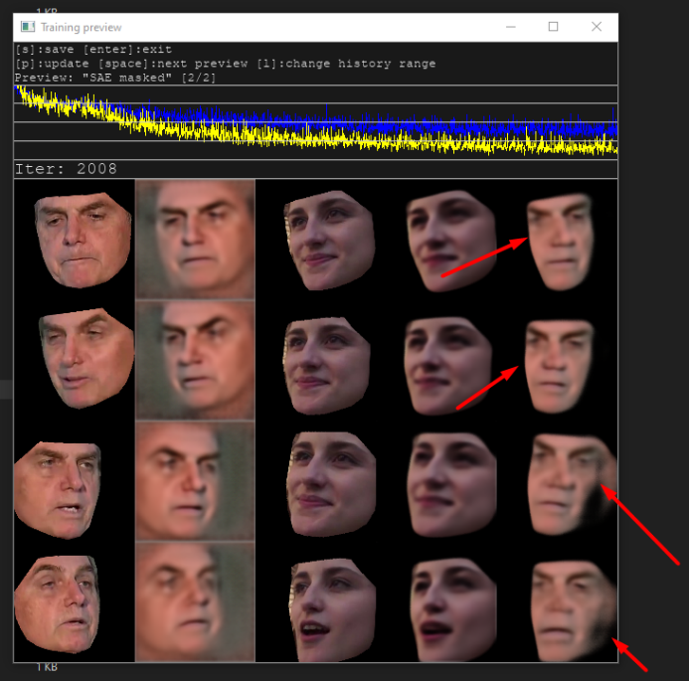
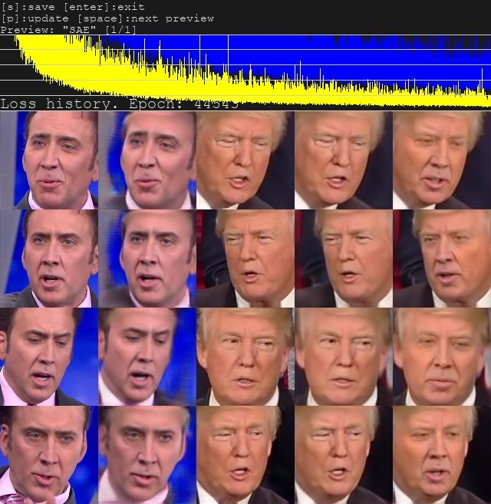
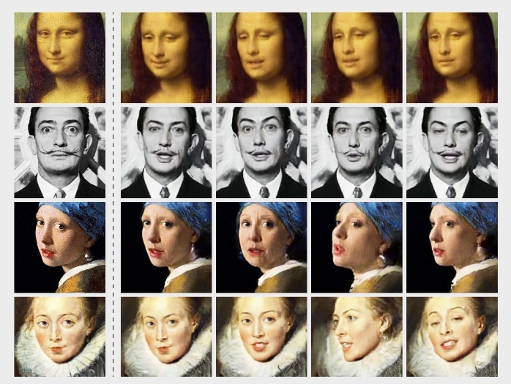
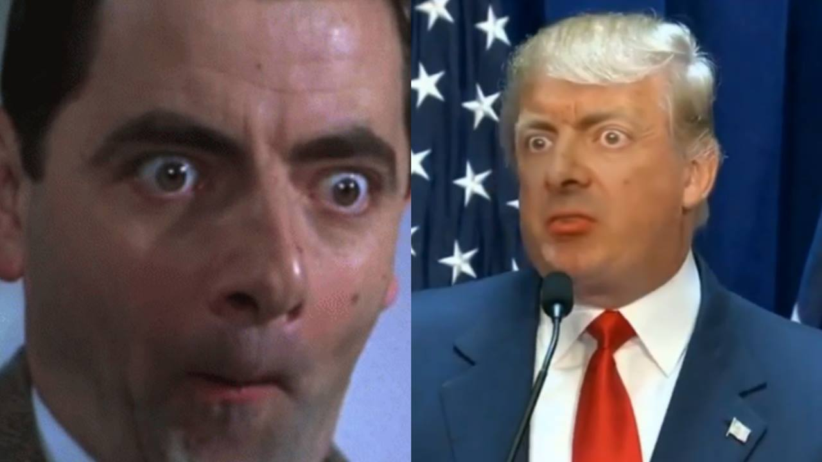

Slide 5
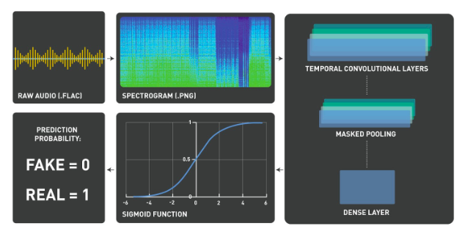
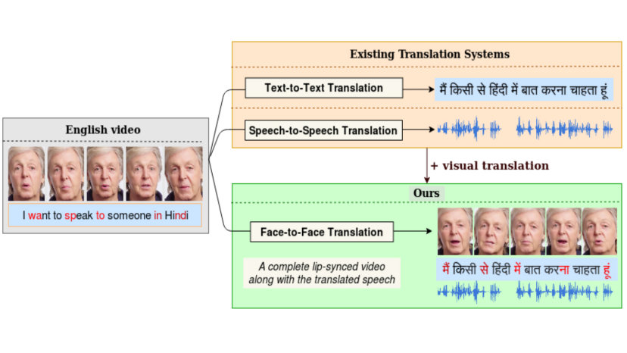
Deepfakes

Slide 6
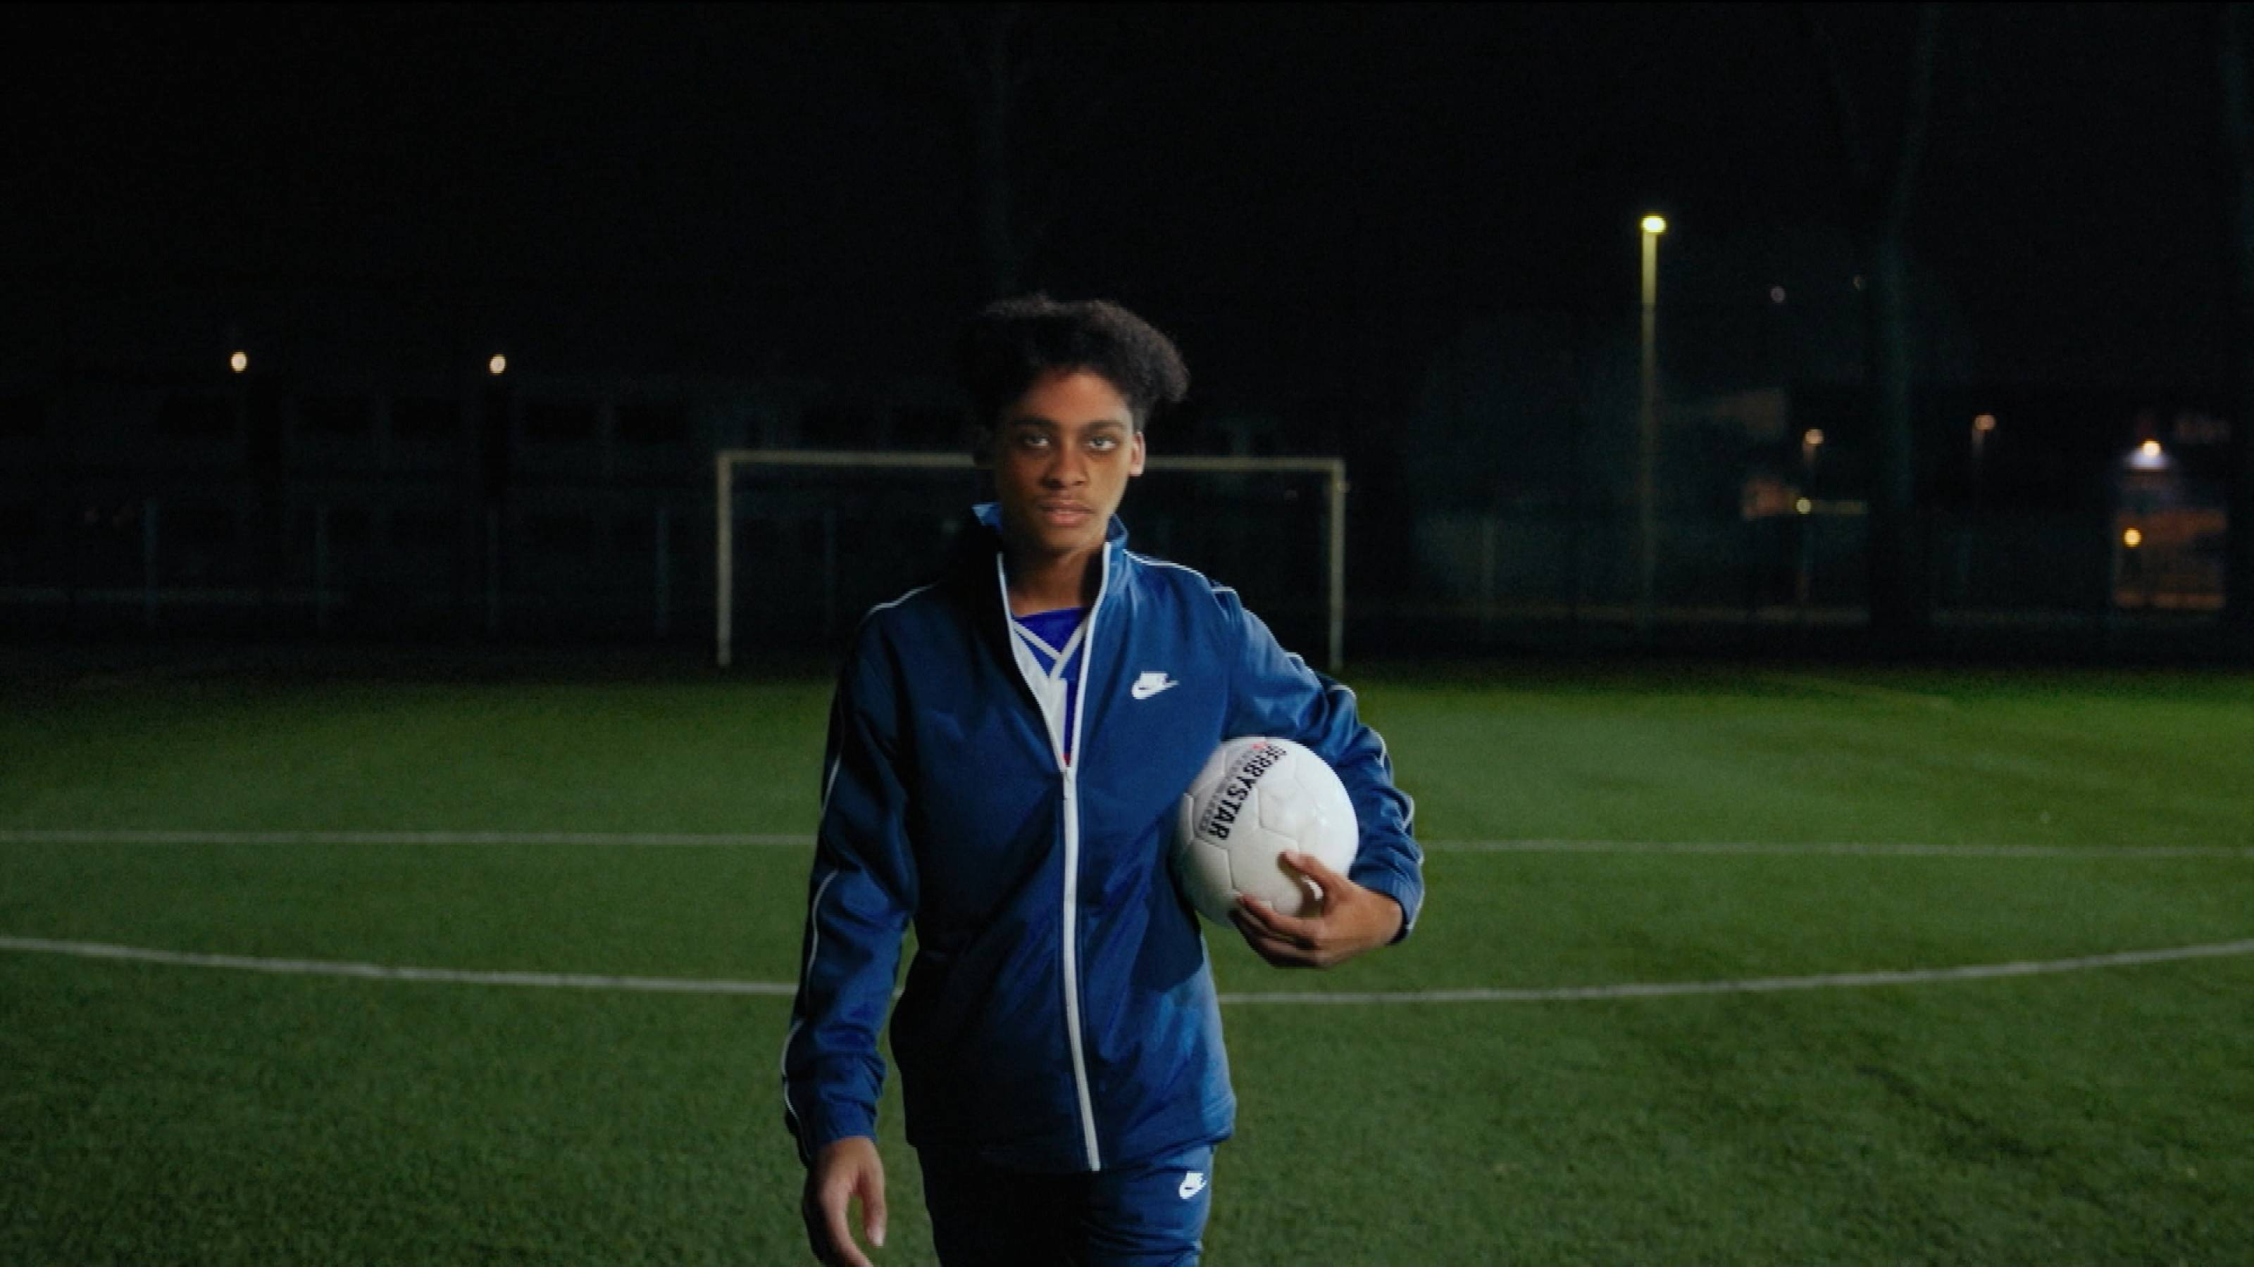
Kort debat

Slide 7
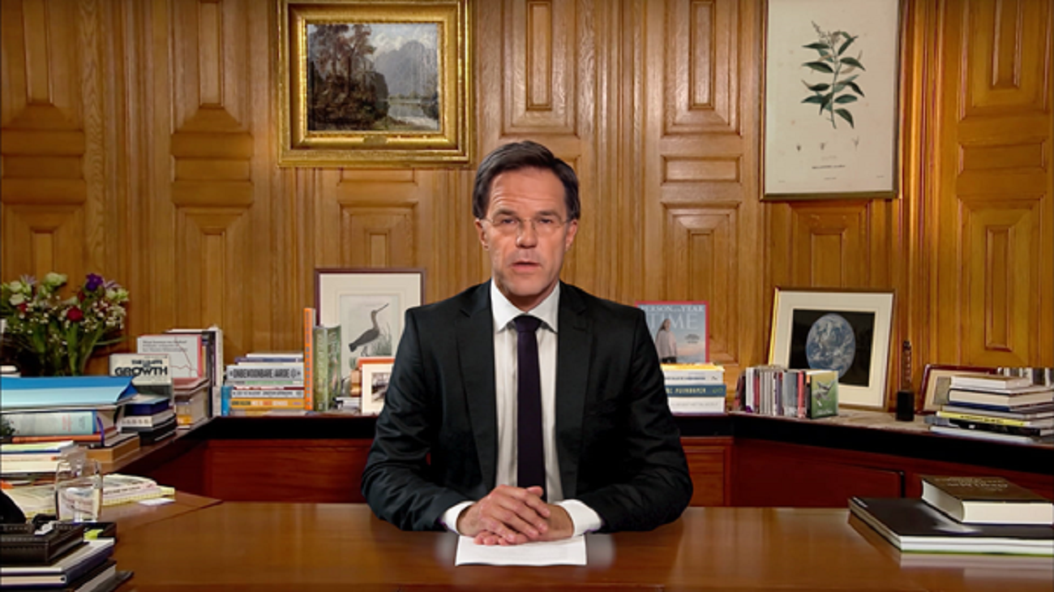
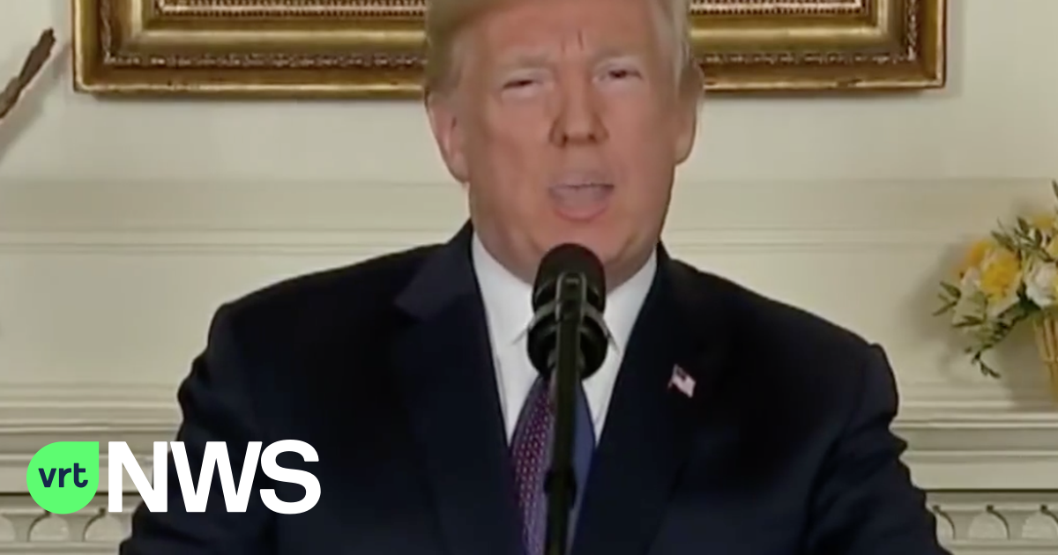

Slide 8
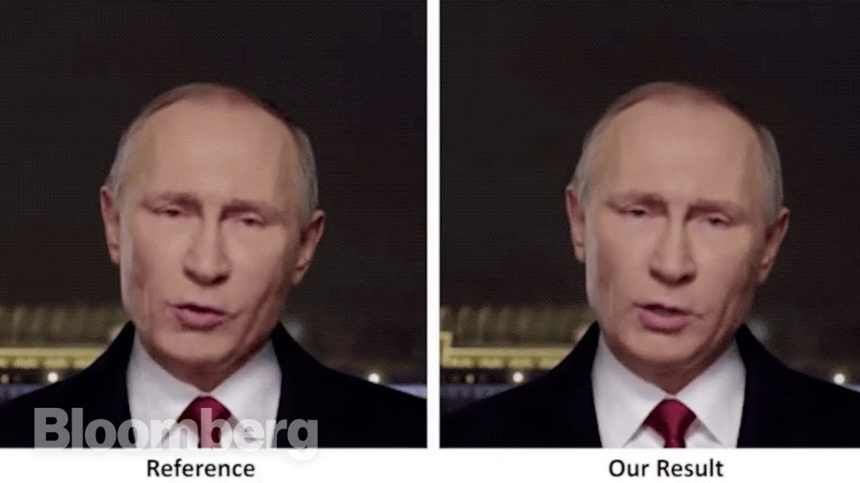

Slide 9


Slide 10
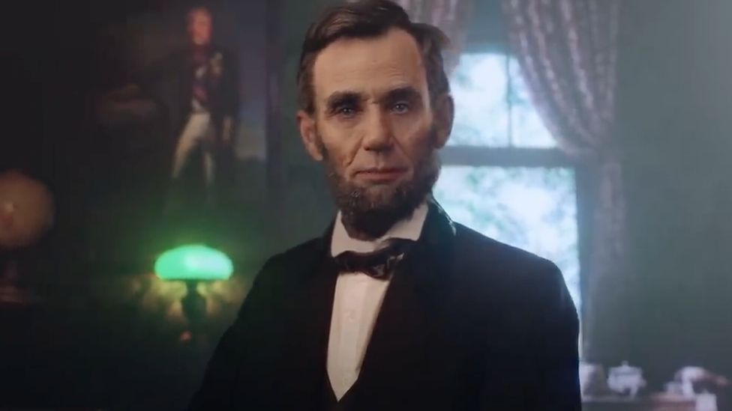

Slide 11


Slide 12
Opportunities
Satire: politicians, head of state, actors, acquaintances
Deceased persons: art, actors, acquaintances
Employee replacement: virtual assistant, influencer, actors
Live conversations: business call, medical application, journalism
Medical Application: Scans, Models, Speech Problems, Identity Problems
Criminal: Sweetie 2.0, Crime Scene Impersonation
Retail: trying on clothes, virtual tour shop
Education: lecture by historical figure
Charities: call for all languages by celebrities + politicians

Slide 13
Risks
Revenge porn
Identity forgery: extortion, deception, extracting secrets
Democratic legal order: influencing elections at home or abroadReputation
Harm: Blackmailing Personal, Commercial, or Political Enemies
Destabilizing financial markets: fake news about failing banks
Incite hatred minorities
Post-mortem privacy
Military Threats
Fake news

Slide 16
Interviews
Experts predict that in about six years more than 90% of all digital content will have been manipulated to a greater or lesser extent.
The best detection techniques that exist now can only detect about 65% of the deepfakes, the other 35% slip through the net. Experts expect that the ability to discover deepfakes through technical means will decrease rather than increase. Moreover, they point out that the opposite problem will also arise: it is fairly easy to use deepfake technology to leave traces (artifacts) of manipulations on an existing and unmanipulated material, which the detection technology can discover. The detection technology will then mark the material as fake and block it, while it is authentic material. Moreover, the problem is that such techniques usually give 'truth' or 'trust' percentages. Then, for example, the outcome is: the probability that this video is authentic, that is, not manipulated, is 78%.
These experts point out that the knowledge that a video is deepfake is only of limited importance. The social consequences of a porn movie for a growing girl can be significant, even if the group knows it is a deepfake. Seeing such a video can also affect the self-image of the woman in question. Even though she knows the material is fake, watching yourself perform all kinds of explicit acts can have a negative impact on your confidence and self-esteem. This point – that even though it is known that certain content is fake, the consequences are no less - also applies to fake news, for example

Slide 17
Literature
Firstly, deepfakes can have major consequences for trust in the media, the functioning of the rule of law and democracy; they can also have a negative impact on the social and societal position of women in general. In addition to these larger, more social dangers, there are also specific, harmful applications of deepfake technology. A deepfake porn movie can have a catastrophic impact on a woman's professional career, her social position and her self-image; in extreme cases this can lead to suicide. Deepfakes are used to commit fraud and deception. This can involve financial gain, deepfakes can also be used to extract business secrets or influence or frustrate political decision-making. In addition, deepfakes can be used to incite hatred and violence, for example against minorities, and can be used to circumvent and undermine the intellectual property rights of artists.

Slide 18
Literature
Secondly, there are also several positive applications. It points out, among other things, the possibilities for the police to use fakes in the infiltration of criminal networks, are there medical applications, can a realistic deepfake avatar figure in a game, a kitchen giant can create a deepfake impression of the house with the new cooking island? give, a deepfake of an actor can perform dangerous stunts and deepfakes can be used by politicians who want to address minorities, celebrities who call for a good cause and in business conversations, for example between Dutch and Chinese employees, where what they see in their own say language is translated in real time, but again their lip movements are adapted accordingly. One thing is striking about this broad collection of possible positive use cases of deepfake technology: they are often applications within professional relationships, such as between customer and company, patient and doctor, citizen and politician, sex worker and customer, employees of different nationalities meeting with each other and applications within the entertainment industry. This study has identified only one common application of deepfake technology in citizen-citizen relations and that is the stakes for satire.

Slide 19
Literature
Thirdly, technology is never neutral. Certain use cases are facilitated or enabled by the design of a technology, others are inhibited or made impossible. This is important because research shows that more than 95% of deepfakes are used for so-called non-consensual porn, the production of pornographic material about someone without permission. To this must be added the use of deepfake technology for fraud, deception and the dissemination of harmful fake news and the fact that deepfakes, due to the increasing confusion between fiction and reality that they by definition cause, can have a negative impact on trust in the media, the rule of law and democracy and the existence of a shared reality. For example, experts interviewed for this study indicate that the confusion about what is real and what is fake is already visible, while the technology is still in its infancy.

Slide 20
Literature
Fourthly, it is important to emphasize that deepfakes have so far been used in a way that is in line with social trends that are already visible. The 'real' problem is broader and social in nature. Deepfake porn videos are in fact a result of the disrespect for women and the objectification of the female body that is rampant both offline and certainly online. Deepfake misinformation fits into the post-truth era, in which opinions become more important than facts and in which more and more groups live in their own bubble and truth. The use of deepfake for political purposes is in line with an increase in interstate hostilities via digital avenues, which have also manifested themselves in numerous hacks and espionage activities. Fraud has been perpetrated for centuries and deepfakes are just the next means of introducing false evidence into a lawsuit. Even in a world without deepfakes, these tendencies would occur.

Slide 21
Literature
Finally, perhaps the most important insight is that adjustments to substantive law and procedural law on specific points are possible and perhaps desirable. The main problem with regard to deepfakes in horizontal relationships and, more generally, privacy violations in horizontal relationships is the supervision and compliance with applicable law. Making pornographic material belonging to another person without their permission is already prohibited; generating child pornography from a fictitious child is already prohibited; committing fraud and deception by means of a deepfake is already prohibited; presenting false evidence in a lawsuit is already prohibited; inciting hatred or violence between groups by means of a deepfake is already prohibited; exploiting anyone's image or likeness or creative works without permission is already prohibited; causing harm to another by means of a fake message can already be tackled under the tort regime; etc. The legal framework of deepfakes is therefore not the primary problem, the problem is the enforcement of the existing and any additional legal rules.

Slide 22
Legal Study
Diversity of approaches: mainly emphasis on opportunities or risks
Diversity of risks addressed: elections, porn, fake news
Diversity of legal response: criminal law, administrative law, civil law
Diversity of regulatory choices: e.g. responsibility on internet platform, producers of deepfake technology, users, etc.

Slide 23
Deepfake under current privacyregime
Deepfakes face a number of obstacles under the data processing regime of the General Data Protection Regulation.
There must be a legitimate ground for processing. First of all, you can opt for permission from the person depicted in the deepfake; this will usually only be an option if the person is known to the creator of the deepfake. If it concerns a deepfake on which no sensitive matters can be seen, such as sexual acts, it can also be a case in which the interests served by the deepfake are greater than the interests of the data subject in order not to be portrayed. This could be the case with an innocent satirical video of a politician. Yet this requirement alone shows how narrow the legitimate application possibilities for deepfakes are within the GDPR.
In addition, there is the obligation to inform the person portrayed that he is appearing in a deepfake.
The question is whether the data quality principle should not be read in such a way that deepfakes are prohibited by definition, which also applies to the requirements of purpose and purpose limitation, from which it follows that data may in principle only be processed for the purpose for which they were initially collected. Deepfakes, by definition, misrepresent things, and data such as photos and videos are rarely collected for the premeditated purpose of turning them into a deepfake.
Then there are the various rights of the data subject that must be taken into account, such as the right to rectification and the right to be forgotten.It should be borne in mind, however, that exceptions may exist in the form of the household exception and the processing of data in the context of freedom of expression. How narrowly or broadly these exceptions should be interpreted in the context of deepfakes, however, cannot be determined in advance and in general.

Slide 24
Deepfakes under freedom of expression
Within the European Convention on Human Rights, deepfakes must be examined at the interplay of Article 8 ECHR, which includes the right to privacy, and Article 10 ECHR, which contains the right to freedom of expression. The European Court of Human Rights has ruled that the right to privacy also includes the right to the protection of one's honour, good name and reputation. The Court has also held that freedom of expression must be understood very broadly and also includes the right to shock, offend and confuse. In the case of deepfakes with a possibly unlawful character, two parties will therefore often be able to invoke two different human rights: the creator of the deepfake on his right to freedom of expression, the person depicted on his right to honor and good name and right to reputation. Because the Court sets few general rules and assesses each individual case on its own merits in view of the circumstances of the case, it cannot be said in general how these two rights relate to each other in deepfake applications. This will have to be looked at on a case-by-case basis. However, two special points are important.
On the one hand, the Court has an extensive doctrine regarding what it calls the 'reasonable expectation of privacy'; it follows that people can expect their privacy to be protected even in a work environment or in the public space. Even if a person puts extreme sexual images of himself on the internet, he can still expect his privacy to be respected by others. This is important because it follows that the right to privacy will apply to the vast majority of material used to generate deepfakes.
On the other hand, there is a special doctrine for famous persons. This is important because most deepfakes are made either about people in the direct environment of the maker or about famous people. According to the Court, these well-known persons must tolerate more restrictions in their private sphere and their reputation, honor and good name than ordinary citizens, especially if they are politicians or office holders. However, it appears that the Court also emphasizes that such restrictions must still be proportional and that public persons also have a right to privacy.

Slide 25
Conclusions
Technical possibilities and limitations
Major challenges and societal questions
Limited interests in horizontal relations
Technology is not neutral
Enforceability

Slide 26
Regulatory option 1
Criminalising/bringing under privacy law producing deepfake porn in private sphere

Slide 27
Regulatory option 2
Develop laws or regulations regarding postmortem privacy

Slide 28
Regulatory option 3
Develop laws or regulations on the use of fully AI-generated individuals

Slide 29
Regulatory option 4
Develop laws or regulations on the protection of the reputation and honour of public figures

Slide 30
Regulatory option 5
Develop laws or regulations regarding manifestly untrue, false, or misleading statements

Slide 31
Regulatory option 6
Develop laws or regulations on influencing or attempting to influence elections or political decisions through the production or dissemination of misinformation

Slide 32
Regulatory option 7
Assess to what extent laws, regulations or policies should be developed or amended to combat (deep)fake evidence in court proceedings

Slide 33
Regulatory option 8
Develop laws or regulations that prohibit the production, distribution, possession or use of deepfake technology

Slide 34


