Slide 1
Big Data, mass surveillance en de Nederlandse staat
Bart van der Sloot
Senior Researcher
Tilburg Institute for Law, Technology, and Society (TILT)
Tilburg University, Netherlands
www.bartvandersloot.com

Slide 2


Slide 3


Slide 4


Slide 5
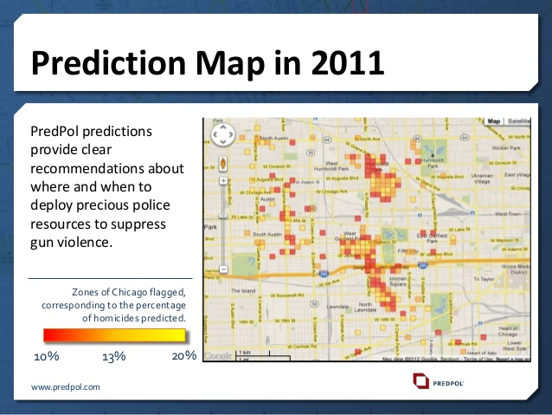

Slide 6
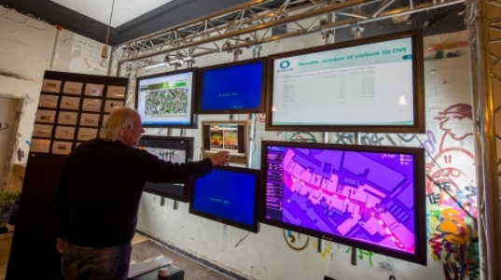

Slide 7


Slide 8


Slide 9
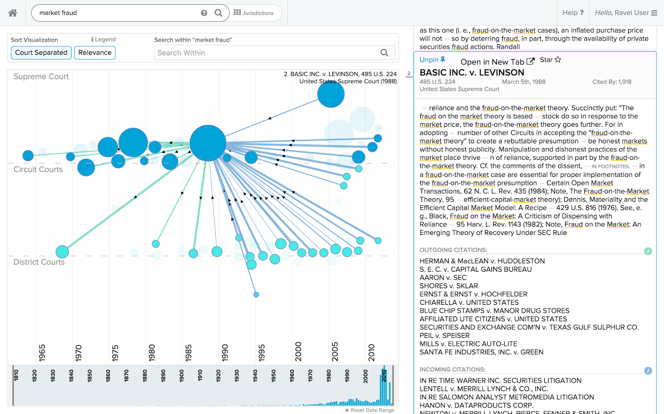

Slide 10
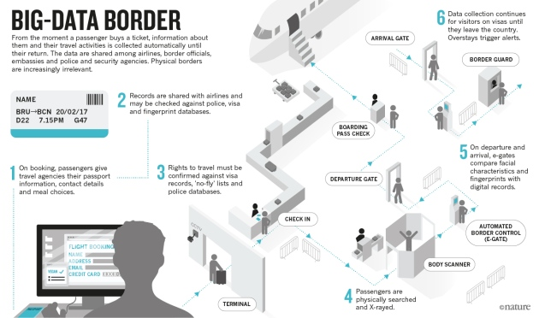

Slide 11


Slide 12


Slide 13


Slide 14
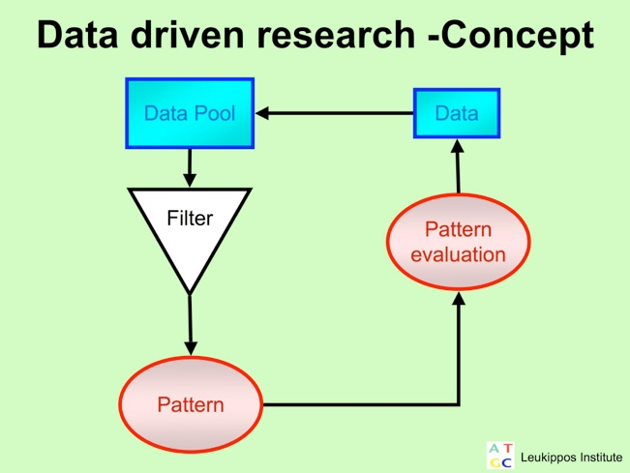

Slide 15


Slide 16


Slide 17


Slide 18
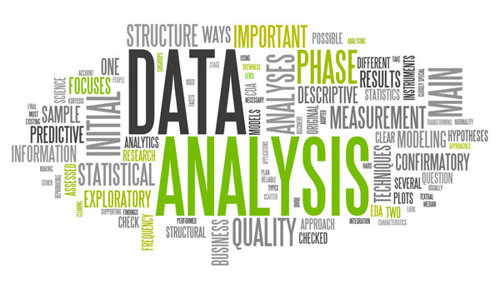

Slide 19


Slide 20
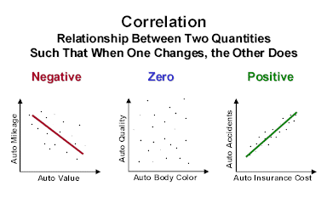

Slide 21


Slide 22
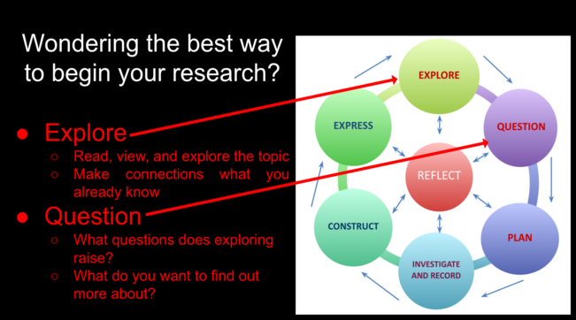

Slide 23


Slide 24


Slide 25


Slide 26


Slide 27


Slide 28


Slide 29


Slide 30


Slide 31


Slide 32


Slide 33


