Slide 1
Big Data, Open Data and Privacy
Bart van der Sloot
Tilburg Institute for Law, Technology, and Society (TILT)
Www.bartvandersloot.com

Slide 2
Overview
(1) PSI Directive & Company Law Directive
(2) Big Data and Open Data
(3) Societal challenges
(4) Legal challenges

Slide 3
If you got nothing to hide, you have nothing to fear

Slide 4
Would you share how much you earn with a stranger?

Slide 5
A parent suspects that his/her child is taking drugs. Should the parent be allowed to: - search his/her room, - go through e-mails and personal files on his/her mobile device - place a tracking-device?

Slide 6
Privacy is dead, get over it

Slide 7
(1) PSI Directive & Company Law Directive
Directive 2003/98/EC of the European Parliament and of the Council of 17 November 2003 on the re-use of public sector information
Article 3 General principle
Member States shall ensure that, where the re-use of documents held by public sector bodies is allowed, these documents shall be re-usable for commercial or non-commercial purposes in accordance with the conditions set out in Chapters III and IV. Where possible, documents shall be made available through electronic means.

Slide 8
(1) PSI Directive & Company Law Directive
Article 4
Requirements applicable to the processing of requests for re-use
1. Public sector bodies shall, through electronic means where possible and appropriate, process requests for re-use and shall make the document available for re-use to the applicant or, if a licence is needed, finalise the licence offer to the applicant within a reasonable time that is consistent with the time-frames laid down for the processing of requests for access to documents.
2. Where no time limits or other rules regulating the timely provision of documents have been established, public sector bodies shall process the request and shall deliver the documents for re-use to the applicant or, if a licence is needed, finalise the licence offer to the applicant within a timeframe of not more than 20 working days after its receipt. This timeframe may be extended by another 20 working days for extensive or complex requests. In such cases the applicant shall be notified within three weeks after the initial request that more time is needed to process it.
3. In the event of a negative decision, the public sector bodies shall communicate the grounds for refusal to the applicant on the basis of the relevant provisions of the access regime in that Member State or of the national provisions adopted pursuant to this Directive, in particular Article 1(2)(a), (b) and (c), or Article 3. Where a negative decision is based on Article 1(2)(b), the public sector body shall include a reference to the natural or legal person who is the rightholder, where known, or alternatively to the licensor from which the public sector body has obtained the relevant material.
4. Any negative decision shall contain a reference to the means of redress in case the applicant wishes to appeal the decision.
5. Public sector bodies covered under Article 1(2)(d), (e) and (f) shall not be required to comply with the requirements of this Article.

Slide 9
(1) PSI Directive & Company Law Directive
Article 5
Available formats
1. Public sector bodies shall make their documents available in any pre-existing format or language, through electronic means where possible and appropriate. This shall not imply an obligation for public sector bodies to create or adapt documents in order to comply with the request, nor shall it imply an obligation to provide extracts from documents where this would involve disproportionate effort, going beyond a simple operation.
2. On the basis of this Directive, public sector bodies cannot be required to continue the production of a certain type of documents with a view to the re-use of such documents by a private or public sector organisation.

Slide 10
(1) PSI Directive & Company Law Directive
Article 6
Principles governing charging
Where charges are made, the total income from supplying and allowing re-use of documents shall not exceed the cost of collection, production, reproduction and dissemination, together with a reasonable return on investment. Charges should be cost-oriented over the appropriate accounting period and calculated in line with the accounting principles applicable to the public sector bodies involved.

Slide 11
(1) PSI Directive & Company Law Directive
DIRECTIVE 2013/37/EU OF THE EUROPEAN PARLIAMENT AND OF THE COUNCIL of 26 June 2013 amending Directive 2003/98/EC on the re-use of public sector information
Pushed for active transparency, re-use and machine readability

Slide 12
(1) PSI Directive & Company Law Directive
Directive (EU) 2017/1132 of the European Parliament and of the Council of 14 June 2017 relating to certain aspects of company law
Article 14 Documents and particulars to be disclosed by companies
Member States shall take the measures required to ensure compulsory disclosure by companies of at least the following documents and particulars:
(a) the instrument of constitution, and the statutes
d) the appointment, termination of office and particulars of the persons who either as a body constituted pursuant to law or as members of any such body:
(e) at least once a year, the amount of the capital subscribed
(f) the accounting documents for each financial
(i) any declaration of nullity of the company by the courts;

Slide 13
(1) PSI Directive & Company Law Directive
Article 18 Availability of electronic copies of documents and particulars 1. Electronic copies of the documents and particulars referred to in Article 14 shall also be made publicly available through the system of interconnection of registers.
2. Member States shall ensure that the documents and particulars referred to in Article 14 are available through the system of interconnection of registers in a standard message format and accessible by electronic means. Member States shall also ensure that minimum standards for the security of data transmission are respected.
3. The Commission shall provide a search service in all the official languages of the Union in respect of companies registered in the Member States, in order to make available through the portal: (a) the documents and particulars referred to in Article 14; (b) the explanatory labels, available in all the official languages of the Union, listing those particulars and the types of those documents.

Slide 14
(1) PSI Directive & Company Law Directive
Article 19 Fees chargeable for documents and particulars
1. The fees charged for obtaining the documents and particulars referred to in Article 14 through the system of interconnection of registers shall not exceed the administrative costs thereof.
2. Member States shall ensure that the following particulars are available free of charge through the system of interconnection of registers: (a) the name and legal form of the company; (b) the registered office of the company and the Member State where it is registered; and (c) the registration number of the company. In addition to those particulars, Member States may choose to make further documents and particulars available free of charge.

Slide 15
(1) PSI Directive & Company Law Directive
Proposal for a DIRECTIVE OF THE EUROPEAN PARLIAMENT AND OF THE COUNCIL amending Directive (EU) 2017/1132 as regards the use of digital tools and processes in company law
Article 16 and Article 16a replace Article 16 of Directive (EU) 2017/1132.
The disclosure of information and documents is to be effected by entering them and making them publically available in the business register. This means that third parties can rely on the information in the register without it being necessary that any further step is carried out, in particular the same information being published in the national gazette. Nevertheless, Member

Slide 16
(1) PSI Directive & Company Law Directive
This article also requires Member States to ensure that all information and documents provided to a competent authority as part of the registration or filing of a company or a branch shall be stored by the registers in a machine-readable and searchable format or as structured data. Member States will have a period of 5 years to ensure full compliance with this requirement. Keeping company information in structured formats will facilitate the way in which data can be searched for and exchanged with other systems.
Article 18 of Directive (EU) 2017/1132 is amended to allow Member States to make available, via the interconnection of registers, electronic copies of information and documents concerning types of companies other than those listed in Annex II of the codified directive.
Article 19 of Directive (EU) 2017/1132 is replaced. The new provision extends the scope of data which Member States shall make available free of charge. The extended list contains now, amongst others, former names of a company (if any), its website (if any), legal status and object (if available in the register under national law). The objective of this provision is to give free of charge access to more company data thus enhancing transparency and confidence in the Single Market.

Slide 17
(1) PSI Directive & Company Law Directive
Company Law Directive Article 161 Data protection The processing of personal data carried out in the context of this Directive shall be subject to Directive 95/46/EC
PSI Directive Article 1 paragraph 4: ‘This Directive leaves intact and in no way affects the level of protection of individuals with regard to the processing of personal data under the provisions of Union and national law, and in particular does not alter the obligations and rights set out in Directive 95/46/EC.’’

Slide 18
(2) Big Data & Open Data

Slide 19
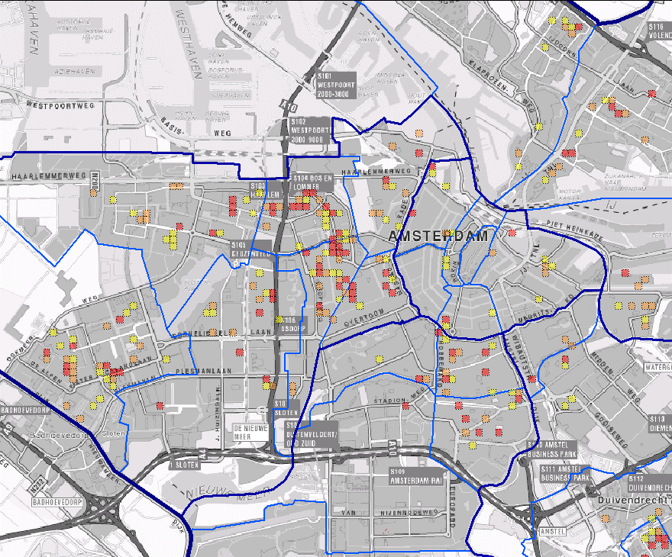

Slide 21
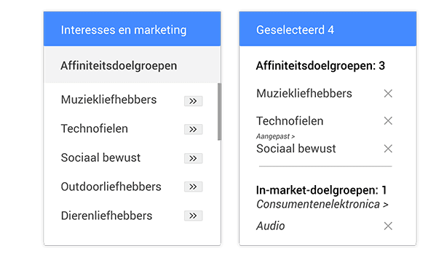
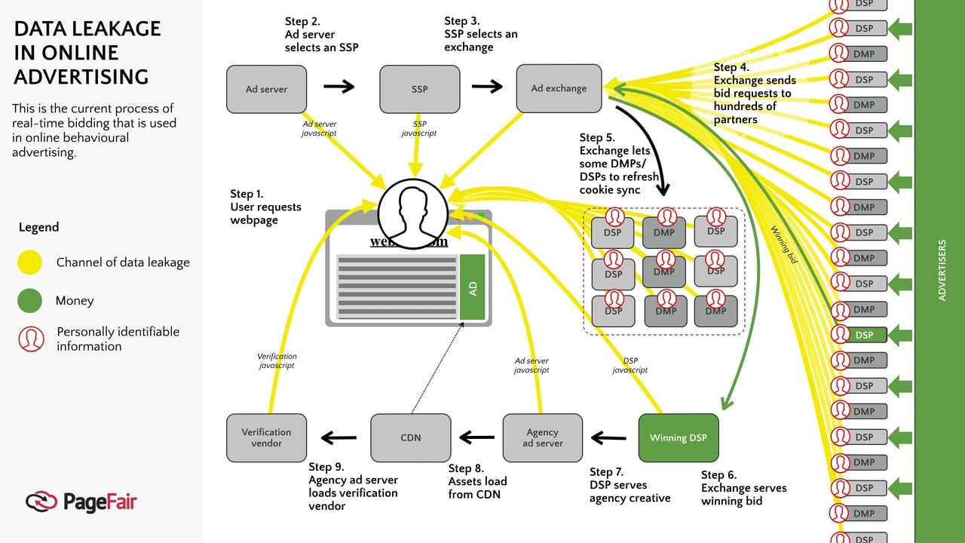

Slide 22
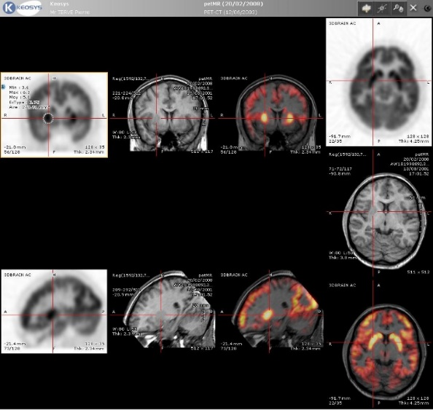
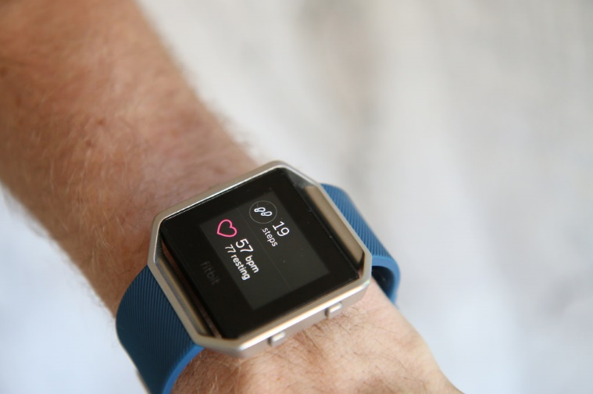

Slide 23
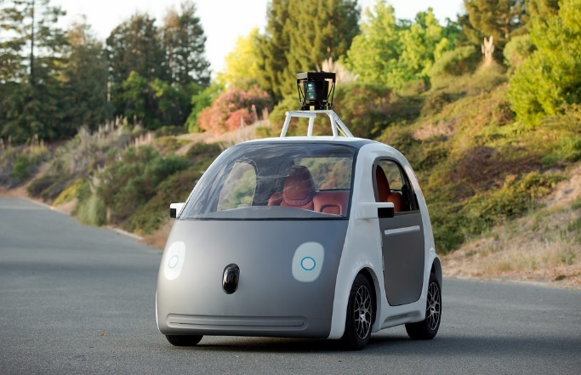

Slide 24
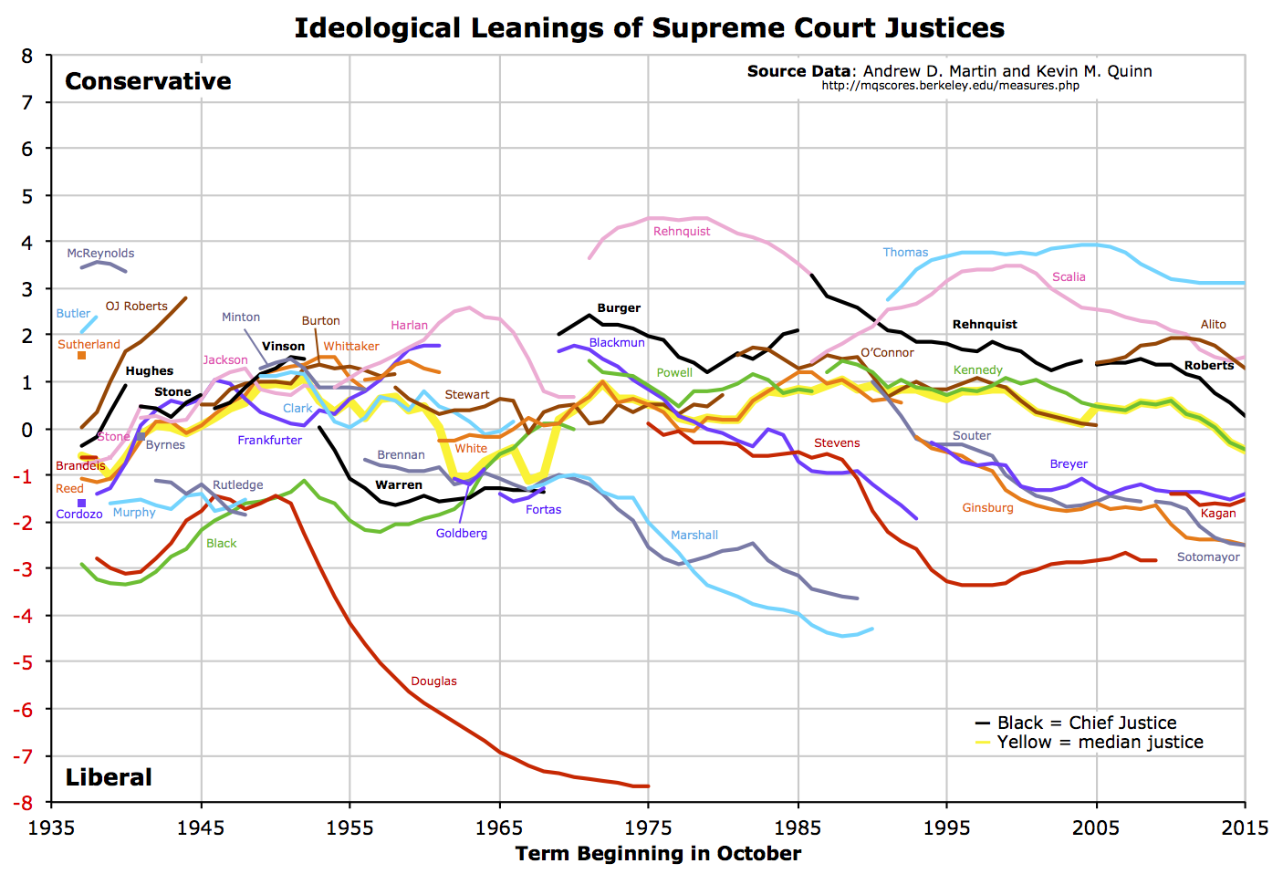

Slide 26
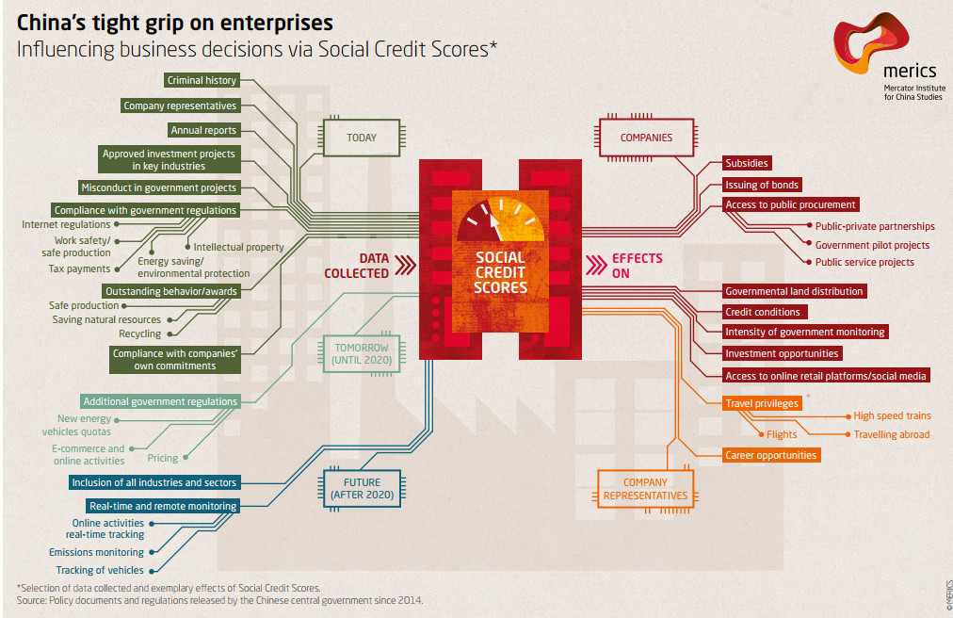

Slide 27
Big Data is an umbrella term
Open Data
Re-use
Internet of Things
Smart applications
Profiling
Algorithms
Cloud Computing
Machine learning
Datafication
Commodification
Securitisation

Slide 29
Three phases
Gathering
Analysing
Use

Slide 30
Ten catch phrases
The more, the merrier:
Quantity over quality:
Dirty data is hot:
Old data is new data:
Gathering data is cheap, storing is cheaper, analysing is cheapest:
Correlation over causation:
Anything can say something about everything and everything can say something about anything:
The future is now:
No harm in trying:
No mountain too high:

Slide 31
(3) Societal challenges

Slide 32
Risks
Effectiveness
Mass Surveillance
Predictive Policing: Aanwĳzingen dat predictive policing uiteindelĳk leidt tot minder (stĳgende) criminaliteit hebben we niet kunnen vinden (Politieacademie 2017).
Belastingdienst: ‘Uit analyse van de 42 projecten in de Investeringsagenda-projectportfolio blijkt dat 36% van de projecten de status ‘vertraagd’ of ‘geannuleerd’ heeft. Als we meer in detail kijken naar wijzigingen van planningsdata (ook van inmiddels afgeronde projecten), dan blijkt dat bijna 60% van de projecten vertraging heeft opgelopen of is geannuleerd.’
Advertisements
Google Flu

Slide 41
(4) Legal challenges
ARTICLE 8 Right to respect for private and family life
1. Everyone has the right to respect for his private and family life, his home and his correspondence.
2. There shall be no interference by a public authority with the exercise of this right except such as is in accordance with the law and is necessary in a democratic society in the interests of national security, public safety or the economic well-being of the country, for the prevention of disorder or crime, for the protection of health or morals, or for the protection of the rights and freedoms of others.

Slide 42
(4) Legal challenges
Can be invoked by natural persons
Can be invoked by legal persons
When their communications are monitored
When their buildings are unlawfully entered
When their data are gathered without legitimate ground by governmental agencies

Slide 43
EU Charter of Fundamental Rights
Article 7 Respect for private and family life Everyone has the right to respect for his or her private and family life, home and communications.
Article 8 Protection of personal data 1. Everyone has the right to the protection of personal data concerning him or her. 2. Such data must be processed fairly for specified purposes and on the basis of the consent of the person concerned or some other legitimate basis laid down by law. Everyone has the right of access to data which has been collected concerning him or her, and the right to have it rectified. 3. Compliance with these rules shall be subject to control by an independent authority.

Slide 44
Icons

Slide 45
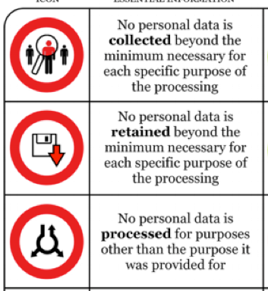
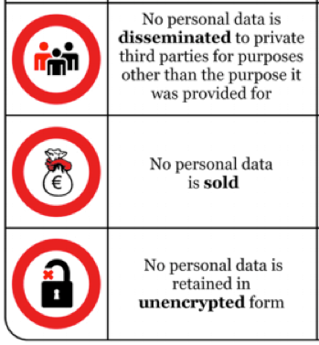
Icons

Slide 46
Personal data
Article 4 Definitions For the purposes of this Regulation: (1) ‘personal data’ means any information relating to an identified or identifiable natural person (‘data subject’); an identifiable natural person is one who can be identified, directly or indirectly, in particular by reference to an identifier such as a name, an identification number, location data, an online identifier or to one or more factors specific to the physical, physiological, genetic, mental, economic, cultural or social identity of that natural person;

Slide 47
Processing
Article 4 Definitions
For the purposes of this Regulation:
(2) ‘processing’ means any operation or set of operations which is performed on personal data or on sets of personal data, whether or not by automated means, such as collection, recording, organisation, structuring, storage, adaptation or alteration, retrieval, consultation, use, disclosure by transmission, dissemination or otherwise making available, alignment or combination, restriction, erasure or destruction;

Slide 48
Data controller
Article 4 Definitions
For the purposes of this Regulation:
(7) ‘controller’ means the natural or legal person, public authority, agency or other body which, alone or jointly with others, determines the purposes and means of the processing of personal data; where the purposes and means of such processing are determined by Union or Member State law, the controller or the specific criteria for its nomination may be provided for by Union or Member State law;

Slide 49
EU has competence

Slide 50
EU has competence
Article 3 Territorial scope 1.This Regulation applies to the processing of personal data in the context of the activities of an establishment of a controller or a processor in the Union, regardless of whether the processing takes place in the Union or not. 2.This Regulation applies to the processing of personal data of data subjects who are in the Union by a controller or processor not established in the Union, where the processing activities are related to: (a) the offering of goods or services, irrespective of whether a payment of the data subject is required, to such data subjects in the Union; or (b) the monitoring of their behaviour as far as their behaviour takes place within the Union. 3.This Regulation applies to the processing of personal data by a controller not established in the Union, but in a place where Member State law applies by virtue of public international law.

Slide 51
Exceptions
Article 2 Material scope
2.This Regulation does not apply to the processing of personal data: (a) in the course of an activity which falls outside the scope of Union law; (b) by the Member States when carrying out activities which fall within the scope of Chapter 2 of Title V of the TEU; (c) by a natural person in the course of a purely personal or household activity; (d) by competent authorities for the purposes of the prevention, investigation, detection or prosecution of criminal offences or the execution of criminal penalties, including the safeguarding against and the prevention of threats to public security.

Slide 52
GDPR requires prior legitimate purpose
Article 5 Principles relating to processing of personal data
1.Personal data shall be:
(a) processed lawfully, fairly and in a transparent manner in relation to the data subject (‘lawfulness, fairness and transparency’);
(b) collected for specified, explicit and legitimate purposes and not further processed in a manner that is incompatible with those purposes;

Slide 53
GDPR requires prior legitimate purpose
Article 6 Lawfulness of processing
1.Processing shall be lawful only if and to the extent that at least one of the following applies:
(a) the data subject has given consent to the processing of his or her personal data for one or more specific purposes;
(b) processing is necessary for the performance of a contract to which the data subject is party or in order to take steps at the request of the data subject prior to entering into a contract;
(c) processing is necessary for compliance with a legal obligation to which the controller is subject;
(d) processing is necessary in order to protect the vital interests of the data subject or of another natural person;
(e) processing is necessary for the performance of a task carried out in the public interest or in the exercise of official authority vested in the controller;
(f) processing is necessary for the purposes of the legitimate interests pursued by the controller or by a third party, except where such interests are overridden by the interests or fundamental rights and freedoms of the data subject which require protection of personal data, in particular where the data subject is a child. Point (f) of the first subparagraph shall not apply to processing carried out by public authorities in the performance of their tasks.

Slide 54
GDPR underlines data minimization
Article 5
1. Member States shall provide that personal data must be:
(c) adequate, relevant and limited to what is necessary in relation to the purposes for which they are processed (‘data minimisation’);

Slide 55
GDPR limits data storage
Article 5
1. Member States shall provide that personal data must be:
(e) kept in a form which permits identification of data subjects for no longer than is necessary for the purposes for which the personal data are processed; personal data may be stored for longer periods insofar as the personal data will be processed solely for archiving purposes in the public interest, scientific or historical research purposes or statistical purposes in accordance with Article 89(1) subject to implementation of the appropriate technical and organisational measures required by this Regulation in order to safeguard the rights and freedoms of the data subject (‘storage limitation’);

Slide 56
GDPR limmits re-use of data
Article 5 Principles relating to processing of personal data
1.Personal data shall be:
(b) collected for specified, explicit and legitimate purposes and not further processed in a manner that is incompatible with those purposes; further processing for archiving purposes in the public interest, scientific or historical research purposes or statistical purposes shall, in accordance with Article 89(1), not be considered to be incompatible with the initial purposes (‘purpose limitation’);

Slide 57
GDPR requires data accuracy
Article 5
1. Member States shall provide that personal data must be:
(d) accurate and, where necessary, kept up to date; every reasonable step must be taken to ensure that personal data that are inaccurate, having regard to the purposes for which they are processed, are erased or rectified without delay (‘accuracy’);

Slide 58
GDPR requires transparancy
Article 13 Information to be provided where personal data are collected from the data subject
1.Where personal data relating to a data subject are collected from the data subject, the controller shall, at the time when personal data are obtained, provide the data subject with all of the following information:
(a) the identity and the contact details of the controller and, where applicable, of the controller's representative;
(b) the contact details of the data protection officer, where applicable;
(c) the purposes of the processing for which the personal data are intended as well as the legal basis for the processing;
(d) where the processing is based on point (f) of Article 6(1), the legitimate interests pursued by the controller or by a third party;
(e) the recipients or categories of recipients of the personal data, if any;
(f) where applicable, the fact that the controller intends to transfer personal data to a third country or international organisation and the existence or absence of an adequacy decision by the Commission, or in the case of transfers referred to in Article 46 or 47, or the second subparagraph of Article 49(1), reference to the appropriate or suitable safeguards and the means by which to obtain a copy of them or where they have been made available.

Slide 59
GDPR requires transparancy
2.In addition to the information referred to in paragraph 1, the controller shall, at the time when personal data are obtained, provide the data subject with the following further information necessary to ensure fair and transparent processing:
(a) the period for which the personal data will be stored, or if that is not possible, the criteria used to determine that period;
(b) the existence of the right to request from the controller access to and rectification or erasure of personal data or restriction of processing concerning the data subject or to object to processing as well as the right to data portability;
(c) where the processing is based on point (a) of Article 6(1) or point (a) of Article 9(2), the existence of the right to withdraw consent at any time, without affecting the lawfulness of processing based on consent before its withdrawal;
(d) the right to lodge a complaint with a supervisory authority;
(e) whether the provision of personal data is a statutory or contractual requirement, or a requirement necessary to enter into a contract, as well as whether the data subject is obliged to provide the personal data and of the possible consequences of failure to provide such data;
(f) the existence of automated decision-making, including profiling, referred to in Article 22(1) and (4) and, at least in those cases, meaningful information about the logic involved, as well as the significance and the envisaged consequences of such processing for the data subject.

Slide 60
GDPR requires confidentiality and security
Article 5
1. Member States shall provide that personal data must be:
(f) processed in a manner that ensures appropriate security of the personal data, including protection against unauthorised or unlawful processing and against accidental loss, destruction or damage, using appropriate technical or organisational measures (‘integrity and confidentiality’).

Slide 61
GDPR prohibits in principle processing sensitive data
Article 9 Processing of special categories of personal data
1.Processing of personal data revealing racial or ethnic origin, political opinions, religious or philosophical beliefs, or trade union membership, and the processing of genetic data, biometric data for the purpose of uniquely identifying a natural person, data concerning health or data concerning a natural person's sex life or sexual orientation shall be prohibited.
2.Paragraph 1 shall not apply if one of the following applies: ………..

Slide 62
GDPR limits legitimacy of profiling
Article 22 Automated individual decision-making, including profiling
1.The data subject shall have the right not to be subject to a decision based solely on automated processing, including profiling, which produces legal effects concerning him or her or similarly significantly affects him or her.
2.Paragraph 1 shall not apply if the decision:
(a) is necessary for entering into, or performance of, a contract between the data subject and a data controller;
(b) is authorised by Union or Member State law to which the controller is subject and which also lays down suitable measures to safeguard the data subject's rights and freedoms and legitimate interests; or (c) is based on the data subject's explicit consent.
3.In the cases referred to in points (a) and (c) of paragraph 2, the data controller shall implement suitable measures to safeguard the data subject's rights and freedoms and legitimate interests, at least the right to obtain human intervention on the part of the controller, to express his or her point of view and to contest the decision.
4.Decisions referred to in paragraph 2 shall not be based on special categories of personal data referred to in Article 9(1), unless point (a) or (g) of Article 9(2) applies and suitable measures to safeguard the data subject's rights and freedoms and legitimate interests are in place.

Slide 63
GDPR limits data transfer
Article 44 General principle for transfers Any transfer of personal data which are undergoing processing or are intended for processing after transfer to a third country or to an international organisation shall take place only if, subject to the other provisions of this Regulation, the conditions laid down in this Chapter are complied with by the controller and processor, including for onward transfers of personal data from the third country or an international organisation to another third country or to another international organisation. All provisions in this Chapter shall be applied in order to ensure that the level of protection of natural persons guaranteed by this Regulation is not undermined.

