Slide 1
General Data Protection Regulation:
Turning the black into white
Bart van der Sloot
Tilburg Institute for Law, Technology, and Society (TILT)
Tilburg University, Netherlands
www.bartvandersloot.com

Slide 2

Lippizaner

Slide 3
The Dark Side of the GDPR
Everything is personal data

Slide 4

The Dark Side of the GDPR

Slide 5
The Dark Side of the GDPR
Sensitive data
Processing of personal data revealing racial or ethnic origin, political opinions, religious or philosophical beliefs, or trade union membership, and the processing of genetic data, biometric data for the purpose of uniquely identifying a natural person, data concerning health or data concerning a natural person's sex life or sexual orientation shall be prohibited

Slide 6
The Dark Side of the GDPR
Medical exception
Where personal data are processed for scientific or historical research purposes or statistical purposes, Union or Member State law may provide for derogations from the rights referred to in Articles 15, 16, 18 and 21 subject to the conditions and safeguards referred to in paragraph 1 of this Article in so far as such rights are likely to render impossible or seriously impair the achievement of the specific purposes, and such derogations are necessary for the fulfilment of those purposes.

Slide 7
The Dark Side of the GDPR
Personal data shall be:
  1. Lawfulness, fairness and transparency
  2. Specified, explicit and legitimate purpose
  3. Purpose limitation
  4. Data minimization
  5. Data accuracy
  6. Storage limitation
  7. Integrity and confidentiality

Slide 8
The Dark Side of the GDPR
Consent
Freely
Specific
Informed
Unambiguous
Burden of proof on data controller
Withdraw his or her consent
Special rules for children

Slide 9
The Dark Side of the GDPR
Rights of individuals
  1. Right to be informed
  2. Right to access
  3. Right to rectify
  4. Right to object
  5. Right to data portability
  6. Right to be forgotten
  7. Right to resist profiling

Slide 10
The Dark Side of the GDPR
Obligations for Data Controllers
1. Documentation
2. Auditing
3. Transparency
4. Technical and organisational security
5. Data leaks
6. Data Protection Impact Assessement
7. Data Protection Officer

Slide 11
The Dark Side of the GDPR
Fines
Infringements of the following provisions shall, in accordance with paragraph 2, be subject to administrative fines up to 20 000 000 EUR, or in the case of an undertaking, up to 4 % of the total worldwide annual turnover of the preceding financial year, whichever is higher

Slide 12
Turning it into white

Slide 13
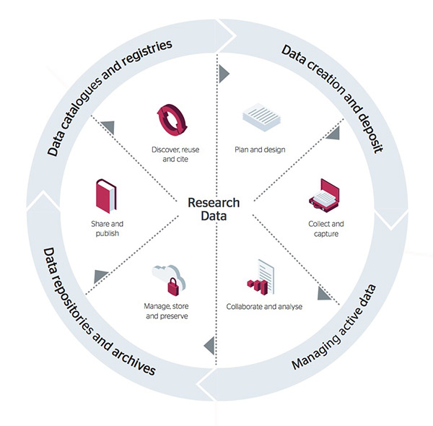
Turning it into white

Slide 14
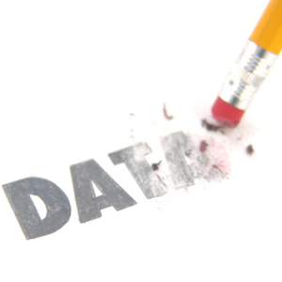
Turning it into white

Slide 15

Turning it into white

Slide 16

Turning it into white

Slide 17
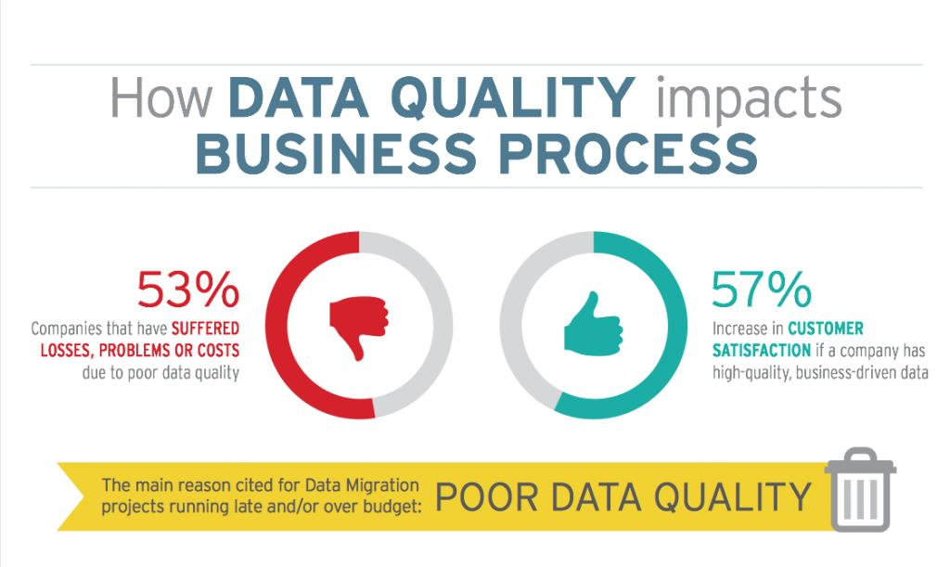
Turning it into white

Slide 18
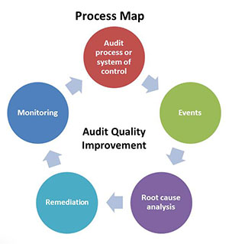
Turning it into white

Slide 19

Turning it into white

Slide 20

GDPR: danger or opportunity?

