Slide 1
Legitimacy of Public-Private Partnerships in cybercrime Botnets and beyond
BotLeg project, NWO grant number 628.001.015
Dr. Bart van der Sloot
B.vdrSloot@uvt.nl
TILT Tilburg Institute for Law, Technology, and Society

Slide 2
Legitimacy: classic model
State
Market
Citizens
TILT Tilburg Institute for Law, Technology, and Society

Slide 3
Legitimacy: classic model
State
General interest
Market
Group interests
Citizens
Private interests
TILT Tilburg Institute for Law, Technology, and Society

Slide 4
Legitimacy: classic model
State
General interest
Public organisations + neutral class
Market
Group interests
Associations/unions/ political parties
Citizens
Private interests
Individuals/family
TILT Tilburg Institute for Law, Technology, and Society

Slide 5
Legitimacy: classic model
State
General interest
Public organisations + neutral class
Public domain
Market
Group interests
Associations/unions/political parties
Economic domain
Citizens
Private interests
Individuals/family
Private domain
TILT Tilburg Institute for Law, Technology, and Society

Slide 6
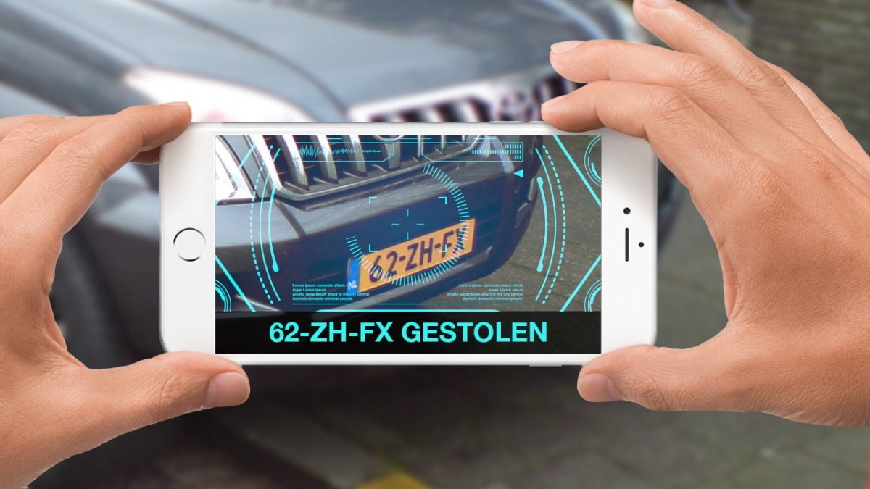
Public-Private partnerships & citizen engagement in Law Enforcement

Slide 7
Enforcement of private norms becomes a public interest & use of public power to enforce economic interests
General Data Protection Regulation: “Those derogations should in particular apply to data transfers required and necessary for important reasons of public interest, for example in cases of international data exchange between competition authorities, tax or customs administrations, between financial supervisory authorities, between services competent for social security matters, or for public health, for example in the case of contact tracing for contagious diseases or in order to reduce and/or eliminate doping in sport.”
Re-use of PSI Directive

Slide 8
Provision of public utilities by private companies & citizens through philanthropy

Slide 9
Smart cities: public space designed by private parties & citizens

Slide 10
Legitimacy: adapted model
State
General interest
Public organisations + neutral class
Public domain
Market
General interest
Companies
Economic & Public domain
Citizens
General interest
Individuals/family
Private & Public domain
TILT Tilburg Institute for Law, Technology, and Society

Slide 11
Three models of future legitimacy: return to the classic model
State
General interest
Public organisations + neutral class
Public domain
Market
Group interests
Associations/unions/political parties
Economic domain
Citizens
Private interests
Individuals/family
Private domain
TILT Tilburg Institute for Law, Technology, and Society

Slide 12
Three models of future legitimacy: market replaces the public sector (smart cities & gated communities)
State
General interest
Public organisations + neutral class
Public domain
Market
Group & public interests
Companies
Economic & public domain
Citizens
Private interests
Individuals/family
Private domain
TILT Tilburg Institute for Law, Technology, and Society

Slide 13
Three models of future legitimacy: state changes its function and role
State
Market
Group interests
Associations/unions/political parties
Economic domain
Citizens
Private interests
Individuals/family
Private domain
(1) State uses its powers to aid market interests (doping & re-use of psi)
(2) Night-watchman state (public utilities provided by private companies & citizens philanthropy)
(3) State determines public interests, but asks private parties to enforce them (PPP-vigilantes)
TILT Tilburg Institute for Law, Technology, and Society

Slide 14
Thank you for your attention
Questions?
Discussion!
e.j.koops@uvt.nl
B.vdrSloot@uvt.nl
TILT Tilburg Institute for Law, Technology, and Society

